Slide 1
Geologic Age Dating
Relative
One event older or younger than another based on a comparison of features
Absolute
Numerical Age based on Radioactive Decay

Slide 2
Relative Age Dating
Uniformitarianism
Principles of correlation
Original horizontality
Superposition
Inclusion
Cross-cutting relationships
Biostratigraphy

Slide 3
Principle of Original Horizontality
Sedimentary rocks were deposited in primarily horizontal beds
deposited last - youngest
gravity
deposited first - oldest
Principle of Superposition
In an undisturbed sedimentary sequence, the oldest rocks are on the bottom of the stack

Slide 4
Principle of Superposition
In an undisturbed sedimentary sequence, the oldest rocks are on the bottom of the stack
Youngest
gravity
Oldest

Slide 5
Principle of Inclusion
When clasts of one rock are found in another, the rock from which the clasts were derived is the older rock, since it must have already existed in order to be included in the new rock
igneous rock
igneous intrusion
Inclusions - pieces of older rock incorporated into younger rock

Slide 6
Principle of Inclusion
When clasts of one rock are found in another, the rock from which the clasts were derived is the older rock, since it must have already existed in order to be included in the new rock
Inclusions - pieces of older rock (clasts) incorporated into younger rock

Slide 7
Principle of Cross-Cutting Relationships
Older features are cut or crossed by younger features.
Fractures or Faults, Igneous Intrusions

Slide 8
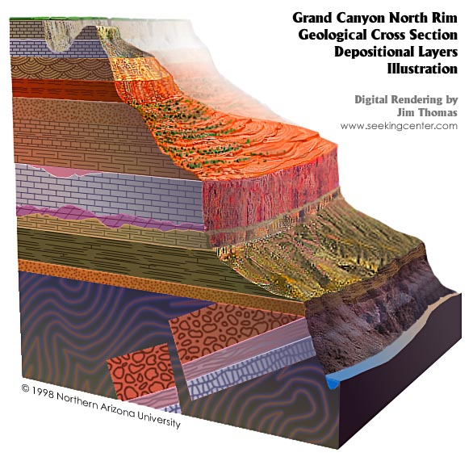
Contact – surface separating two formations
Hermit Shale
Supai Group
Redwall Limestone
Formation – bodies of rock with recognizable characteristic that are thick enough to map
Muav Limestone
Bright Angel Shale
Tapeats Sandstone

Slide 9
Reconstructing Geologic History
disconformity unconformity between parallel strata.
nonconformity unconformity between non-sedimentary and sedimentary rocks
angular unconformity unconformity between non-parallel strata

Slide 10
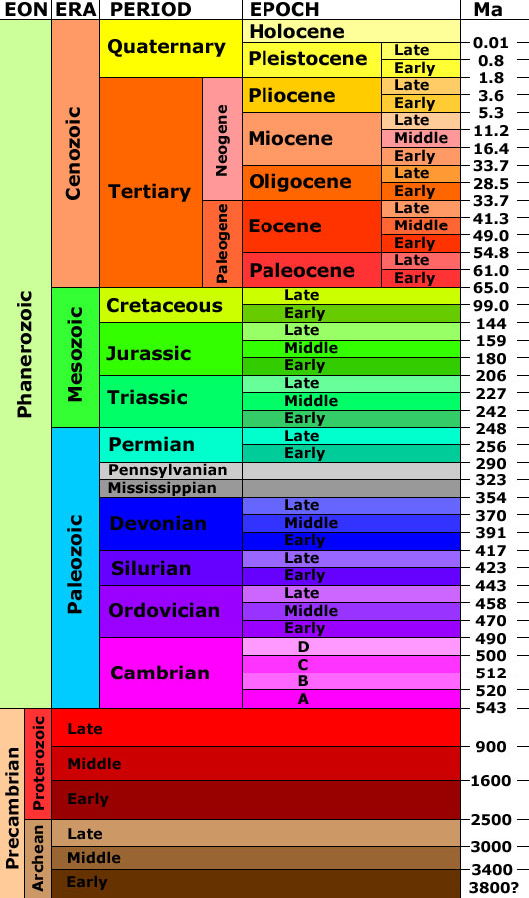
The Geologic Time Scale subdivides the history of the Earth based on biostratigraphy and other dating techniques into:
4 Eons (Hadean, Archean, Proterozoic, Phanerozoic), each of which contains
Eras (e.g., Paleozoic, Mesozoic, Cenozoic) which are further subdivided into
Periods (e.g., Triassic, Jurassic and Cretaceous), Epochs and smaller time divisions
Geologic Time Scale
http://3dparks.wr.usgs.gov/coloradoplateau/images/timescale.jpg

Slide 11
Absolute Age Dating
Absolute Ages
Radiometric Dating
Radioactive isotopes
Atomic Number & Mass
Carbon-14* (12, 13, etc)
Hydrogen (1, 2, 3*)
Radioactive decay - spontaneous
Half-life
Amount of time for one-half of the mass of isotopes to decay

Slide 12
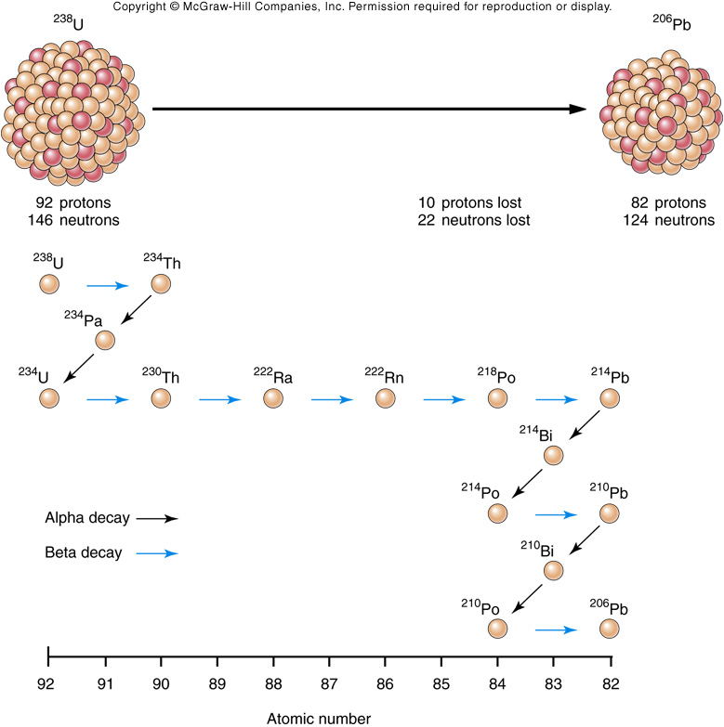
Decay of ²³⁸U
General Decay Rules
Atomic mass number
No change
Decrease
Atomic number
Decrease
Increase
Alpha emission
Beta emission
Intermediary Daughters
Varying Half-Lifes
Seconds to
Billions of Years
Total: 4.5 Billion Years
Fig. 08.23

Slide 13
100%
Parentium
75%
Nuclei
50%
25%
Daughterium
0
0
1
2
3
4
5
Number of Half-lifes

Slide 14
Geologically Useful Radioactive Isotopes
Parent
Daughter
Half-life (yrs)
Useful Range (yrs)
⁴⁰K
²³⁸U
²³⁵U
⁸⁷Rb
⁴⁰Ar
²⁰⁶Pb
²⁰⁷Pb
⁸⁷Sr
1,250,000,000
4,500,000,000
713,000,000
49,000,000,000
100,000 - formation of Earth
10,000,000 - formation of Earth
10,000,000 - formation of Earth
10,000,000 - formation of Earth
An analysis of a feldspar crystal in a rock reveals that it contains 75% ⁴⁰Ar and 25% ⁴⁰K.
How many half-lives have passed since the formation of the feldspar?
Assuming the feldspar and rock formed at the same time, how old is the rock?

Slide 15
Parent
Daughter
Half-life (yrs)
Useful Range (yrs)
²³⁸U
²³⁵U
²⁰⁶Pb
²⁰⁷Pb
4,500,000,000
713,000,000
10,000,000 - formation of Earth
10,000,000 - formation of Earth
An analysis of a zircon crystal in a rock reveals that it contains:
50.0% ²³⁸U and 50.0% ²⁰⁶Pb
1.6% ²³⁵U and 98.4% ²⁰⁷Pb
How many half-lives of ²³⁸U have passed since the formation of the zircon?
How many half-lives of ²³⁵U have passed since the formation of the zircon?
What is the age of the zircon?

Slide 16
ROCK SAMPLE (U²³⁵)
Collect an igneous rock in the field with zircon crystals with U²³⁵/Pb²⁰⁷.
Lab sample: ~91.7% U²³⁵ to ~8.3% Pb²⁰⁷ or
__ half-lifes? (age in Million Years)
1/8 of a half-life (713 MY / 8 = 89 MY)
Younger rock beside your original rock with zircon crystals with U²³⁵/Pb²⁰⁷. Is the % U²³⁵ higher or lower than the sample in question?
What happens to the % U²³⁵ and the estimated age of the rock in question, if you get some of the younger rock in your sample?

Slide 17
Average Height of Golf Team
8 Players, 5’ 9” to 6’ 1’ tall, average 5’ 11”.
The two centers from the basketball team slip in during the measurements by some outside consultant with no knowledge of the team, The basketball players are 6’ 8” and 6’ 10” tall.
What happens to the average height of the golf team now?
10 players, 5’ 9’ to 6’ 10”, Average Height = 6’ 1”
So, the average height of the golf team was incorrectly determined to be higher than the actual average.

Slide 18
ACTIVITIES FOR LAB
8.2, A
8.4, all except D.2.
8.5, A

