Slide 1
12
Thermodynamics
Why Chemical Reactions Happen

Slide 2
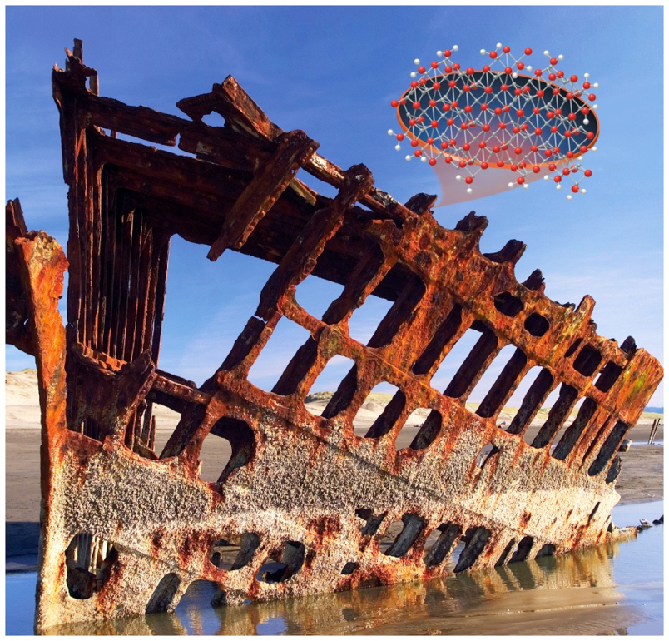
Chapter Outline
12.1 Spontaneous Processes
12.2 Entropy
12.3 Absolute Entropy and Molecular Structure
12.4 Applications of the Second Law
12.5 Calculating Entropy Changes
12.6 Free Energy
12.7 Temperature and Spontaneity
12.8 Coupled Reactions

Slide 3
Spontaneous Processes
Spontaneous Process:
A process that, once started, occurs without outside intervention
Nonspontaneous Process:
A process that only occurs as long as energy is continually added to the system
Spontaneity depends on dispersion of energy that occurs during a process.
3

Slide 4
Spontaneity and Enthalpy (ΔH)
Although many spontaneous processes are exothermic (i.e., combustion), not true for all spontaneous reactions:
Endothermic (ΔH > 0), but reaction is spontaneous.
4

Slide 5
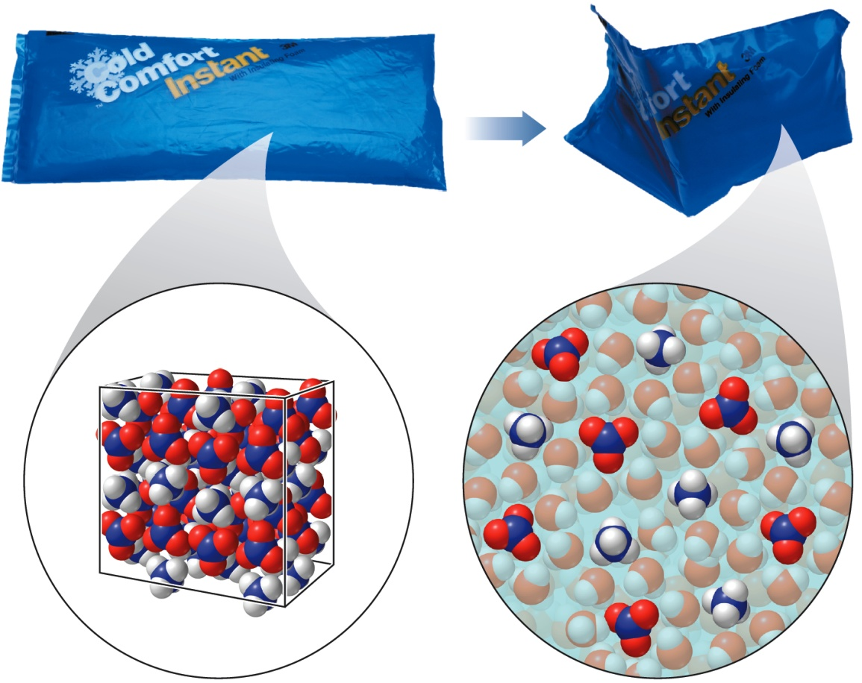
Spontaneity of Cold Packs
ΔH_{soln} = positive.
Particles in products are more spread out or have more freedom of motion than starting materials!
5

Slide 6
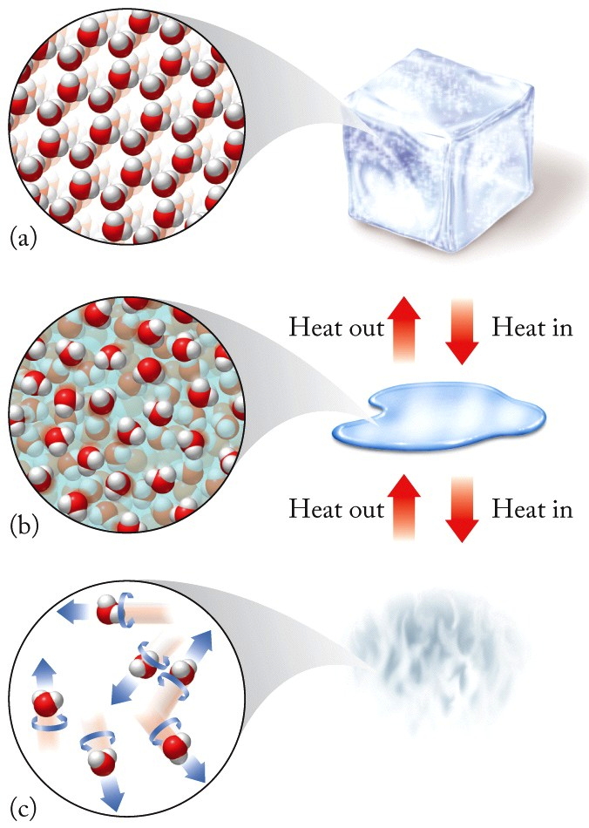
Molecular Motion
Solid
Liquid
Gas
6

Slide 7
Chapter Outline
12.1 Spontaneous Processes
12.2 Entropy
12.3 Absolute Entropy and Molecular Structure
12.4 Applications of the Second Law
12.5 Calculating Entropy Changes
12.6 Free Energy
12.7 Temperature and Spontaneity
12.8 Coupled Reactions

Slide 8
Thermodynamics: Entropy
Entropy (S):
A measure of how dispersed the energy in a system is at a specific temperature
Energy distribution affected by molecular motion, volume
Second Law of Thermodynamics:
The entropy of the universe increases in any spontaneous process
ΔS_{univ} = ΔS_{sys} + ΔS_{surr} > 0
8

Slide 9
Entropy and Microstates
The motion of molecules is quantized:
Different molecular states related to molecular motion are separated by specific energies.
Energy State or Energy Level:
An allowed value of energy
Microstate:
A unique distribution of particles among energy levels
9

Slide 10
Example: Microstates of Mixing

Slide 11
Statistical Entropy
Boltzmann Equation:
S = k_{B} ln W
S = entropy
k_{B} = Boltzmann constant (1.38 × 10⁻²³ J/K)
= R/N_{A}
W = # of microstates
Entropy increases as the number of microstates increases.
11

Slide 12
Third Law of Thermodynamics
Third Law of Thermodynamics:
The entropy of a perfect crystal is zero at absolute zero
Provides a point of reference or baseline for entropy
12

Slide 13
Chapter Outline
12.1 Spontaneous Processes
12.2 Entropy
12.3 Absolute Entropy and Molecular Structure
12.4 Applications of the Second Law
12.5 Calculating Entropy Changes
12.6 Free Energy
12.7 Temperature and Spontaneity
12.8 Coupled Reactions

Slide 14
Standard Molar Entropy
Standard molar entropy (Sº):
The absolute entropy of 1 mol of a substance in its standard state at 298 K and 1 bar (~1 atm) of pressure
Calculated from measurement of molar heat capacities as a function of temperature
14

Slide 15
Factors Affecting Entropy
Entropy increases with:
Increasing temperature
Increasing volume
Increasing number of independent particles
At what temperature does all molecular motion cease, and entropy equal zero?
15

Slide 16
Types of Molecular Motion
Three types of motion:
Translational: Movement through space
Rotational: Spinning motion around axis perpendicular to bond
Vibrational: Movement of atoms toward/away from each other
As temperature increases, the amount of motion increases.
16

Slide 17
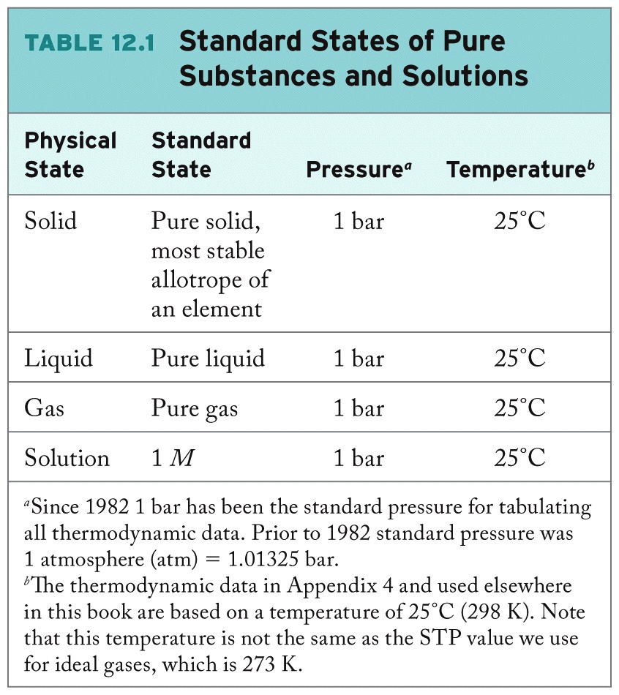
17

Slide 18
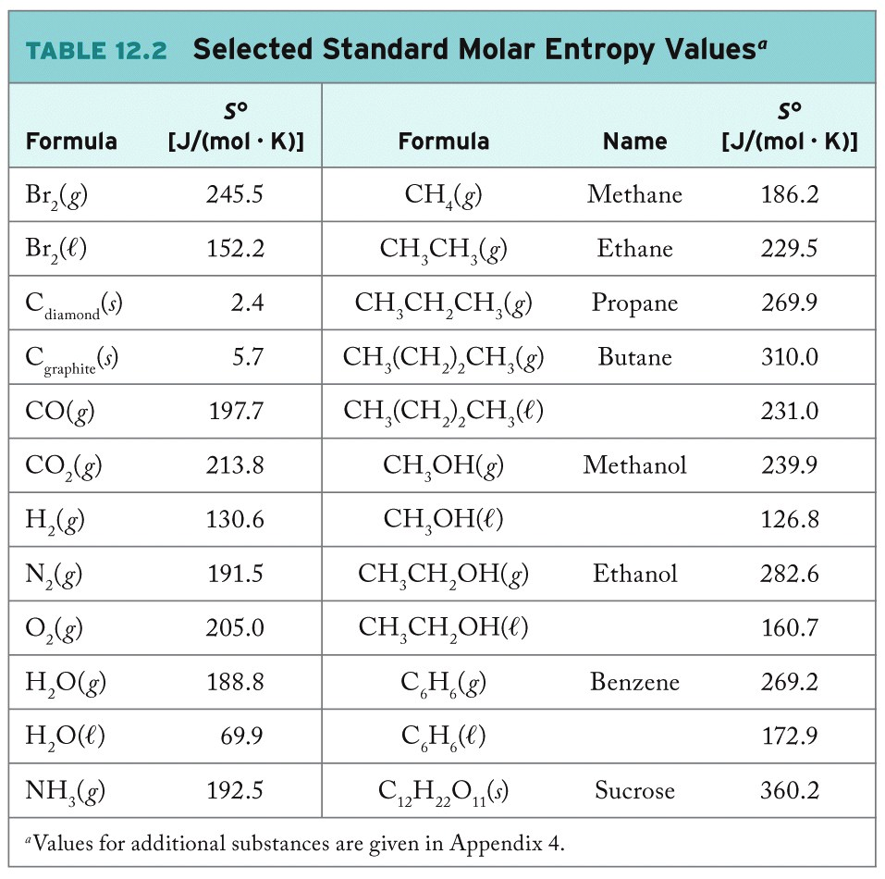
18

Slide 19
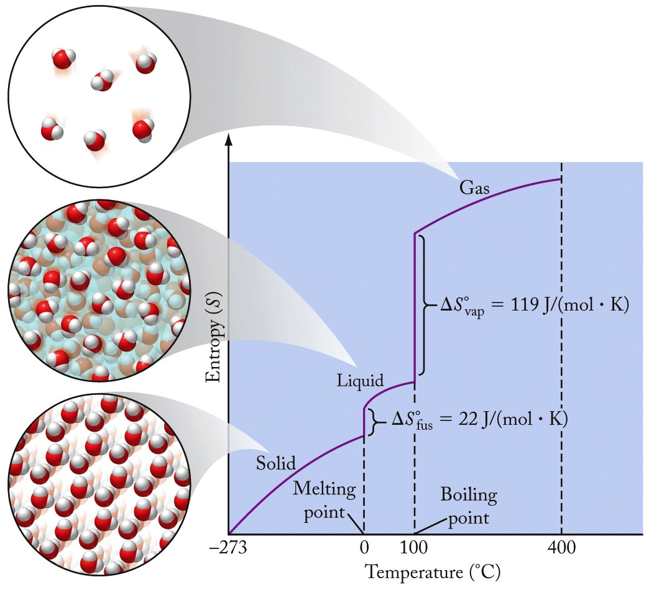
Trends in Entropies
Example:
H₂O at 298 K
H₂O(ℓ) = 69.9 J/(mol·K)
H₂O(g) =188.8 J/(mol·K)
ΔS_{vap} = 119 J/(mol·K)
19

Slide 20
Entropy and Structure
Entropy increases as the complexity of molecular structure increases.
More bonds, more opportunities for internal motion (more internal vibrational motion).
S° (J/(mol·K):
186 230 270 310
20

Slide 21
Chapter Outline
12.1 Spontaneous Processes
12.2 Entropy
12.3 Absolute Entropy and Molecular Structure
12.4 Applications of the Second Law
12.5 Calculating Entropy Changes
12.6 Free Energy
12.7 Temperature and Spontaneity
12.8 Coupled Reactions

Slide 22
Entropy of the Universe
ΔS_{univ} = ΔS_{sys} + ΔS_{surr}
Consider an ice cube melting at 0.0 °C (273 K) on a countertop at 22.0 °C (295 K).
Heat flows into ice cube: ΔS_{sys} = q_{rev}/273 K
Heat flows out of countertop: ΔS_{surr} = -q_{rev}/295 K
ΔS_{univ}= (q_{rev}/273) + (-q_{rev}/295) > 0
Spontaneous!
22

Slide 23
Thermodynamic Entropy
For an isothermal process: ΔS = q_{rev}/T
q_{rev} = flow of heat for reversible process
Reversible Process:
A process that can be run in the reverse direction in such a way that, once the system has been restored to its original state, no net energy has flowed either to the system or to its surroundings

Slide 24
Spontaneity and Entropy
For ice melting:
ΔS_{sys} = +22.0 J/K
ΔS_{surr} = -20.4 J/K
ΔS_{univ} = ΔS_{sys} + ΔS_{surr}
= +1.6 J/K
(spontaneous)
24

Slide 25
Chapter Outline
12.1 Spontaneous Processes
12.2 Entropy
12.3 Absolute Entropy and Molecular Structure
12.4 Applications of the Second Law
12.5 Calculating Entropy Changes
12.6 Free Energy
12.7 Temperature and Spontaneity
12.8 Coupled Reactions

Slide 26
Calculating Entropy Changes
Entropy change for the system (ΔS°_{rxn}):
ΔS_{rxn} = ΔS_{sys} = S_{final} - S_{initial}
ΔS°_{rxn} = Σn_{products}S°_{products} - Σn_{reactants}S°_{reactants}
n = coefficients of the products / reactants in the balanced equation
Entropy change for the universe:
ΔS°_{surr} = -q_{sys} / T (q_{sys} = ΔH°_{rxn} )
26

Slide 27
Practice: Calculating ΔS°
Using values from Appendix 4, calculate the standard entropy change for the reaction:
2C₂H₆(g) + 7O₂(g) → 4CO₂(g) + 6H₂O(ℓ)
Collect and Organize:
Analyze:
Solve:
Think about It:
27

Slide 28
Chapter Outline
12.1 Spontaneous Processes
12.2 Entropy
12.3 Absolute Entropy and Molecular Structure
12.4 Applications of the Second Law
12.5 Calculating Entropy Changes
12.6 Free Energy
12.7 Temperature and Spontaneity
12.8 Coupled Reactions

Slide 29
Free Energy
Gibbs Free Energy (G): the maximum energy released by a process occurring at constant temperature and pressure that is available to do useful work
Spontaneous Process: S_{univ} = S_{sys} + S_{surr} > 0
ΔS_{univ} = ΔS_{sys} + ΔS_{surr} = ΔS_{sys} - ΔH_{sys} / T > 0
Rearrange:
-T ΔS_{univ} = ΔH_{sys} - TΔS_{sys} (ΔG_{sys} = -TΔS_{univ})
29

Slide 30
Spontaneous Chemical Processes
Driving forces that contribute to spontaneity:
The system experiences and increase in entropy: ΔS_{rxn} > 0
The process is exothermic: ΔH_{rxn} < 0
Free energy (G) relates enthalpy, entropy, and temperature for a process:
G = H – TS or ΔG = ΔH – TΔS
ΔG°_{rxn} = Σn_{prod.}ΔGº_{f, prod.} - Σn_{react.}ΔGº_{f,} _{react.}
30

Slide 31
Free Energy
Free energy: Energy available to do useful work (w)
Change in internal energy of system can be used to perform work: ∆E = q + w
ΔH = ΔG + TΔS (by rearrangement)
ΔG = energy that does work
Some energy lost due to entropy (-T∆S)
Efficiency = (work done)/(energy produced)

Slide 32
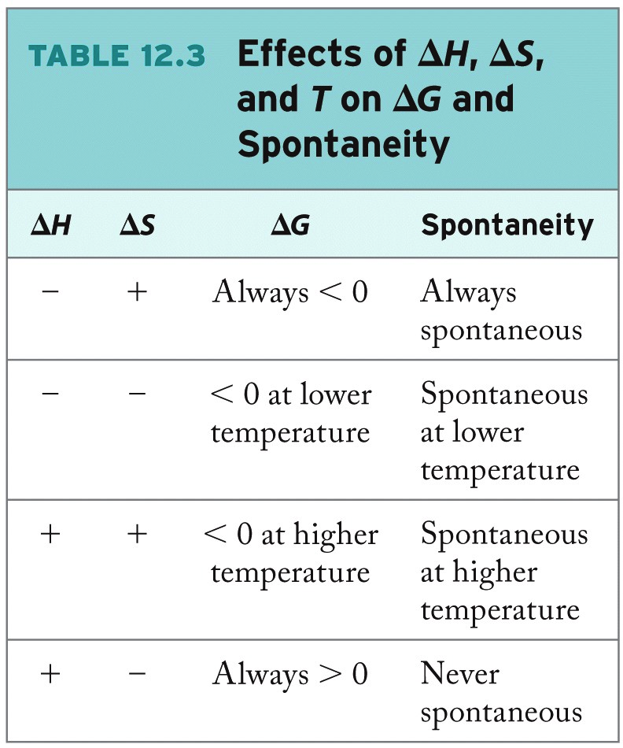

Slide 33
Chapter Outline
12.1 Spontaneous Processes
12.2 Entropy
12.3 Absolute Entropy and Molecular Structure
12.4 Applications of the Second Law
12.5 Calculating Entropy Changes
12.6 Free Energy
12.7 Temperature and Spontaneity
12.8 Coupled Reactions

Slide 34
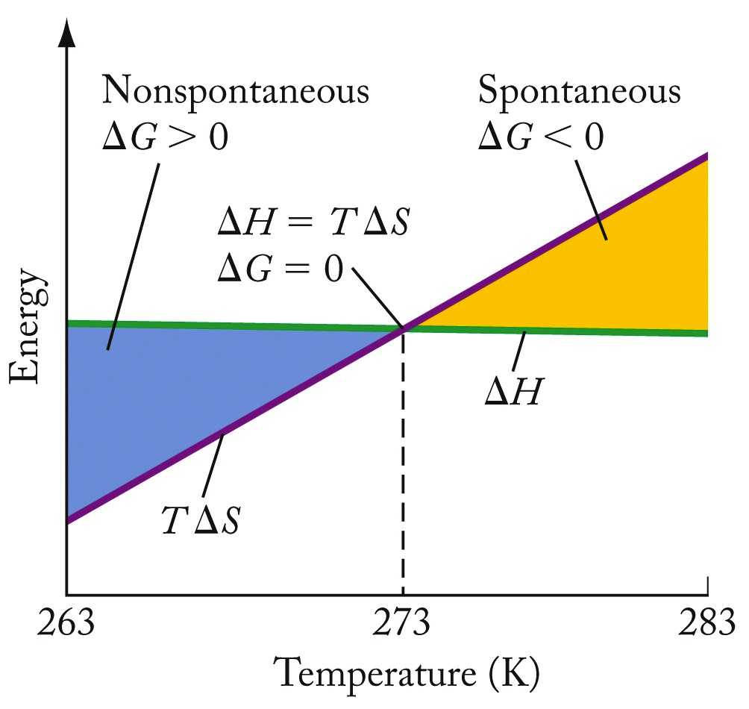
Temperature and Spontaneity
∆H = positive
∆S = positive
∆G = ∆H - T∆S
= negative above a certain temperature, when T∆S > ∆H
34

Slide 35
Practice: Determining Spontaneity (Part 1)
For the condensation of steam, predict the sign for each of the following without consulting Appendix 4.
A. ΔH B. ΔS
Collect and Organize:
Analyze:
Solve:
Think about It:
35

Slide 36
Practice: Determining Spontaneity (Part 2)
Based on your answers in Part 1, the condensation of steam is spontaneous at _____ temperature(s)?
A. All B. Low C. High D. No
Collect and Organize:
Analyze:
Solve:
Think about It:
36

Slide 37
Chapter Outline
12.1 Spontaneous Processes
12.2 Entropy
12.3 Absolute Entropy and Molecular Structure
12.4 Applications of the Second Law
12.5 Calculating Entropy Changes
12.6 Free Energy
12.7 Temperature and Spontaneity
12.8 Coupled Reactions

Slide 38
Driving the Human Engine
In living systems:
Breaking down food, generating heat
ΔG < 0; spontaneous
Metabolic processes (building muscle, etc.)
ΔG > 0, nonspontaneous
Living systems drive nonspontaneous reactions by coupling them to spontaneous reactions
38

Slide 39
Breakdown of Glucose
Glycolysis: Series of reactions that converts glucose into pyruvate (a major anaerobic path for metabolism of glucose in cells of living organisms)
39

Slide 40
Phosphorylation
Phosphorylation Reaction: Reaction resulting in addition of a phosphate group to an organic molecule
∆G°_{rxn} = + 13.8 kJ/mol, nonspontaneous

Slide 41
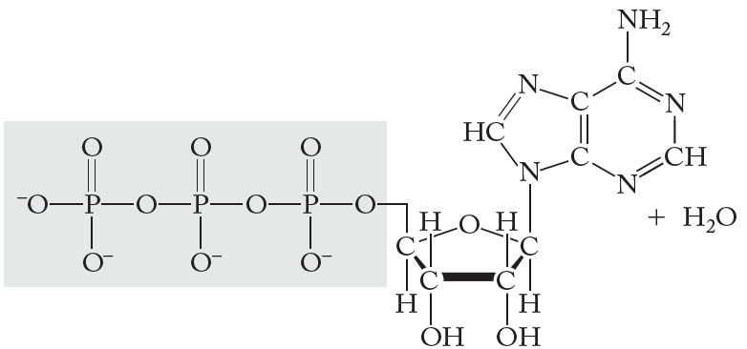
Adenosine Triphospate (ATP)
ATP:
Can be used to drive nonspontaneous cellular reactions
41

Slide 42
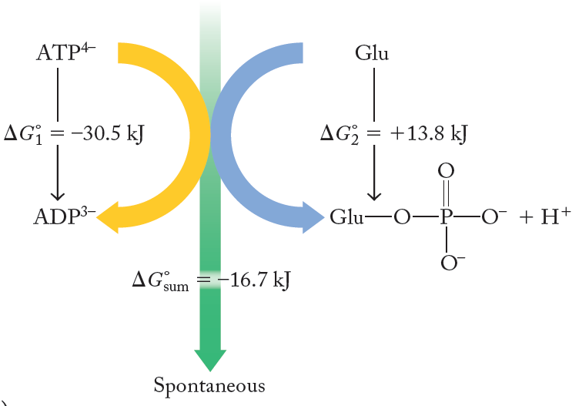
Coupled Reactions
Net process: ∆G°_{sum} = -16.7 kJ
42

Slide 43
ChemTours: Chapter 12
Click here to launch the ChemTours website

Slide 44
This concludes the Lecture PowerPoint presentation for Chapter 12

