Slide 1
11
Properties of Solutions
Their Concentrations and Colligative Properties

Slide 2
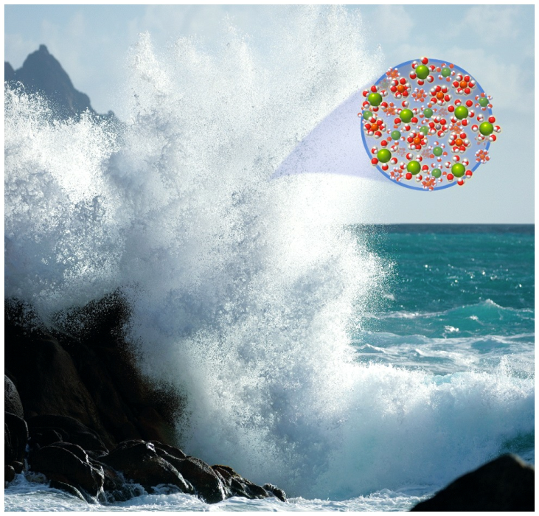
Chapter Outline
11.1 Energy Changes when Substances Dissolve
11.2 Vapor Pressure
11.3 Mixtures of Volatile Substances
11.4 Colligative Properties of Solutions
11.5 Osmosis and Osmotic Pressure
11.6 Using Colligative Properties to
Determine Molar Mass

Slide 3
Enthalpy of Solution
Dissolution of Ionic Solids:
Enthalpy of solution (∆H_{soln}) depends on:
Energies holding solute ions in crystal lattice
Attractive force holding solvent molecules together
Interactions between solute ions and solvent molecules
∆H_{soln} = ∆H_{ion-ion} + ∆H_{dipole-dipole} + ∆H _{ion-dipole}
When solvent is water:
∆H_{soln} ⁼ ∆H_{ion-ion} + ∆H_{hydration}
Notes:
Animation: Add box around last half of equation

Slide 4
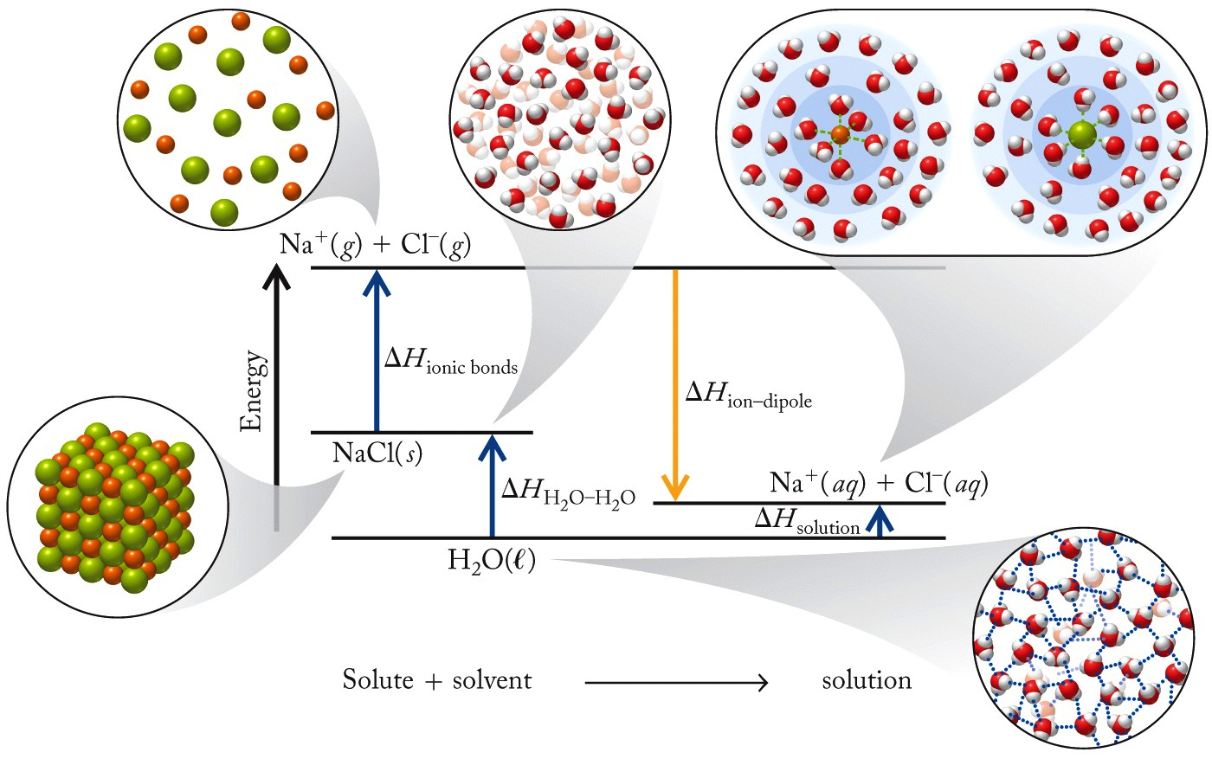
Dissolution of Ionic Compound

Slide 5
Lattice Energy
Lattice Energy (U):
Energy released when 1 mol of an ionic compound forms from its free ions in the gas phase
M⁺_{(g)} + X⁻_{(g)} → MX(s)
where k is proportionality constant and depends on lattice structure

Slide 6
∆H_{ion–ion}
Lattice Energy (U): Energy released when crystal lattice is formed
∆H_{ion–ion} = Energy required to remove ions from crystal lattice
∆H_{ion–ion} = –U
And: ∆H_{soln} ⁼ ∆H_{hydration} – U

Slide 7
Born–Haber Cycle and Lattice Energy
Born–Haber Cycle:
Series of steps with corresponding ΔHs that describe the formation of an ionic solid from its elements
e.g., Na(s) + ½ Cl₂(g) → NaCl(s) ∆H_{f}° = -411.2 kJ
Steps:
1. Sublimation of 1 mol Na(s) → Na(g) = ∆H_{sub}
2. Breaking bonds of ½ mol of Cl₂(g) = ½ ∆H_{BE}
3. Ionization of 1 mol Na(g) atoms = IE₁
4. Ionization of 1 mol Cl(g) atoms = EA₁
5. Formation of 1 mol NaCl(s) from ions(g) = U

Slide 8
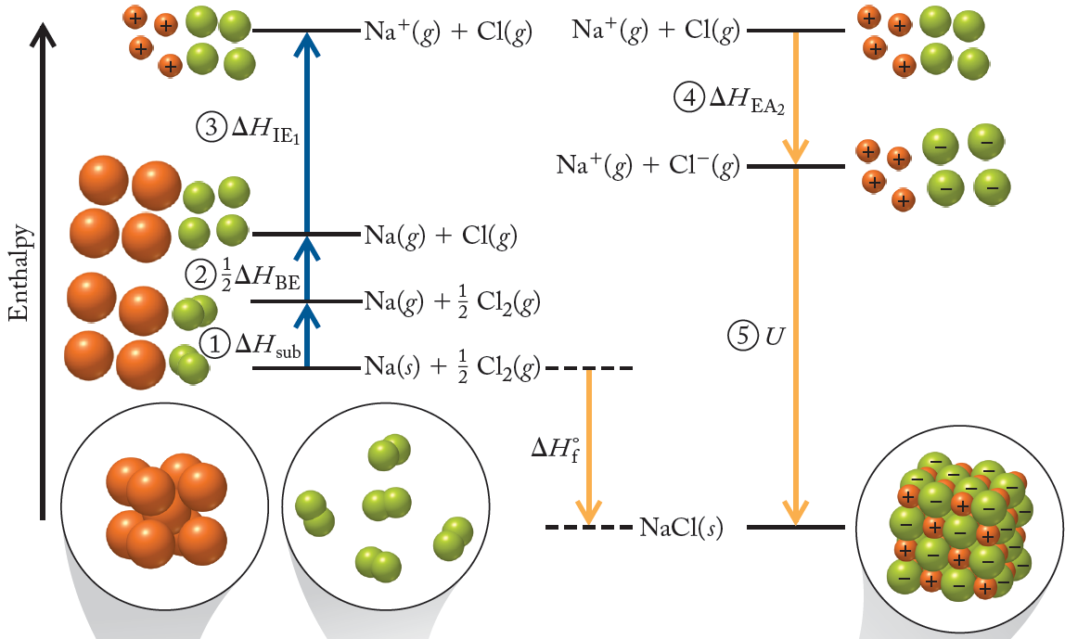
Born–Haber Cycle
∆H_{f}° = ∆H_{sub}
+ ½ ∆H_{BE}
+ IE₁
+ EA₁
+ U

Slide 9
Calculating U
Na⁺(g) + e⁻(g) → Na(g) -ΔH_{IE1}
Na(g) → Na(s) -ΔH_{sub}
Cl⁻(g) → Cl(g) + e⁻(g) -ΔH_{EA}
Cl(g) → ½Cl₂(g) -½ΔH_{BE}
Na(s) + ½Cl₂(g) → NaCl(s) ΔH_{f}
Na⁺(g) + Cl⁻(g) → NaCl(s) U
U = ΔH_{f} - ½ ΔH_{BE} - ΔH_{EA} - ΔH_{sub} - ΔH_{IE1}
Notes:
Animation in three parts:
1. starting with first five equations, add arrows to cancel species on both sides.
2. add ovals around remaining species, show summary equation.
3. add equation for lattice energy.

Slide 10
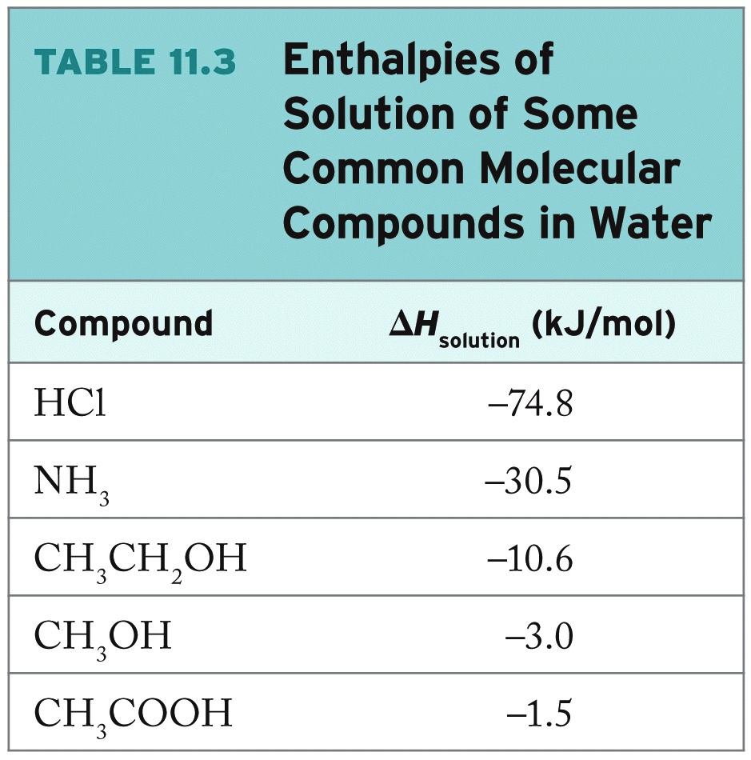

Slide 11
Chapter Outline
11.1 Energy Changes when Substances Dissolve
11.2 Vapor Pressure
11.3 Mixtures of Volatile Substances
11.4 Colligative Properties of Solutions
11.5 Osmosis and Osmotic Pressure
11.6 Using Colligative Properties to Determine Molar
Mass

Slide 12
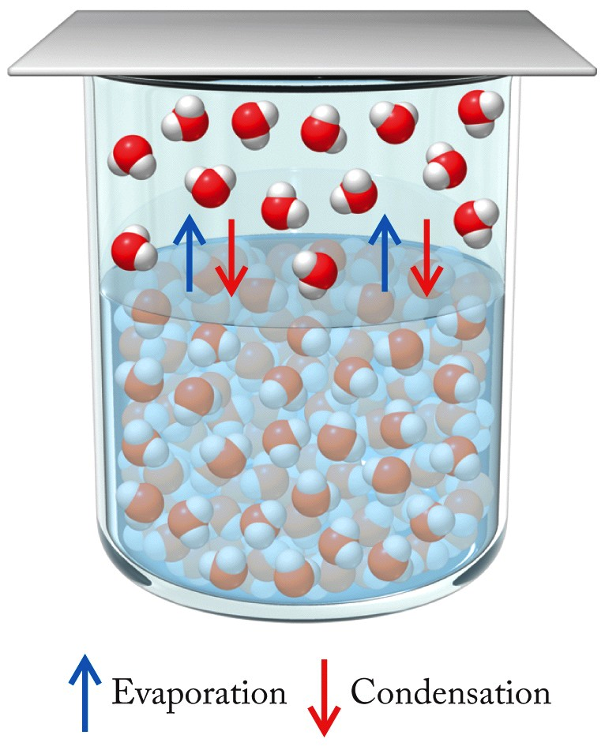
Vapor Pressure of Solutions
Vapor Pressure:
Pressure exerted by a gas in equilibrium with liquid
Rates of evaporation/condensation are equal
Normal Boiling Point:
Boiling point when ambient pressure is standard pressure

Slide 13
Factors Affecting Vapor Pressure
Temperature/Surface Area/Intermolecular forces (Discussed in Chapter 6):
Stronger forces = Higher E_{k} needed to enter gas phase.
Presence of Nonvolatile Solute:
Affects rate of evaporation, decreases vapor pressure of solution compared to pure solvent

Slide 14
Clausius–Clapeyron Equation
Clausius–Clapeyron Equation:
Relates vapor pressure of a substance to different temperatures to its heat of vaporization

Slide 15
Chapter Outline
11.1 Energy Changes when Substances Dissolve
11.2 Vapor Pressure
11.3 Mixtures of Volatile Substances
11.4 Colligative Properties of Solutions
11.5 Osmosis and Osmotic Pressure
11.6 Using Colligative Properties to Determine Molar
Mass

Slide 16
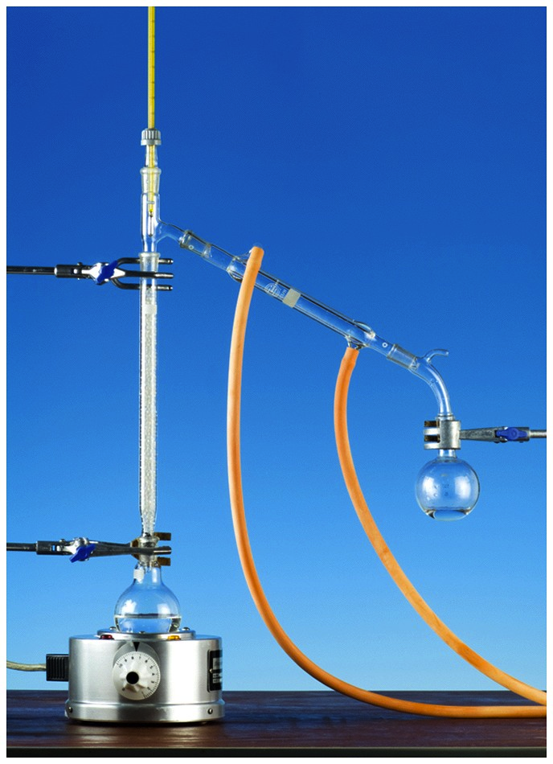
Fractional Distillation
Method of separating a mixture of compounds based on their different boiling points
Vapor phase enriched in more volatile component

Slide 17
Solutions of Volatile Components
Raoult’s Law:
Total vapor pressure of an ideal solution depends on how much the partial pressure of each volatile component contributes to total vapor pressure of solution
P_{total} = χ₁P₁° + χ₂P₂° + χ₃P₃° + …
where χ_{i} = mole fraction of component i, and
P_{i}° = equilibrium vapor pressure of pure volatile component at a given temperature

Slide 18
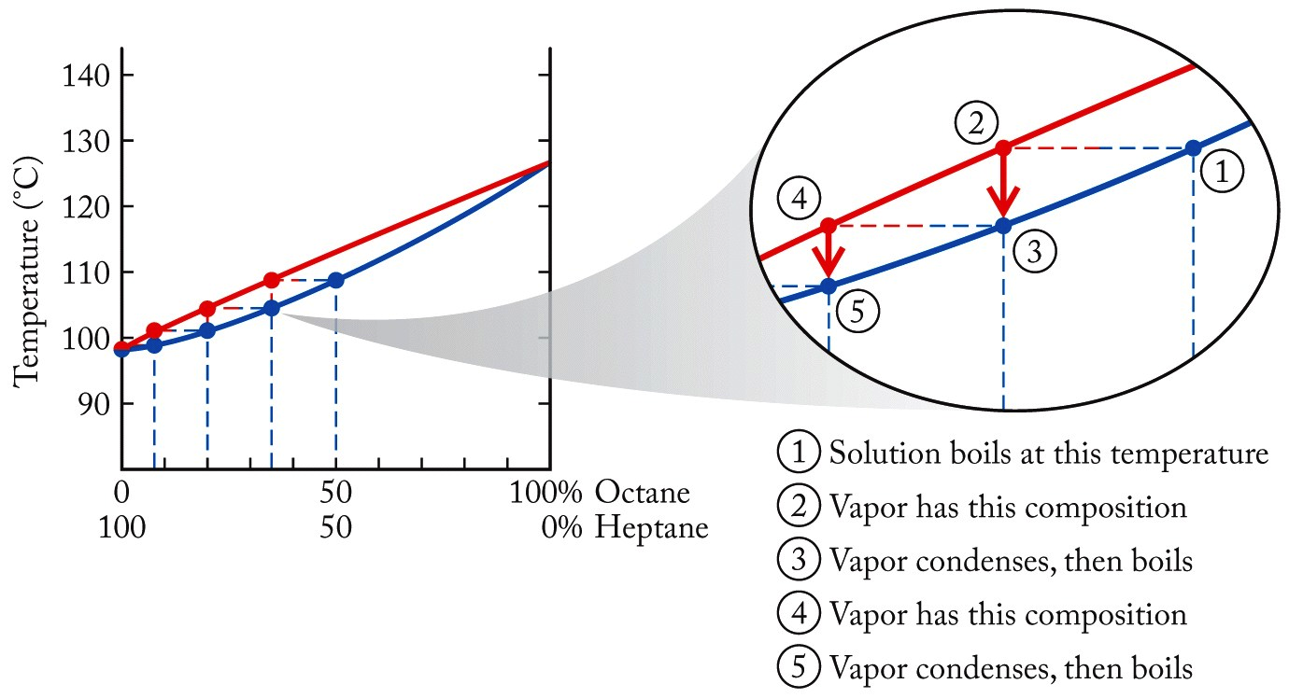
Fractional Distillation
Boiling Points:
heptane = 98°C
octane = 126°C

Slide 19
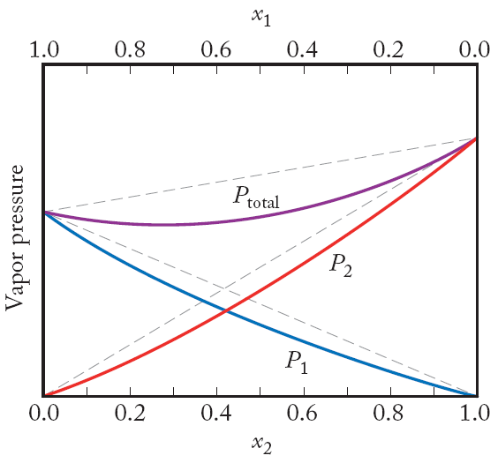
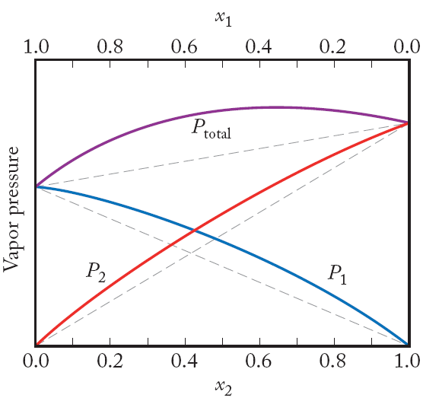
Real vs. Ideal Solutions
Deviations from Raoult’s Law:
Due to differences in solute–solvent and solvent–solvent interactions
(dashed lines = ideal behavior)
Negative deviations
Positive deviations

Slide 20
Practice: Vapor Pressure of Solution
A solution contains 100.0 g of water (MW = 18.0 g/mol) and 25.00 g of ethanol (MW = 44.0 g/mol). What are the mole fractions of water and ethanol, and the vapor pressure of the solution at 25°C? (P°_{water} = 23.8 torr; P°_{ethanol} = 58.7 torr)
Collect and Organize:
Analyze:
Solve:
Think about It:

Slide 21
Chapter Outline
11.1 Energy Changes when Substances Dissolve
11.2 Vapor Pressure
11.3 Mixtures of Volatile Substances
11.4 Colligative Properties of Solutions
11.5 Osmosis and Osmotic Pressure
11.6 Using Colligative Properties to Determine Molar
Mass

Slide 22
Colligative Properties of Solutions
Colligative Properties:
Set of properties of a solution relative to the pure solvent
Due to solute–solvent interactions
Depend on concentration of solute particles, not the identity of particles
Include lowering of vapor pressure, boiling point elevation, freezing point depression, osmosis and osmotic pressure

Slide 23
Vapor Pressure of Solutions
Raoult’s Law:
Vapor pressure of solution is equal to the vapor pressure of the pure solvent multiplied by the mole fraction of solvent in the solution
P_{solution} = χ_{solvent}·P °_{solvent}
Vapor pressure lowering:
A colligative property of solutions (Section 11.5)
Ideal Solution:
One that obeys Raoult’s law

Slide 24
Colligative Properties of Solutions
Colligative Properties:
Vapor pressure lowering
Consequences:
Δ in b.p. and f.p. of solution relative to pure solvent

Slide 25
Solute Concentration: Molality
Changes in boiling point/freezing point of solutions depends on molality:
Preferred concentration unit for properties involving temperature changes because it is independent of temperature
For typical solutions: molality > molarity

Slide 26
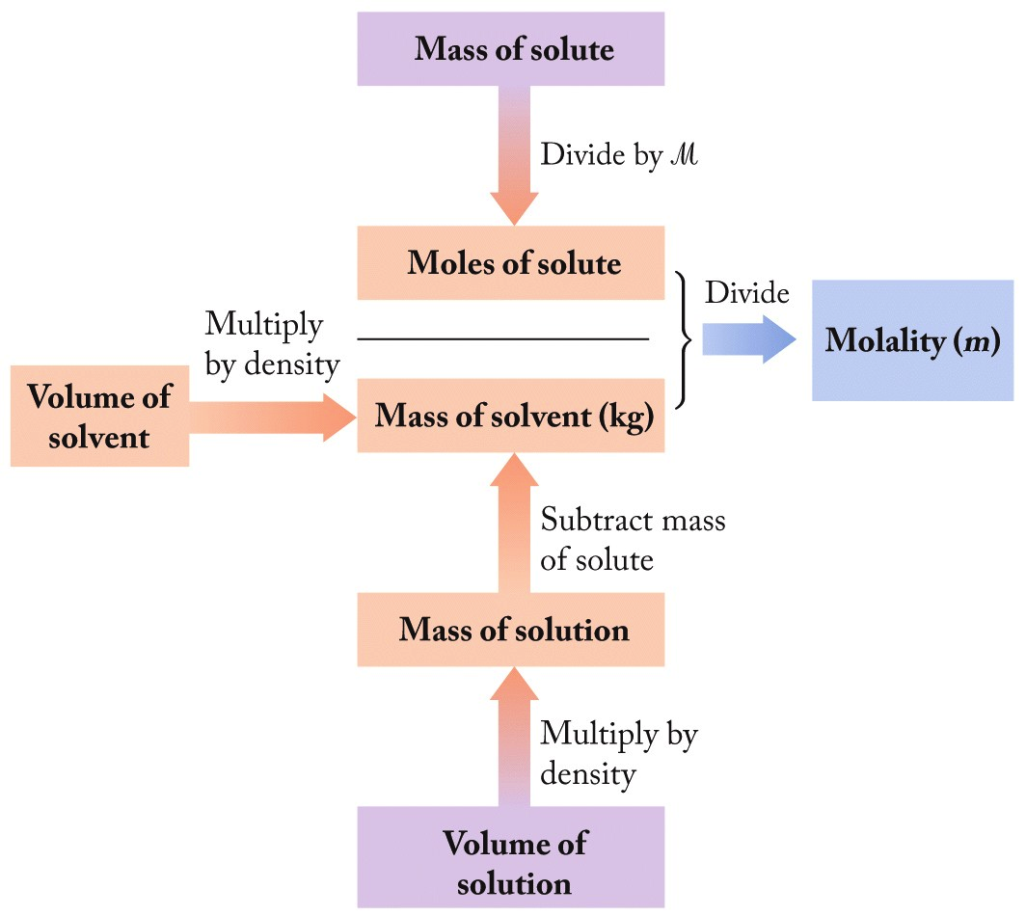
Calculating Molality
Starting with:
a) Mass of solute
b) Volume of solvent, or
c) Volume of solution

Slide 27
Practice: Molality #1
Calculate the molality of a solution containing 0.875 mol of glucose (C₆H₁₂O₆) in 1.5 kg of water.
Collect and Organize:
Analyze:
Solve:
Think about It:

Slide 28
Practice: Molality #2
Seawater contains 0.558 M Cl⁻ at the surface at 25°C. If the density of seawater is 1.022 g/mL, what is the molality of Cl⁻ in seawater?
Collect and Organize:
Analyze:
Solve:
Think about It:

Slide 29
Boiling Point Elevation and Freezing Point Depression
Boiling Point Elevation (∆T_{b}):
∆T_{b} = K_{b}·m
K_{b} = boiling point elevation constant of solvent; m = molality
Freezing Point Depression (∆T_{f}):
∆T_{f} = K_{f}·m
K_{f} = freezing point depression constant; m = molality

Slide 30
Practice: Boiling Point Elevation
Cinnamon owes its flavor and odor to cinnamaldehyde (C₉H₈O). Determine the boiling point elevation of a solution of 100 mg of cinnamaldehyde dissolved in 1.00 g of carbon tetrachloride (K_{b} = 2.34ºC/m).
Collect and Organize:
Analyze:
Solve:
Think about It:

Slide 31
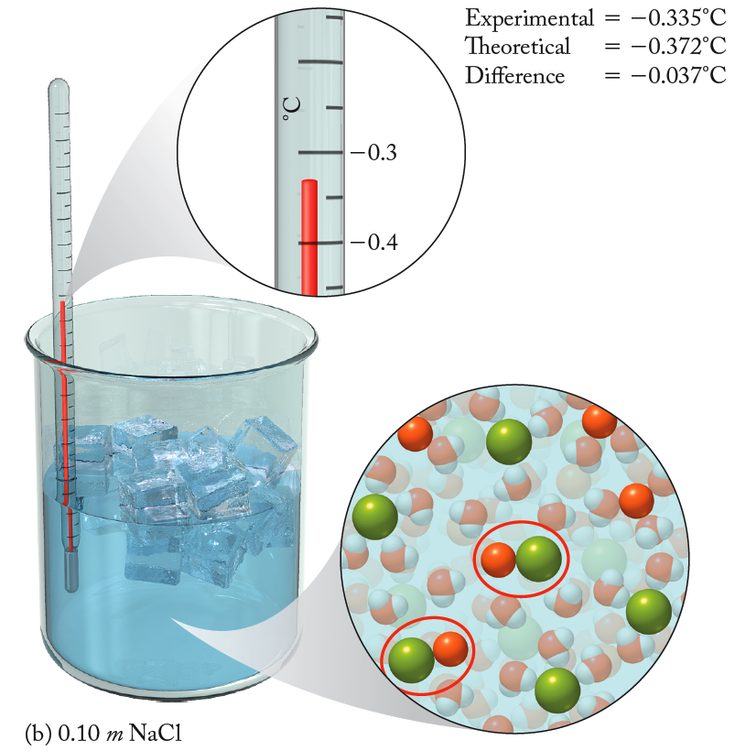
The van’t Hoff Factor
Solutions of Electrolytes:
Need to correct for # of particles formed when ionic substance dissolves
van’t Hoff Factor (i):
# ions in formula unit.
e.g., NaCl, i = 2
ΔT_{b} = i·K_{b}·m ΔT_{f} = i·K_{f}·m
(Deviations → ion pair formation.)

Slide 32
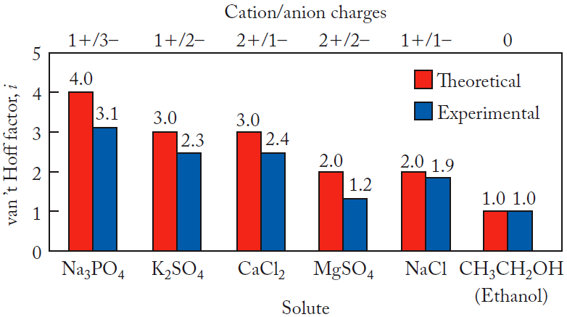
Values of van’t Hoff Factors

Slide 33
Practice: Freezing Point Depression
CaCl₂ is widely used to melt frozen precipitation on sidewalks after a winter storm. Could CaCl₂ melt ice at -20°C? Assume that the solubility of CaCl₂ at this temperature is 70.0 g/100.0 g of H₂O and that the van’t Hoff factor for a saturated solution of CaCl₂ is 2.5 (K_{f} for water is 1.86 °C/m).
Collect and Organize:
Analyze:
Solve:
Think about It:

Slide 34
Chapter Outline
11.1 Energy Changes when Substances Dissolve
11.2 Vapor Pressure
11.3 Mixtures of Volatile Substances
11.4 Colligative Properties of Solutions
11.5 Osmosis and Osmotic Pressure
11.6 Using Colligative Properties to Determine Molar
Mass

Slide 35
Osmosis
Osmosis:
Flow of fluid through a semipermeable membrane to balance the concentration of solutes in solutions on the two sides of the membrane
Osmotic Pressure (Π ):
Pressure applied across a membrane to stop the flow of solvent through membrane
Π = i MRT (M = molarity of solution)

Slide 36
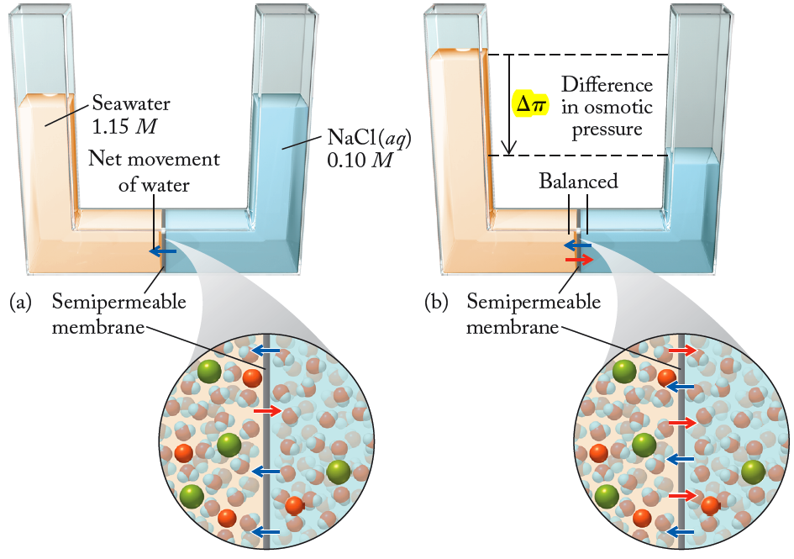
Osmosis at the Molecular Level
Direction of solvent flow.
Notes:
Animation in two parts:
1. Starting with picture on left with arrow/text indicating direction of solvent flow.
2. Add picture on right with red box indicating Δ osmotic pressure.

Slide 37
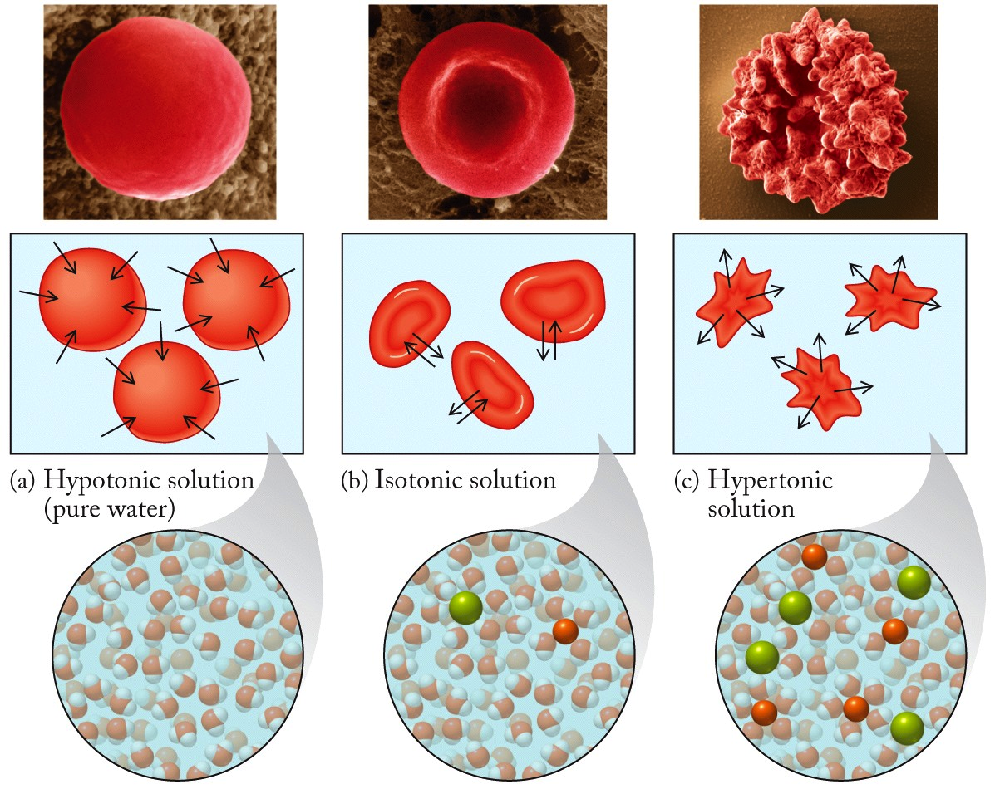
Osmosis: Medical Application

Slide 38
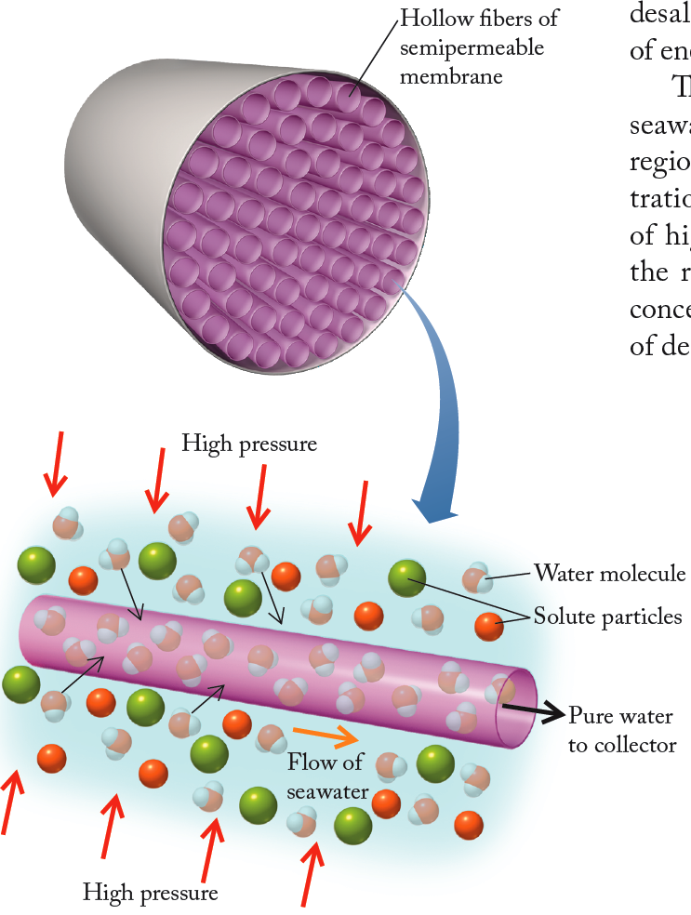
Reverse Osmosis
Process in which solvent is forced through a semipermeable membrane, leaving a more concentrated solution behind
Application: Desalination / water purification

Slide 39
Chapter Outline
11.1 Energy Changes when Substances Dissolve
11.2 Vapor Pressure
11.3 Mixtures of Volatile Substances
11.4 Colligative Properties of Solutions
11.5 Osmosis and Osmotic Pressure
11.6 Using Colligative Properties to Determine Molar
Mass

Slide 40
Molar Mass from Colligative Properties
Rearrange colligative property relationships:
ΔT_{f}, ΔT_{b}:
Osmotic Pressure:
Typically used only for nonelectrolyte solutes
(Osmotic pressure most common application)

Slide 41
Practice: Molar Mass from Colligative Properties
The freezing point of a solution prepared by dissolving 1.50 × 10² mg of caffeine in 10.0 g of camphor is 3.07°C lower than that of pure camphor (K_{f} = 39.7°C/m). What is the molar mass of caffeine?
Collect and Organize:
Analyze:
Solve:
Think about It:

Slide 42
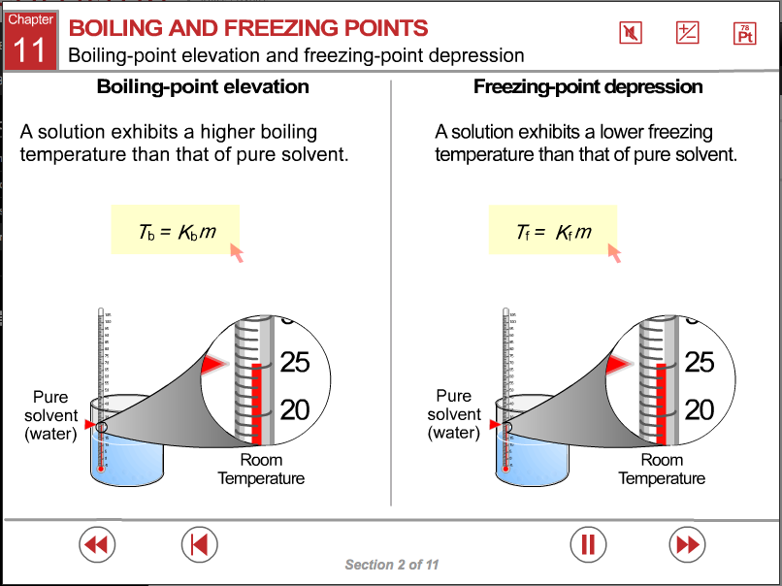
ChemTours: Chapter 11
Click here to launch the ChemTours website

Slide 43
This concludes the Lecture PowerPoint presentation for Chapter 11

