Slide 1
Algebra and Physics Connections
Program for TEA fellows 2014
Feb. 20 & March 6, 1-3 PM, Sims 207
BY
Ponn Maheswaranathan, PhD
Physics
Dept of Chem/Physics/Geol
Winthrop University
Rock Hill SC 29733
Ph: 803-323-4940
Fax: 803-323-2246
http://bohr.winthrop.edu/faculty/mahes/ link_to_webpages/personal/mahes.html
Zachary Abernathy, PhD
Mathematics
Dept of Mathematics
Winthrop University
Rock Hill SC 29733
Ph: 803-323-4605
http://faculty.winthrop.edu/abernathyz/

Slide 2
Useful Websites
http://www.goorulearning.org/gooru/index.g?gclid=CK2uzvucw7UCFQjNnAod2ioAmQ#!/library/tilesView/20001/22912/22913
https://www.khanacademy.org/
http://www.hippocampus.org/
http://ocw.mit.edu/index.htm
http://sprott.physics.wisc.edu/wop.htm
http://tutoring.sylvanlearning.com/newsletter/0704/math.cfm
http://www.mrlsmath.com/20-free-resources-for-high-school-math-teachers/

Slide 3
Mechanics
The study of Physics begins with mechanics.
Mechanics is the branch of physics that focuses on the motion of objects and the forces that cause the motion to change.
There are two parts to mechanics: Kinematics and Dynamics.
Kinematics deals with the concepts that are needed to describe motion, without any reference to forces. Motion Along a Straight Line Motion in two and three dimensions
Dynamics deals with the effect that forces have on motion. Newton’s Laws of Motion
Terms in Kinematics: Position, Displacement, Distance, Speed, Velocity, and Acceleration.

Slide 4
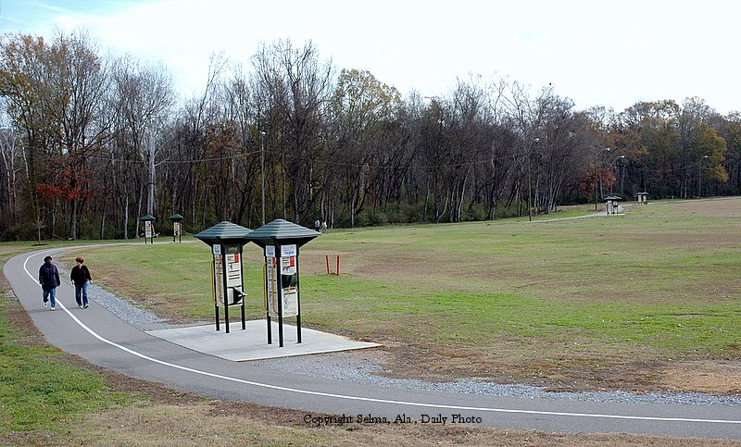
Walking in the Park

Slide 5
Constant Acceleration: Kinematics Equations
Equation | Missing Quantity
 | x-x₀
 | v
 | t
 | a
 | v₀
http://www.physicsclassroom.com/class/1dkin/u1l6c.cfm

Slide 6
Activities
Problems with Kinematic Equations
Problems with vertical kinematics
Plotting Motion Graph
Combining Resistors

