Slide 1
Observable Properties
Standard K-5: The student will demonstrate the understanding that objects can be described by their observable properties. (Physical Science)
K-5.1 Classify objects by observable properties (including size, color, shape, magnetic attraction, heaviness, texture, and the ability to float in water).
OP1. Give objects of the same shape with different sizes, and ask them to arrange the objects depending on size. Small to big and also big to small.
OP2. Give objects of the same shape and size with different masses, and ask them to arrange the objects depending on heaviness. Small to big and also big to small.
OP3. Give various objects with different shapes: cylinders, rectangular blocks, cubes, and spheres. Ask them to classify the objects by shapes.
OP4. Give various objects, and ask them to classify depending on magnetic attraction. 2-5.3 Compare the effect of magnets on various materials.
OP5. Give various objects, and ask them to classify depending on its ability to float in water.

Slide 2
Exploring Motion
Standard 1-5: The student will demonstrate an understanding of the positions and motions of objects. (Physical Science)
1-5.1 Identify the location of an object relative to another object.
1-5.2 Explain the importance of pushing and pulling to the motion of an object
1-5.3 Illustrate the fact that sound is produced by vibrating objects.
Vibrating tuning fork in water. Feeling a vibrating speaker.
1-5.4 Illustrate ways in which objects can move in terms of direction and speed (including straight forward, back and forth, fast or slow, zigzag, and circular).
http://www.discoveryeducation.com/search/page/k-5/science/-/-/index.cfm?campaign=flyout_teachers_k5_science

Slide 3
Motion
3-5.4 Explain the relationship between the motion of an object and the pull of gravity.
2-5.1 Use magnets to make an object move without being touched. 5-5.1 Illustrate the affects of force (including magnetism, gravity, and friction) on motion.
3-5.2 Compare the motion of common objects in terms of speed and direction.
5-5.2 Summarize the motion of an object in terms of position, direction, and speed.
5-5.5 Use a graph to illustrate the motion of an object. Hand-Plotting motion graphs
Density of water

Slide 4
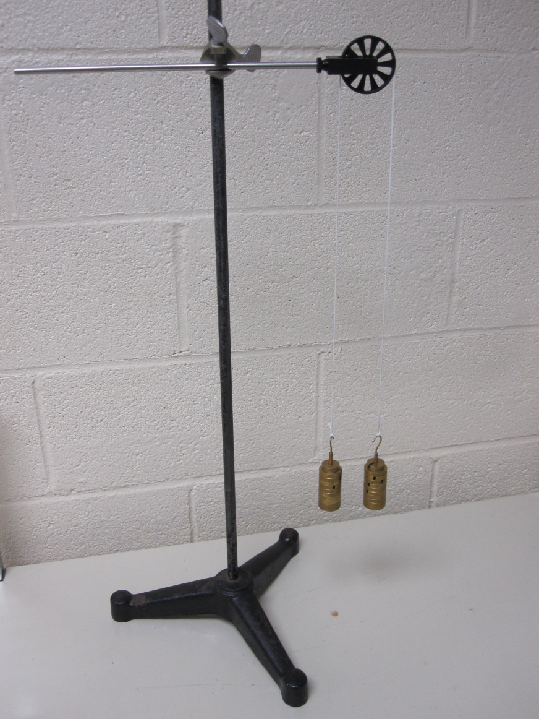
Forces and Motion
5-5.3 Explain how unbalanced forces affect the rate and direction of motion in objects.
3-5.3 Explain how the motion of an object is affected by the strength of a push or pull and the mass of the object.
5-5.6 Explain how a change of force or a change in mass affects the motion of an object. Atwood’s machine activity

