Slide 1
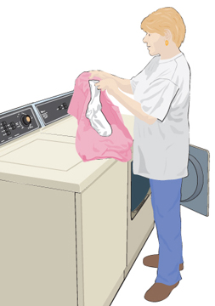
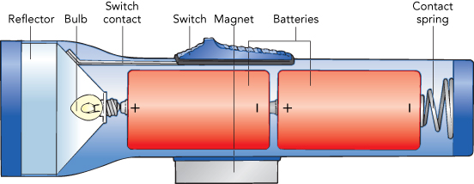
Electricity
Static Electricity Current Electricity
(dc and ac)
AAA, AA, C, D = 1.5 V
Car battery = 12 V
9-volt battery = 9 V
Lantern battery = 6 V

Slide 2
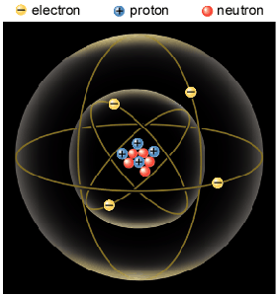
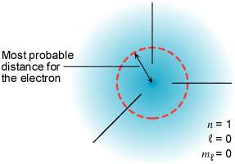
Atom
Atomic Particle
Charge
Mass
Electron
–1.6 × 10⁻¹⁹ C
9.11 × 10⁻³¹ Kg
Proton
+1.6 × 10⁻¹⁹ C
1.673 × 10⁻²⁷ Kg
Neutron
0
1.675 × 10⁻²⁷ Kg

Slide 3
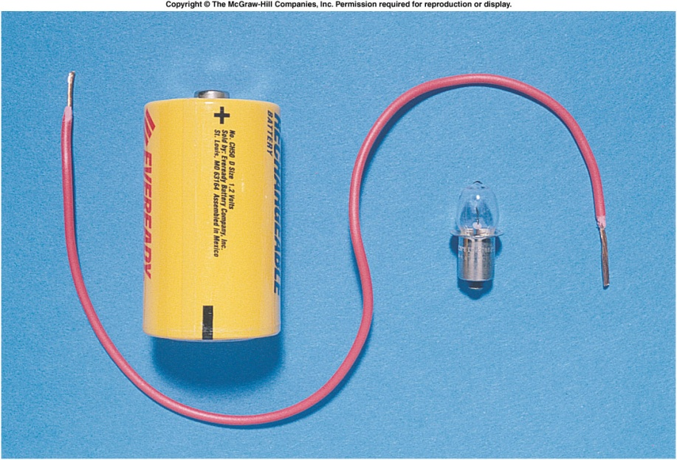
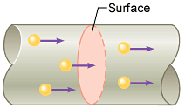
Electric Current
The electric current is the amount of charge per unit time that passes through a surface that is perpendicular to the motion of the charges.
The SI unit of electric current is the ampere (A), after the French mathematician André Ampére (1775-1836). 1 A = 1 C/s. Ampere is a large unit for current. In practice milliampere (mA) and microampere (μA) are used.

Slide 4
Electrical Quantities and their Units
Quantity | Symbol | Unit Name | Unit Abbreviation
Current | I | ampere | A
Voltage | V | volt | V
Resistance | R | ohm | Ω
Power | P | watt | W
Energy | E | killo-watt-hour | kWH

Slide 5
Ohm’s Law and Electric Power
Georg Simon Ohm (1787-1854), a German physicist, discovered Ohm’s law in 1826.
This is an experimental law, valid for both alternating current (ac) and direct current (dc) circuits.
When you pass an electric current (I) through a resistance (R) there will be a potential difference or voltage (V) created across the resistance.
Ohm’s law gives a relationship between the voltage (V), current (I), and resistance (R) as follows:
V = I R
Electric Power,P: P = V I
The SI unit of power is watt, after James Watt (1736-1819), who developed steam engines.
Utility companies use the unit kilowatt-hour to measure the electrical energy used by customers. One kilowatt-hour, kWh is the energy consumed for one hour at a power rate of 1 kW.

Slide 6
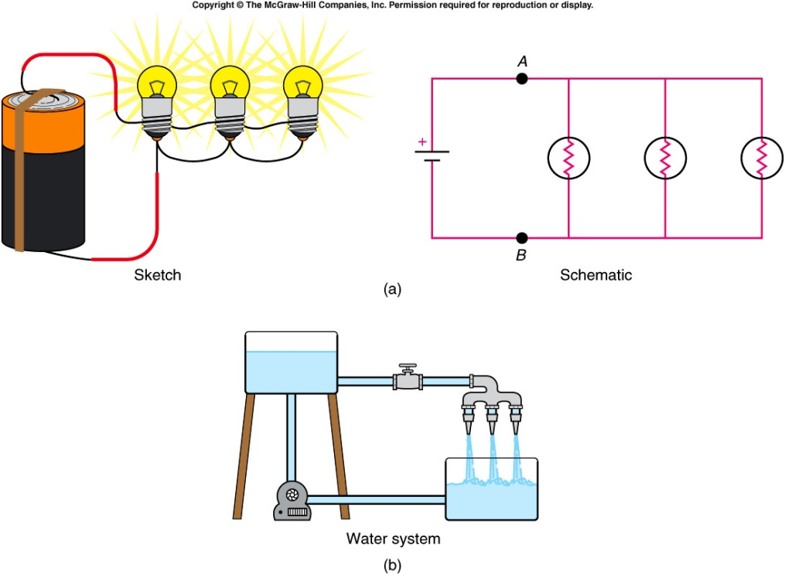
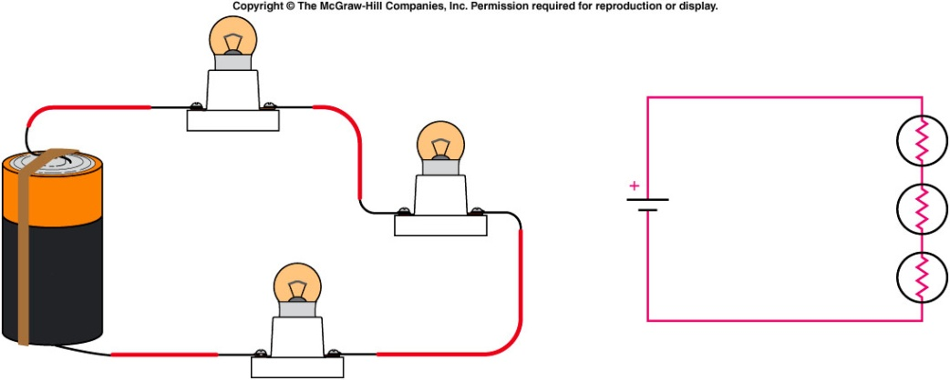
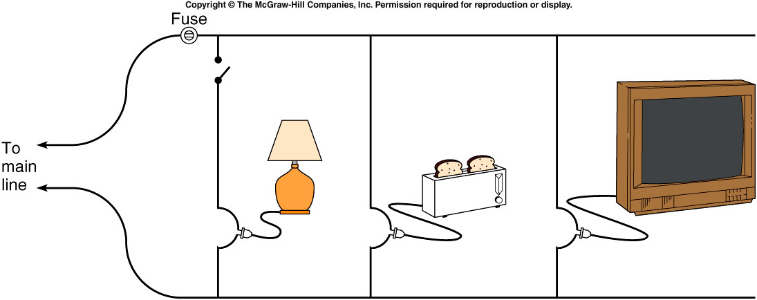
Series and Parallel Circuit
Parallel Circuit
Series Circuit
Household Circuit

Slide 7
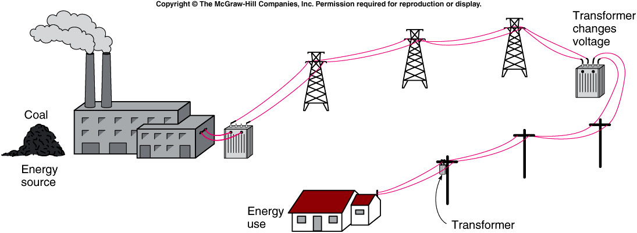
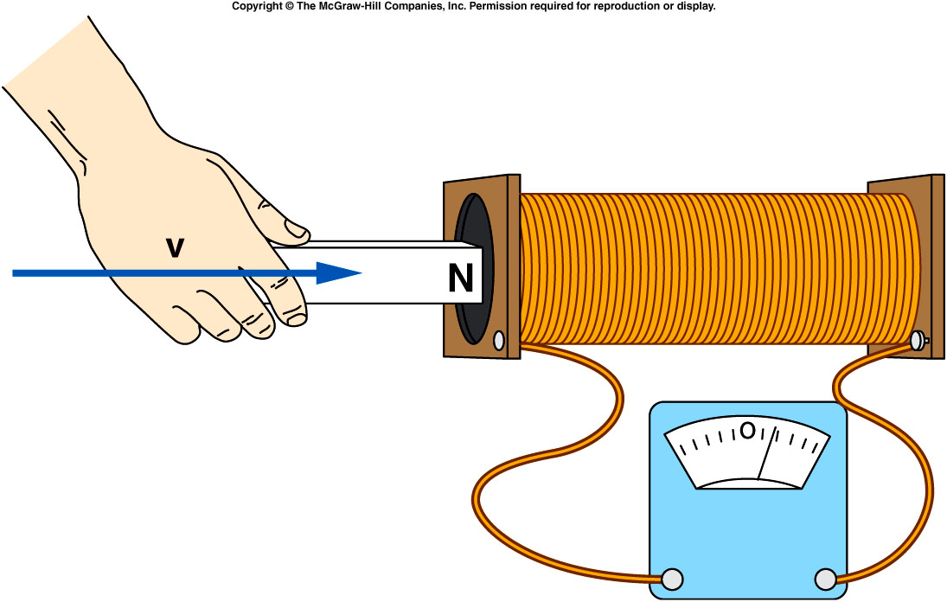
Electricity: Generation and Transmission
http://www.duke-energy.com/about-energy/generating-electricity/nuclear.asp

Slide 8
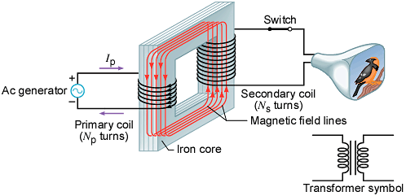
Transformers
A transformer is a device for increasing or decreasing an ac voltage.
A transformer consists of a primary coil and a secondary coil, both wound on an iron core. The changing magnetic flux produced by the current in the primary coil induces an emf in the secondary coil. At the far right is the symbol for a transformer.

