Slide 1
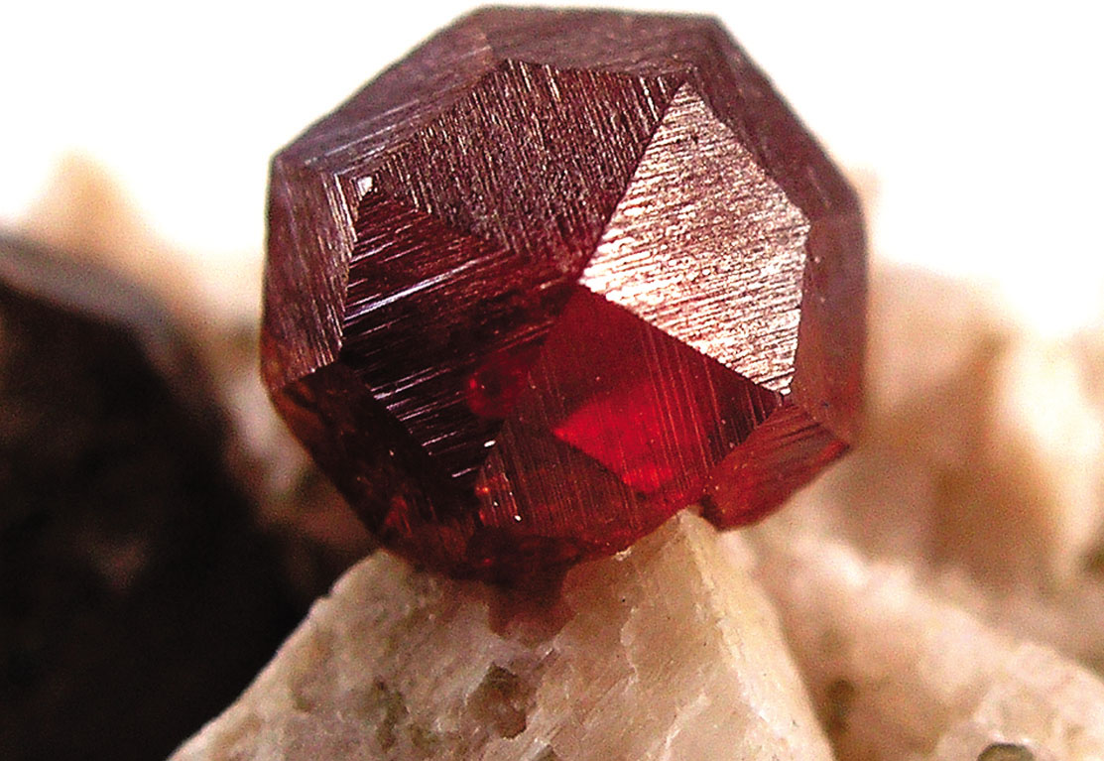
Single Crystal
A garnet single crystal found in Tongbei, Fujian Province, China. If the extremities of a single crystal are permitted to grow without any external constraint, the crystal will assume its geometric shape, with flat surfaces as shown in the figure.
The periodic and repeated arrangements of atoms is perfect or extends throughout the entirety of the specimen without interruption.
All unit cells interlock in the same way and have the same orientation.
Single crystals exist in nature, but they may also produced artificially. They are ordinarily difficult to grow, because the environment must be carefully controlled.
Single crystals are needed for modern technologies today.
Electronic micro-chips uses single crystals of silicon and other semiconductors.

Slide 2
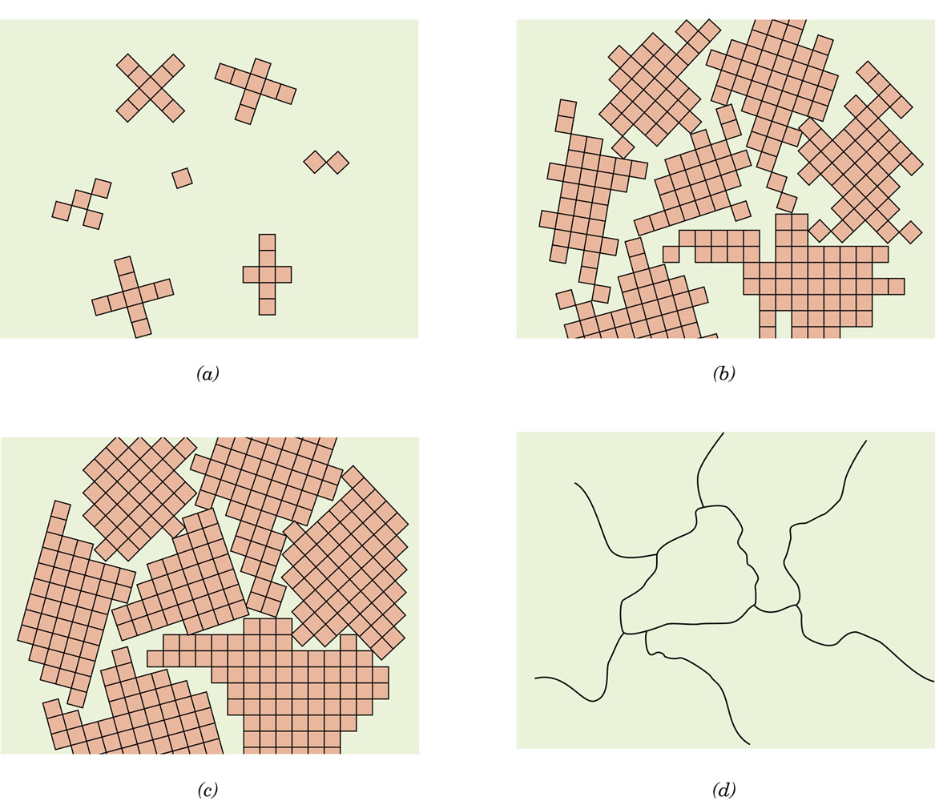
Polycrystalline Materials
Composed of a collection of many small crystals or grains.
Stages in the solidification of a polycrystalline material: a. Crystallite Nuclei b. Growth of the Crystallites c. Formation of grains d. Microscopic view

Slide 3
Anisotropy
Physical properties of single crystals of some substances depend on the crystallographic direction in which measurements are made.
This directionality of properties is termed anisotropy, and it is associated with the variance of atomic or ionic spacing with crystallographic direction.
Substances in which measured properties are independent of the direction of measurement are isotropic.

Slide 4
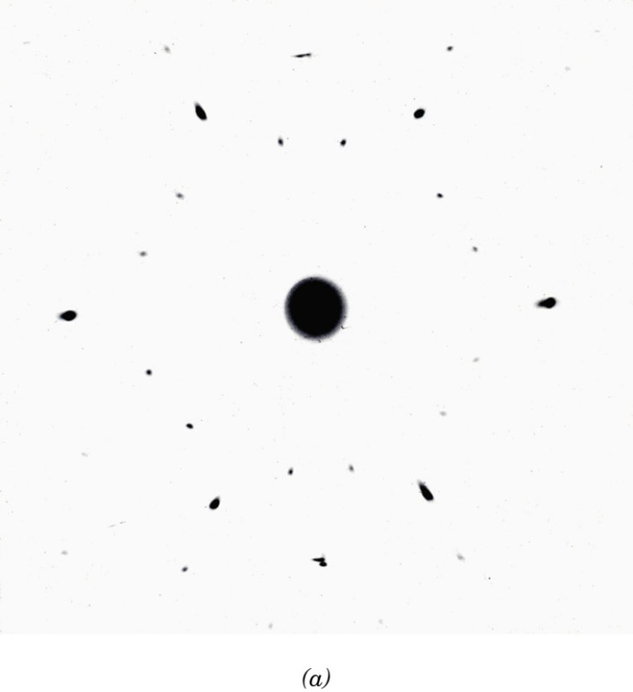
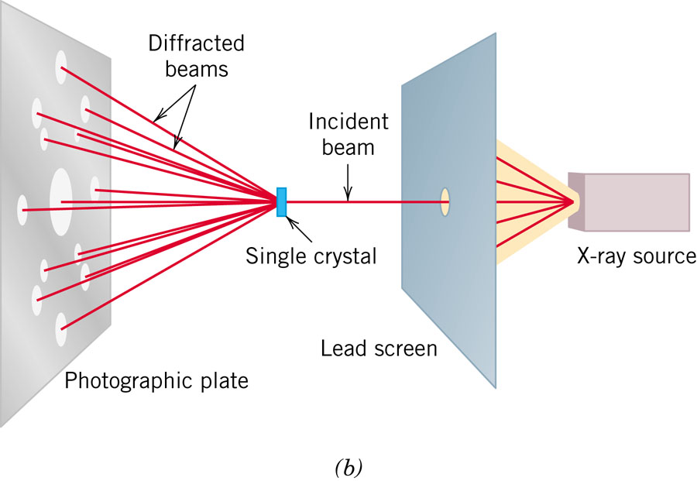
Diffraction
Diffraction occurs when a wave encounters a series of regularly spaced obstacles that
Are capable of scattering the wave, and
Have spacings that are comparable to the wavelength.
Furthermore, diffraction is a consequence of specific phase relationships that are established between two or more waves that have been scattered by the obstacles.

Slide 5
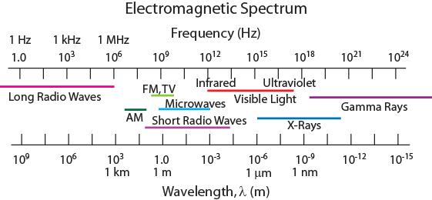
X-Ray Diffraction
Diffraction gratings must have spacings comparable to the wavelength of diffracted radiation.
Can’t resolve spacings < λ
Spacing is the distance between parallel planes of atoms.

Slide 6
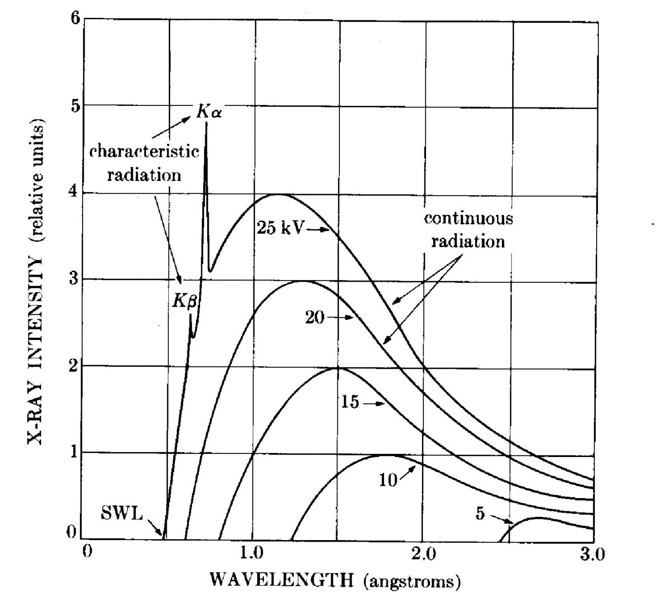
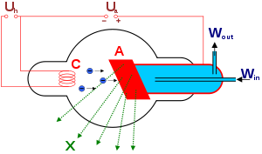
X-rays
Exptal Setup
https://www.youtube.com/watch?v=UjyHK7jy1Vw
http://en.wikipedia.org/wiki/X-ray_tube

Slide 7
Constructive and Destructive Interference

Slide 8
X-Rays to Determine Crystal Structure
• Incoming X-rays diffract from crystal planes.
“1”
detector
incoming
reflections must
X-rays
“2”
“1”
be in phase for
outgoing X-rays
a detectable signal
extra
“2”
λ
distance
θ
θ
Adapted from Fig. 3.20, Callister & Rethwisch 8e.
travelled
by wave “2”
spacing
d
between
Measurement of diffraction angle, 2θ, allows computation of planar spacing, d.
planes
Bragg’s Law:

Slide 9
Additional Conditions
•Bragg’s Law is a necessary but insufficient condition for diffraction.
•It only defines the diffraction condition for primitive unit cells, e.g. P cubic, P tetragonal, etc., where atoms are only at unit cell corners.
•Crystal structures with non-primitive unit cells have atoms at additional lattice (basis) sites.
•These extra scattering centers can cause out-of-phase scattering to occur at certain Bragg angles.
•The net result is that some of the diffraction predicted by Bragg’s Law (eqn. 1) does not occur, i.e. certain sets of planes do not exist.
Additional Conditions:
BCC: h+k+l = even FCC: h,k,l either odd or even

Slide 10
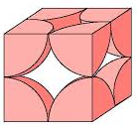
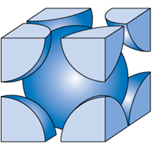
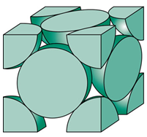
Selection Rules for Reflection
hkl | h²+k²+l² | SC | BCC | FCC
100
110
111
200
210
211
220
300
310
311
222
320
321
400

Slide 11
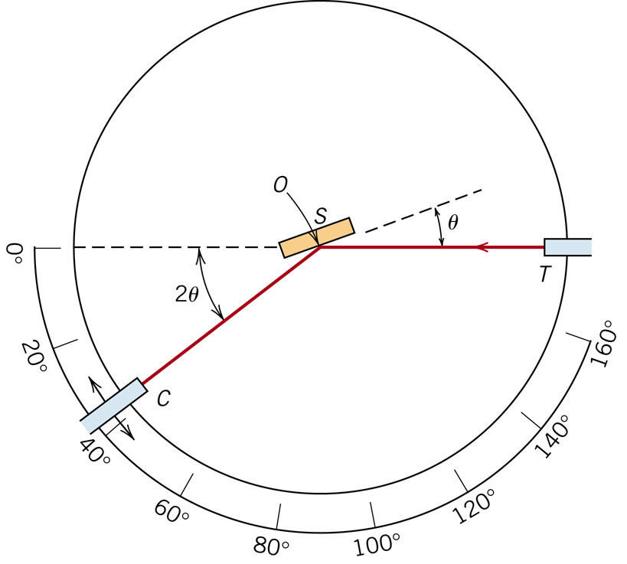
Diffraction Angle

Slide 12
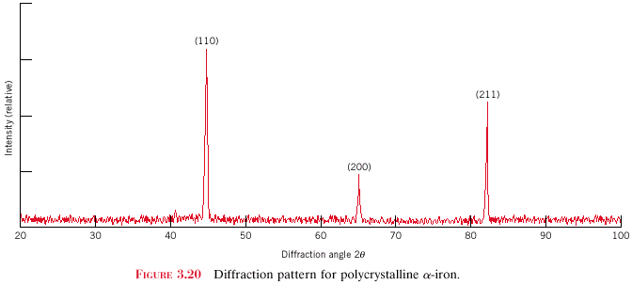
X-Ray Diffraction Pattern
z
z
z
c
c
c
y
(110)
y
y
a
b
a
b
a
b
x
x
x
(211)
Intensity (relative)
(200)
Diffraction angle 2θ
Diffraction pattern for polycrystalline α-iron (BCC)
Adapted from Fig. 3.22, Callister 8e.
Sum of the indices: h + k + l = even Problem 3.64

Slide 13
SUMMARY
• Atoms may assemble into crystalline or
amorphous structures.
• Common metallic crystal structures are FCC, BCC, and
HCP. Coordination number and atomic packing factor
are the same for both FCC and HCP crystal structures.
• We can predict the density of a material, provided we
know the atomic weight, atomic radius, and crystal
geometry (e.g., FCC, BCC, HCP).
• Crystallographic points, directions and planes are specified in terms of indexing schemes.
Crystallographic directions and planes are related to atomic linear densities and planar densities.
• Materials can be single crystals or polycrystalline.
Material properties generally vary with single crystal orientation (i.e., they are anisotropic), but are generally non-directional (i.e., they are isotropic) in polycrystals with randomly oriented grains.
• Some materials can have more than one crystal structure. This is referred to as polymorphism (or allotropy).
X-ray diffraction is used for crystal structure and
interplanar spacing determinations.

Slide 14
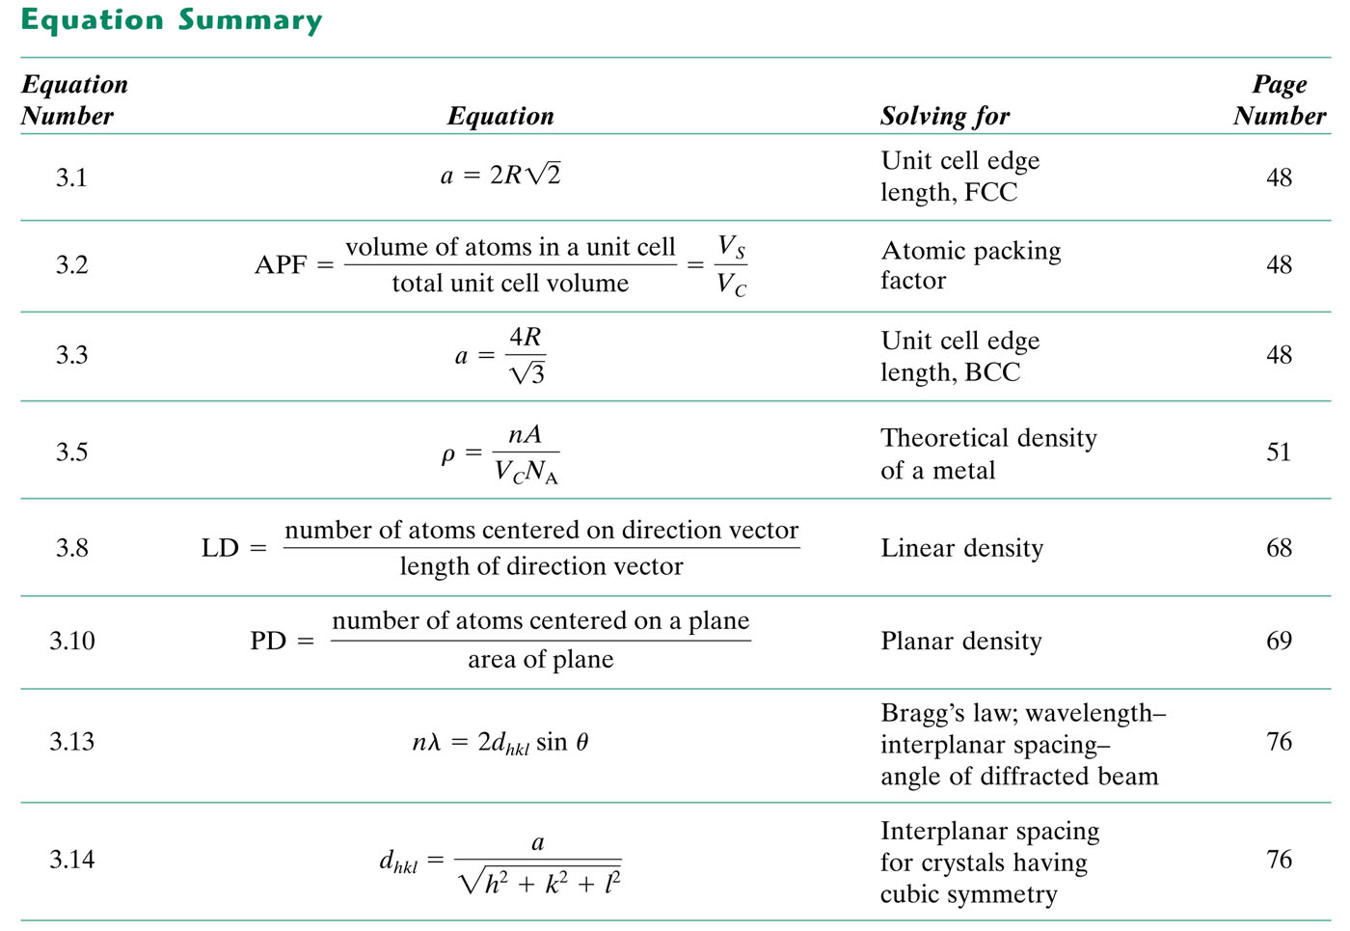
tableun_03_p82a

