Slide 1
Indexing Crystallographic Planes: Why we need to index?
Making of Al cans: Deep drawing

Slide 2
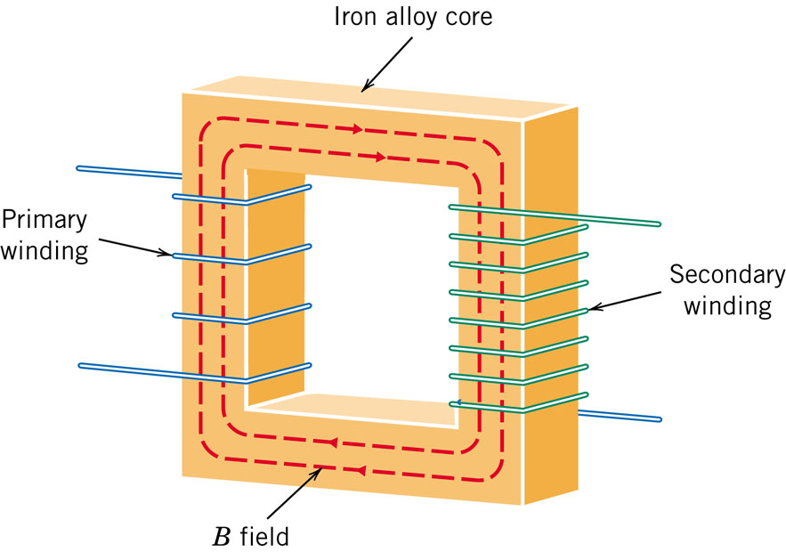
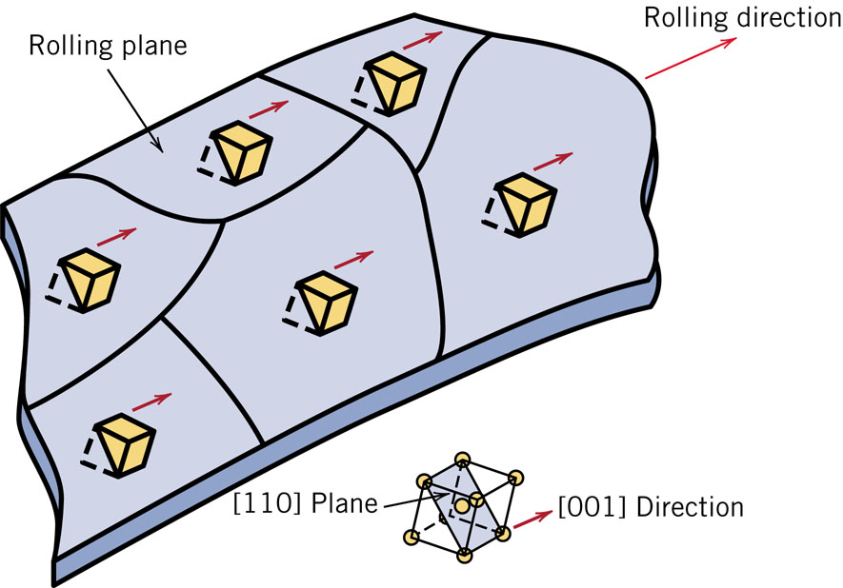
Indexing Crystallographic Planes: Why we need to index?
Transformer cores require soft magnetic materials, which are easily magnetized and de-magnetized, and have high electrical resistivity.
Energy losses in transformers could be minimized if their cores were fabricated such that the easy magnetization direction is parallel to the direction of the applied magnetic field.

Slide 3
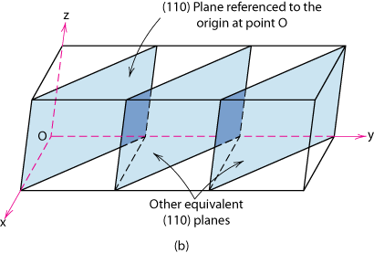
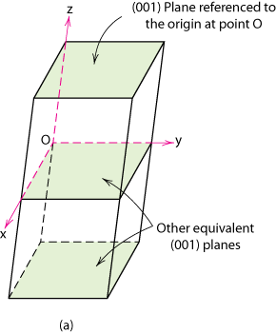
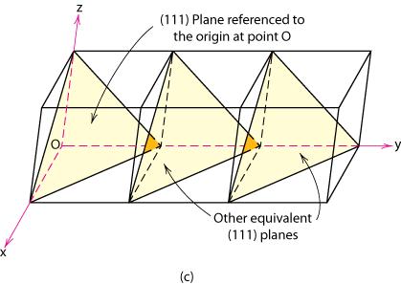
Crystallographic Planes
For cubic crystals, planes and directions having the same indices are perpendicular to one another.

Slide 4
Crystallographic Planes
Miller Indices: Reciprocals of the (three) axial intercepts for a plane, cleared of fractions & common multiples. All parallel planes have same Miller indices.
Algorithm
1a. If the plane passes through the selected origin or doesn't intersect majority of the axes, choose another plane or move the origin.
1b. Read off intercepts of plane with axes in
terms of a, b, c
2. Take reciprocals of intercepts
*3. Reduce to smallest integer values
4. Enclose in parentheses, no commas i.e., (hkl)
*3 On occasion, index reduction is not carried out, as you will see later.

Slide 5
Crystallographic Planes
Example Problem I
z
x y z
1. Relocate origin – not needed
c
2. Intercepts
a b ∞c
3. Reciprocals
1/a 1/b 1/∞c
y
4. Normalize
a/a b/b c/∞c
a
b
1 1 0
5. Reduction
1 1 0
x
6. Miller Indices (110)

Slide 6
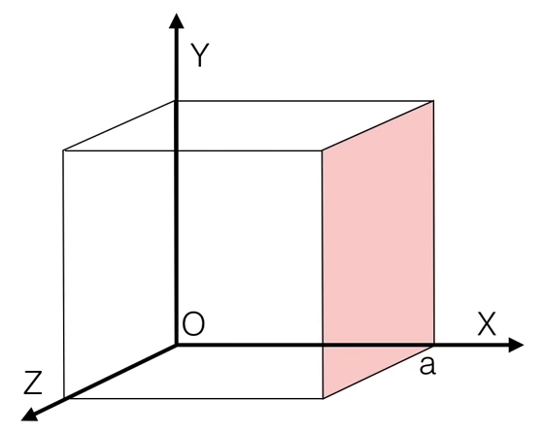

Slide 7
Crystallographic Planes
z
example
a b c
c
1. Intercepts
1 1 ∞
2. Reciprocals
1/1 1/1 1/∞
1 1 0
3. Reduction
1 1 0
y
a
b
4. Miller Indices (110)
x
z
example
a b c
1. Intercepts
1/2 ∞ ∞
c
2. Reciprocals
1/½ 1/∞ 1/∞
2 0 0
3. Reduction, not done
2 0 0
y
4. Miller Indices (200)
a
b
x

Slide 8
Crystallographic Planes
z
example
a b c
c
1. Intercepts
1/2 1 3/4
2. Reciprocals
1/½ 1/1 1/¾
2 1 4/3
y
3. Reduction
6 3 4
a
b
x
4. Miller Indices (634)
Family of Planes {hkl}
Ex: {100} = (100),
(010),
(001),
(100),
(010),
(001)

Slide 9
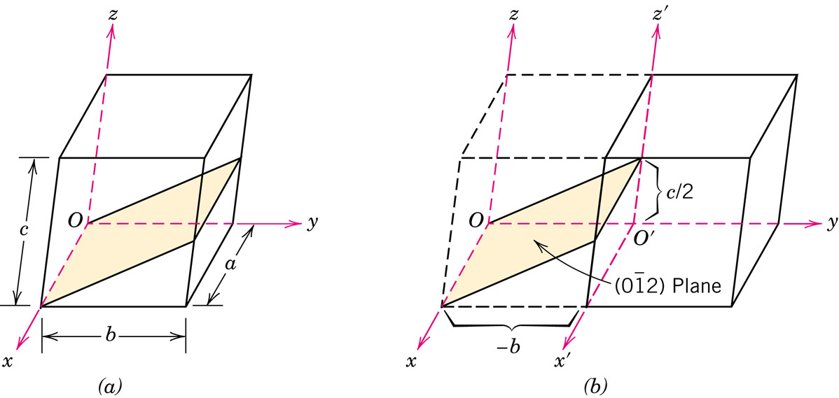
Determine the Miller indices for the plane shown.

Slide 10
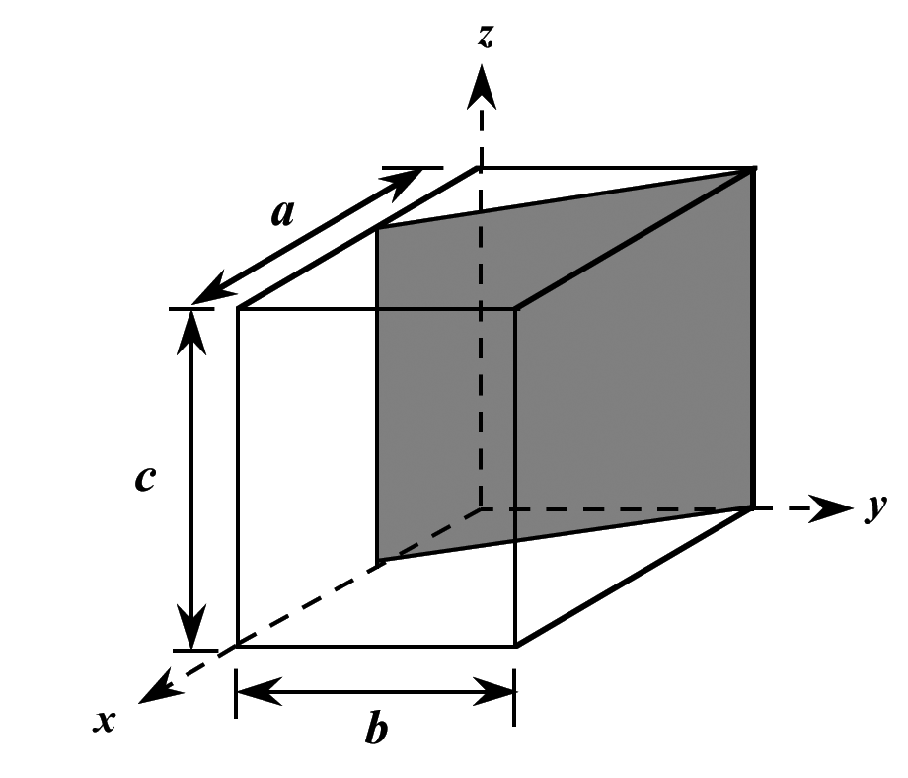
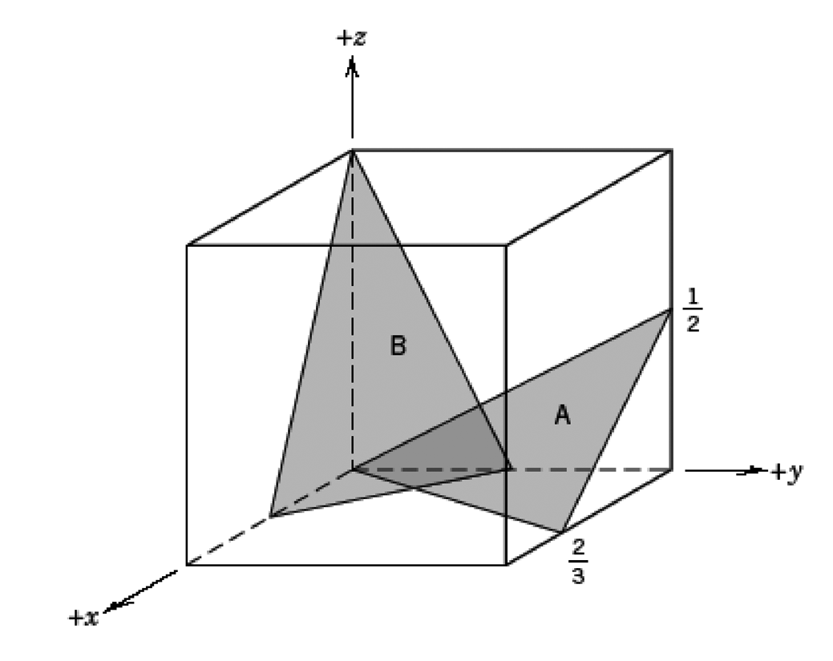

Slide 11
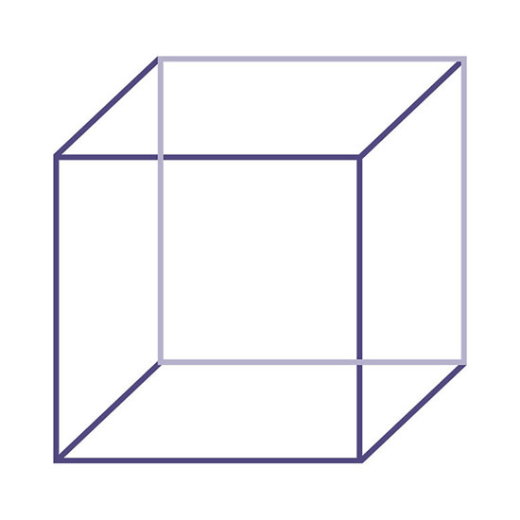
Sketching Planes
Sketch within a cubic unit cell the following plane:($\overline{1}1\overline{1})$

Slide 12
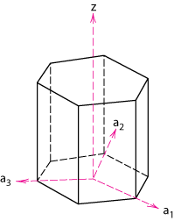
Crystallographic Planes (HCP)
In hexagonal unit cells the same idea is used
z
example
a₁ a₂ a₃ c
1. Intercepts
1 ∞
-1
1
2. Reciprocals
1 1/∞
-1
1
1 0
-1
1
a₂
3. Reduction
1 0
-1
1
a₃
4. Miller-Bravais Indices
(1011)
a₁
Adapted from Fig. 3.8(b), Callister & Rethwisch 8e.

Slide 13
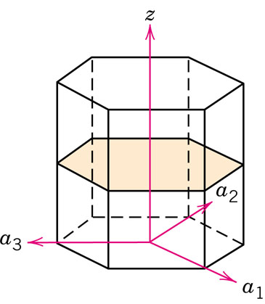
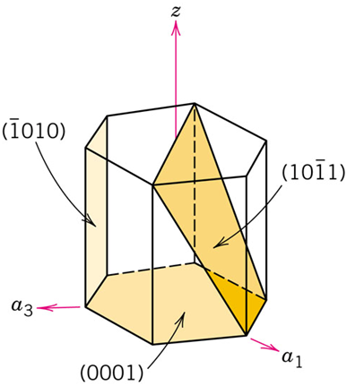
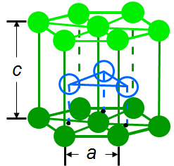
3.50 Determine the indices for the planes shown in the hexagonal unit cells below:

Slide 14
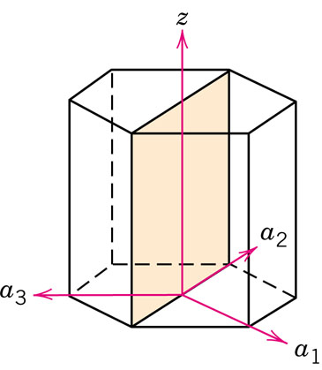
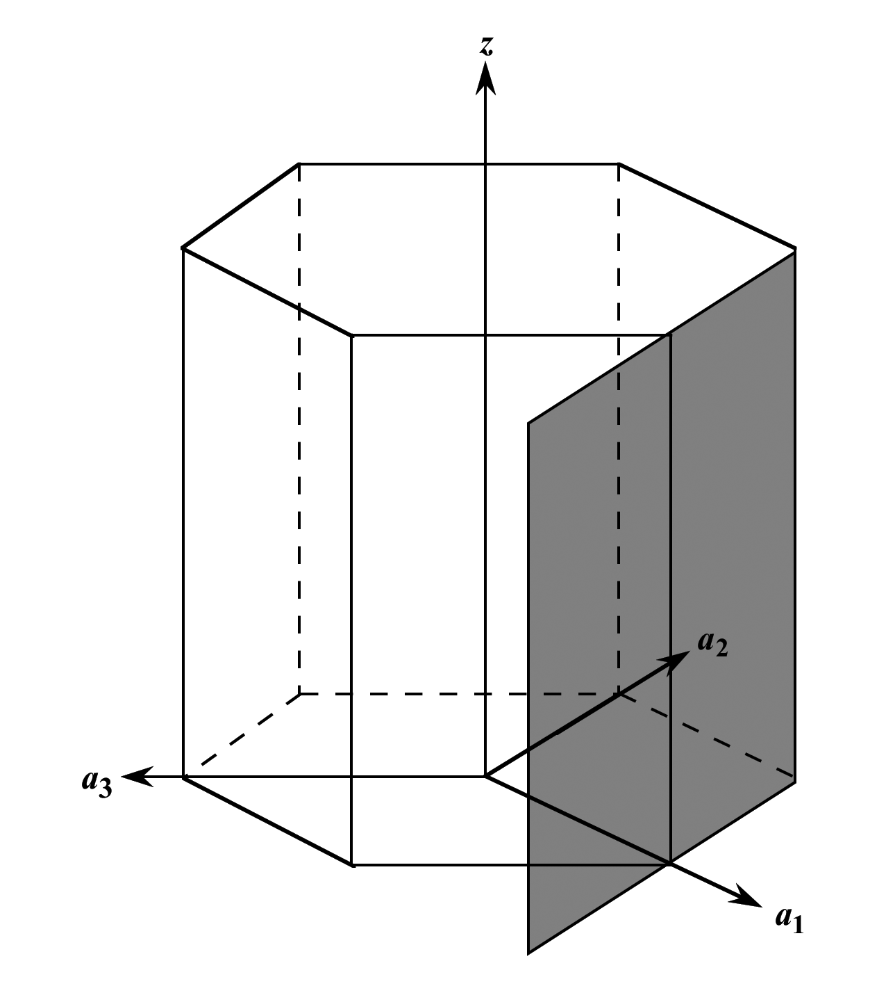
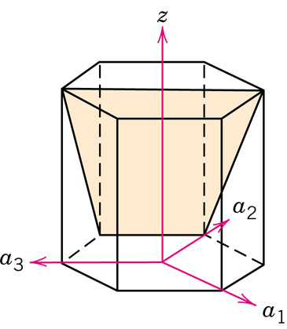
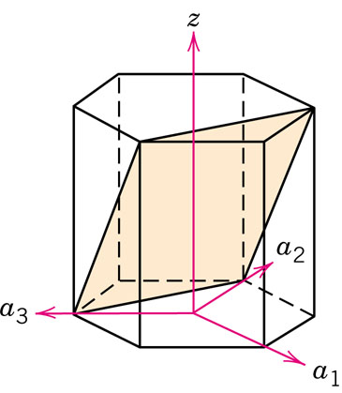
3.50 Determine the indices for the planes shown in the hexagonal unit cells below:

