Slide 1
Chapter 6:
Mechanical Properties
ISSUES TO ADDRESS...
• Stress and strain: What are they and why are
they used instead of load and deformation?
• Elastic behavior: When loads are small, how much
deformation occurs? What materials deform least?
• Plastic behavior: At what point does permanent
deformation occur? What materials are most
resistant to permanent deformation?
• Toughness and ductility: What are they and how
do we measure them?

Slide 2
Elastic Deformation
1. Initial
2. Small load
3. Unload
bonds
stretch
return to
initial
δ
F
F
Linear-
elastic
Elastic means reversible!
Non-Linear-
elastic
δ

Slide 3
Plastic Deformation (Metals)
1. Initial
2. Small load
3. Unload
bonds
stretch
planes
& planes
still
shear
sheared
δ
plastic
δ
elastic + plastic
F
F
Plastic means permanent!
linear
linear
elastic
elastic
δ
δ
plastic
Demo: Hooke’s law experiment

Slide 4
Engineering Stress
• Tensile stress, σ:
• Shear stress, τ:
F
t
F
t
F
Area, A_{o}
F
s
Area, A_{o}
F
s
F
t
F
s
F
t
F
τ
=
F
t
lb
N
σ
=
=
f
or
A
o
A
in
2
m
2
o
original area
∴ Stress has units:
N/m² or lb_{f} /in²
before loading

Slide 5
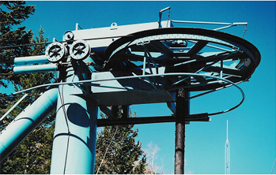
Common States of Stress
• Simple tension: cable
F
F
A
o
= cross sectional
area (when unloaded)
F
σ
=
σ
σ
A
o
• Torsion (a form of shear): drive shaft
Ski lift (photo courtesy P.M. Anderson)
M
F
s
A
o
A
c
F
s
τ
=
A
M
o
2R

Slide 6


OTHER COMMON STRESS STATES (i)
• Simple compression:
A
o
Canyon Bridge, Los Alamos, NM
(photo courtesy P.M. Anderson)
F
Note: compressive
structure member
(σ < 0 here).
σ
=
Balanced Rock, Arches
A
National Park
o
(photo courtesy P.M. Anderson)

Slide 7
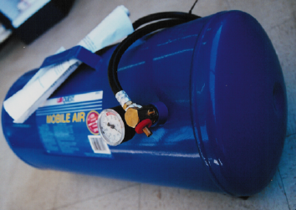
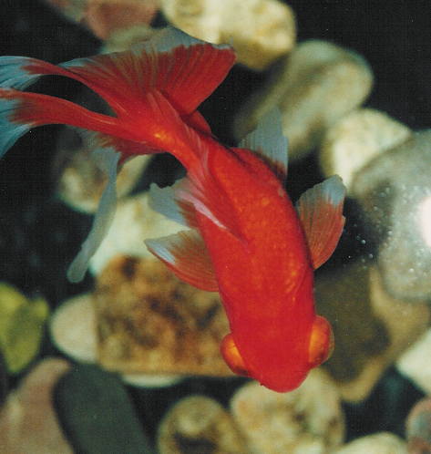
OTHER COMMON STRESS STATES (ii)
• Bi-axial tension:
• Hydrostatic compression:
Pressurized tank
Fish under water
(photo courtesy
P.M. Anderson)
(photo courtesy
P.M. Anderson)
σ
> 0
θ
σ
> 0
σ < 0
z
h

Slide 8
Engineering Strain
• Tensile strain:
• Lateral strain:
δ
/2
δ
−
δ
ε
=
ε
=
L
L
L
L
w
o
w
o
o
o
δ
L
/2
• Shear strain:
θ
Δx
γ = Δx/y = tan
θ
y
90º - θ
Strain is always
dimensionless.
90º
Adapted from Fig. 6.1(a) and (c), Callister & Rethwisch 8e.

Slide 9
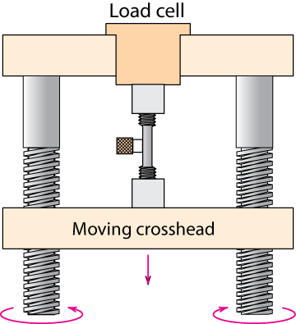
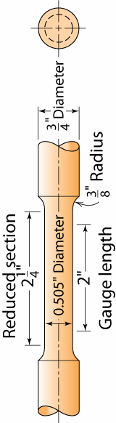
Stress-Strain Testing
• Typical tensile test
machine
• Typical tensile
specimen
Adapted from Fig. 6.2,
Callister & Rethwisch 8e.
extensometer
specimen
gauge
length
Adapted from Fig. 6.3, Callister & Rethwisch 8e. (Fig. 6.3 is taken from H.W. Hayden, W.G. Moffatt, and J. Wulff, The Structure and Properties of Materials, Vol. III, Mechanical Behavior, p. 2, John Wiley and Sons, New York, 1965.)

Slide 10
Linear Elastic Properties
• Modulus of Elasticity, E:
(also known as Young's modulus)
• Hooke's Law:
σ = E ε
σ
F
E
ε
Linear-
elastic
F
simple
tension
test

Slide 11
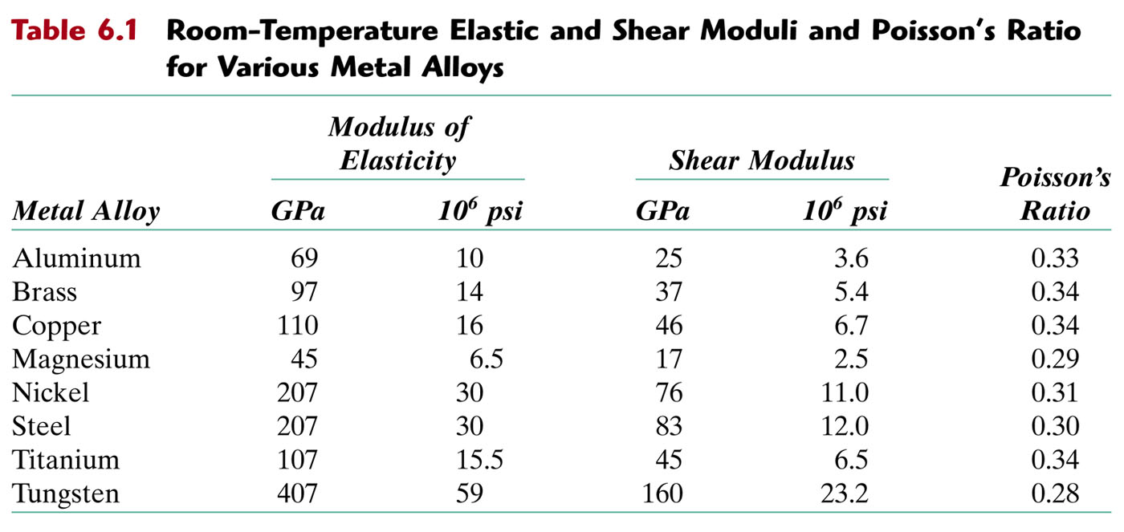
Elastic and Shear Moduli

Slide 12
Problems
6.3 A specimen of aluminum having a rectangular cross section 10 mm × 12.7 mm (0.4 in. × 0.5 in.) is pulled in tension with 35,500 N (8000 lb_{f}) force, producing only elastic deformation. Calculate the resulting strain.
6.5 A steel bar 100 mm (4.0 in.) long and having a square cross section 20 mm (0.8 in.) on an edge is pulled in tension with a load of 89,000 N (20,000 lb_{f}), and experiences an elongation of 0.10 mm (4.0 × 10⁻³ in.). Assuming that the deformation is entirely elastic, calculate the elastic modulus of the steel.

Slide 13
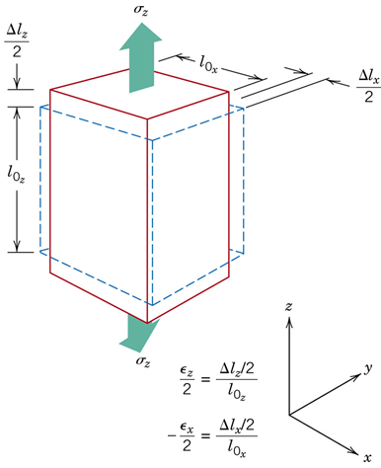

Poisson's ratio, ν
https://www.youtube.com/watch?v=IoYQ1ddT2MU
• Poisson's ratio, ν:
ε_{L}
ε
ν
=
−
L
ε
ε
-ν
metals: ν ~ 0.33
ceramics: ν ~ 0.25
polymers: ν ~ 0.40
  ν > 0.50 density increases
  ν < 0.50 density decreases
  (voids form)

Slide 14
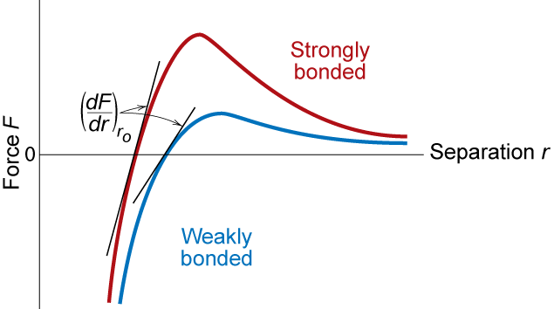
Mechanical Properties
Slope of stress strain plot (which is proportional to the elastic modulus) depends on bond strength of metal
Adapted from Fig. 6.7,
Callister & Rethwisch 8e.

Slide 15
Other Elastic Properties
τ
M
• Elastic Shear
modulus, G:
G
simple
torsion
test
γ
τ = G γ
M
• Elastic Bulk
modulus, K:
P
P
Δ
V
P
P
Δ
V
P = -
K
V
V
o
K
o
pressure
test: Init.
vol =V_{o}.
Vol chg.
= ΔV
• Special relations for isotropic materials:
E
E
G
=
K
=
2(1 + ν)
3(1 − 2ν)

Slide 16
E = 2G (1+ ν)
6.18 A cylindrical specimen of a hypothetical metal alloy is stressed in compression. If its original and final diameters are 20.000 and 20.025 mm, respectively, and its final length is 74.96 mm, compute its original length if the deformation is totally elastic. The elastic and shear moduli for this alloy are 105 GPa and 39.7 GPa, respectively.

Slide 17
Young’s Moduli: Comparison
Metals
Alloys
Graphite
Ceramics
Semicond
Composites
/fibers
Polymers
1200
10
00
Diamond
8
00
6
00
Si carbide
4
00
Tungsten
Al oxide
Carbon
fibers only
E(GPa)
Molybdenum
Si nitride
2
00
Steel, Ni
C
FRE(|| fibers)*
Tantalum
<111>
Platinum
Si crystal
A
ramid fibers only
10
0
Cu alloys
<100>
8
0
Zinc, Ti
Based on data in Table B.2,
Callister & Rethwisch 8e.
Composite data based on
reinforced epoxy with 60 vol%
of aligned
carbon (CFRE),
aramid (AFRE), or
glass (GFRE)
fibers.
Silver, Gold
Glass
-
soda
A
FRE(|| fibers)*
6
0
Aluminum
Glass fibers only
4
0
Magnesium,
G
FRE(|| fibers)*
Tin
10⁹ Pa
Concrete
2
0
GFRE*
CFRE
*
10
G
raphite
G
FRE( fibers)*
8
C
FRE( fibers)
*
6
AFRE( fibers)
*
4
Polyester
PET
PS
Epoxy only
2
PC
PP
1
HDP
E
0.8
0.6
PTF
E
Wood( grain)
0.4
0.2
LDPE

Slide 18
Plastic (Permanent) Deformation
(at lower temperatures, i.e. T < T_{melt}/3)
• Simple tension test:
Elastic+Plastic
engineering stress, σ
at larger stress
Elastic
initially
permanent (plastic)
after load is removed
ε_{p}
engineering strain, ε
plastic strain
Adapted from Fig. 6.10(a),
Callister & Rethwisch 8e.

Slide 19
Yield Strength, σ_{y}
• Stress at which noticeable plastic deformation has
occurred.
when ε_{p} = 0.002
tensile stress,
σ
σ_{y} = yield strength
Note: for 2 inch sample
ε = 0.002 = Δz/z
∴ Δz = 0.004 in
σ_{y}
engineering strain,
ε
ε_{p}
= 0.002
Adapted from Fig. 6.10(a),
Callister & Rethwisch 8e.

Slide 20
Yield Strength : Comparison
Metals/
Graphite/
Composites/
Alloys
Ceramics/
Polymers
fibers
Semicond
2000
Steel
(4140)
qt
1000
Ti
(5Al-2.5Sn)
a
(MPa)
700
W
(pure)
600
Cu
(71500)
cw
500
Mo (pure)
400
Steel
(4140)
a
Room temperature
values
y
Steel
(1020)
cd
σ
300
,
Al
(6061)
ag
200
Steel
(1020)
hr
¨
Ti
(pure)
a
Ta
(pure)
hr
Hard to measure,
Based on data in Table B.4,
Callister & Rethwisch 8e.
a = annealed
hr = hot rolled
ag = aged
cd = cold drawn
cw = cold worked
qt = quenched & tempered
Cu
(71500)
Hard to measure
in tension, fracture usually occurs before yield.
since in tension, fracture usually occurs before yield.
in ceramic matrix and epoxy matrix composites, since
100
Yield strength,
dry
70
PC
60
Al
a
Nylon 6,6
50
(6061)
PET
40
PVC
humid
30
PP
H
DPE
20
Tin (pure)
LDPE
10

Slide 21
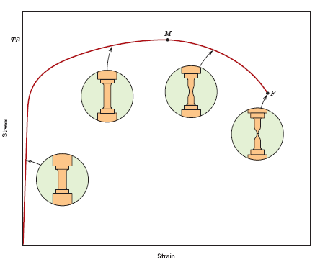
Tensile Strength, TS
• Maximum stress on engineering stress-strain curve.
Adapted from Fig. 6.11, Callister & Rethwisch 8e.
TS
F = fracture or
ultimate
strength
Neck – acts
as stress concentrator
σ_{y}
stress
engineering
Typical response of a metal
strain
engineering strain
• Metals: occurs when noticeable necking starts.
• Polymers: occurs when polymer backbone chains are
aligned and about to break.

Slide 22
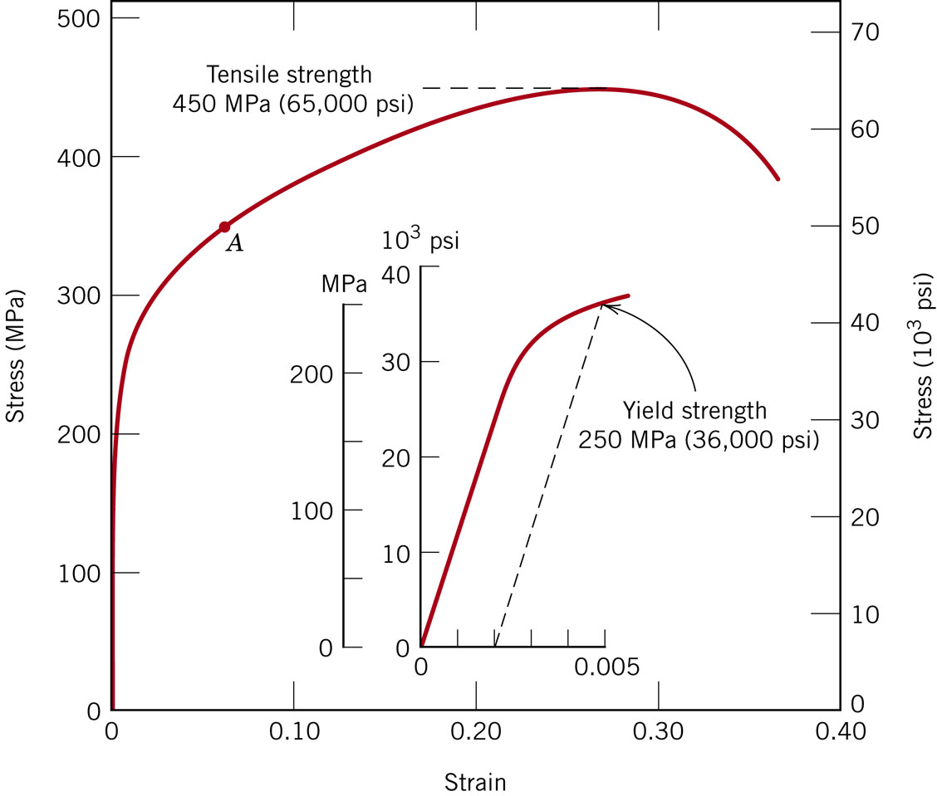
Figure 6.12
From the behavior shown below for a brass specimen, Find:
Modulus of elasticity
Yield strength at a strain
offset of 0.002.
3. Max load by a cylindrical
specimen, dia = 12.8 mm.
4. Change in length of a
specimen, 250 mm long,
subjected to a tensile
stress of 345 MPa.

Slide 23
Tensile Strength: Comparison
Metals/
Graphite/
Composites/
Alloys
Ceramics/
Polymers
fibers
Semicond
5000
C
fibers
3000
Aramid
fib
E-glass fib
2000
Steel
(4140)
qt
(MPa)
A
FRE
(|| fiber)
1000
W
(pure)
a
Diamond
GFRE
(|| fiber)
Ti
(5Al-2.5Sn)
a
C
FRE
(|| fiber)
Steel
(4140)
cw
Si nitride
Cu
(71500)
hr
Cu
(71500)
Al oxide
Room temperature
values
300
Steel
(1020)
Al
(6061)
ag
200
Ti
(pure)
a
Ta
(pure)
Al
(6061)
a
Si crystal
wood(|| fiber)
Based on data in Table B.4,
Callister & Rethwisch 8e.
a = annealed
hr = hot rolled
ag = aged
cd = cold drawn
cw = cold worked
qt = quenched & tempered
AFRE, GFRE, & CFRE =
aramid, glass, & carbon
fiber-reinforced epoxy
composites, with 60 vol%
fibers.
100
<100>
strength, TS
Nylon 6,6
Glass-soda
PC
PET
40
Concrete
PVC
GFRE
( fiber)
30
PP
C
FRE
( fiber)
H
DPE
A
FRE( fiber)
20
Graphite
L
DPE
10
Tensile
wood
( fiber)
1

Slide 24
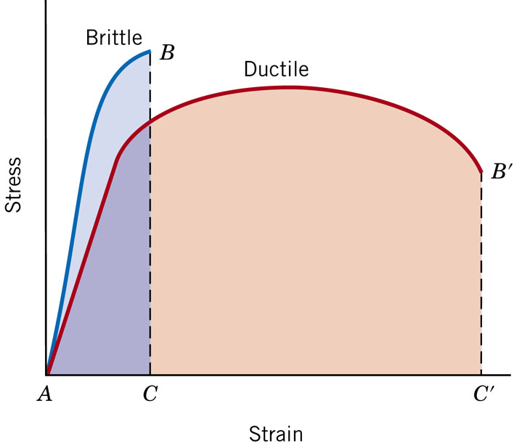
Ductility
Ductility is another important mechanical property.
It is a measure of the degree of plastic deformation that has been sustained at fracture.
If very little or no plastic deformation → brittle.

Slide 25
Ductility
L
−
L
• Plastic tensile strain at failure: (percent elongation)
%
EL
=
f
o
x 100
L
o
smaller %EL
E
ngineering
tensile
stress, σ
larger %EL
A_{o}
L_{o}
A_{f}
L_{f}
Adapted from Fig. 6.13, Callister & Rethwisch 8e.
Engineering tensile strain, ε
A
-
A
• Another ductility measure: (reduction in area)
=
o
f
%
RA
x
100
A
o
In general, for a given material, above two measures of ductility will be different.
https://www.youtube.com/watch?v=MyksI4O26G4

Slide 26
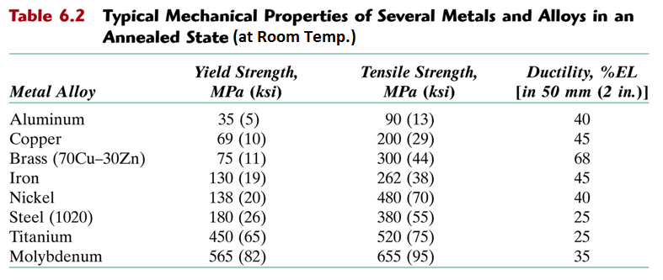

Slide 27
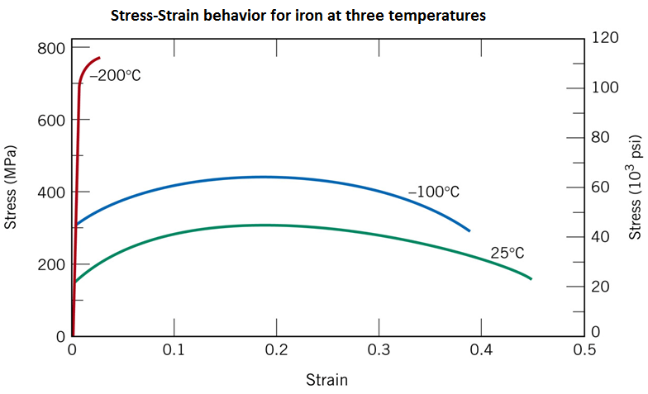
Temperature Dependence
Modulus of elasticity: Temp. Independent
Yield strength & Tensile strength: Decline with temp. increase
Ductility: Increases with temp. increase

Slide 28
Toughness
• Energy to break a unit volume of material
• Approximate by the area under the stress-strain curve.
E
ngineering
small toughness (ceramics)
tensile
large toughness (metals)
stress, σ
Adapted from Fig. 6.13, Callister & Rethwisch 8e.
very small toughness
(unreinforced polymers)
Engineering tensile strain, ε
Brittle fracture: elastic energy
Ductile fracture: elastic + plastic energy

Slide 29
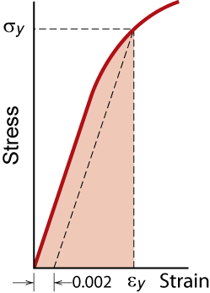
Resilience, U_{r}
Ability of a material to absorb energy during deformation, and recover it upon unloading.
  Energy stored best in elastic region
If we assume a linear stress-strain curve this simplifies to
1
U
≅
σ
ε
r
2
y
y
Adapted from Fig. 6.15, Callister & Rethwisch 8e.
Energy per unit volume.

Slide 30
Elastic Strain Recovery
σ_{yi}
D
σ_{yo}
2. Unload
Stress
1. Load
3. Reapply
load
Strain
Elastic strain
recovery
Adapted from Fig. 6.17, Callister & Rethwisch 8e.
https://www.youtube.com/watch?v=tmwt6Yaj9yk

Slide 31
Summary
• Stress and strain: These are size-independent
measures of load and displacement, respectively.
• Elastic behavior: This reversible behavior often
shows a linear relation between stress and strain.
To minimize deformation, select a material with a
large elastic modulus (E or G).
• Plastic behavior: This permanent deformation
behavior occurs when the tensile (or compressive)
uniaxial stress reaches σ_{y}.
• Toughness: The energy needed to break a unit
volume of material.
• Ductility: The plastic strain at failure.

Slide 32
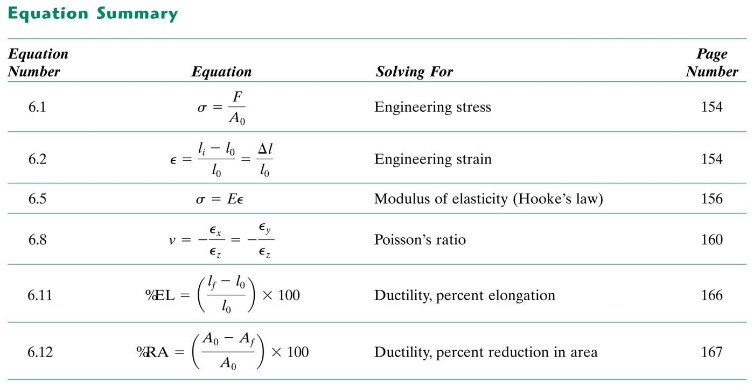
tableun_06_p186
E = 2G (1+ ν)
tableun_06_p186

