Slide 1
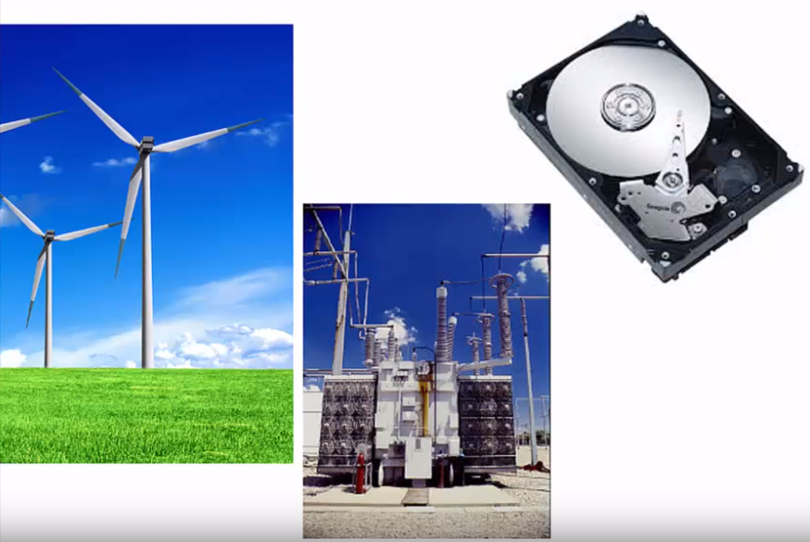
Chap 20: Magnetic Properties
Why study magnetic properties?
Magnetic materials are in the heart of many current technological systems.
Electric generators
Transformers
Hard Disk in a computer
Speakers
Microphones
Electric motors

Slide 2
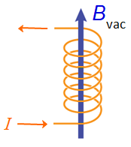
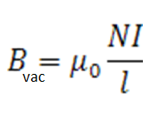
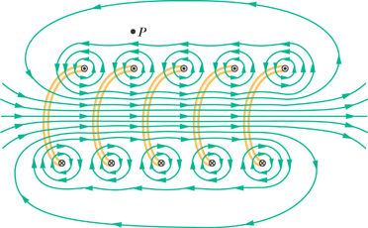
Generation of a Magnetic Field -- Vacuum
• Created by current through a coil:
N = total number of turns
● = length of each turn (m)
I = current (ampere)

Slide 3
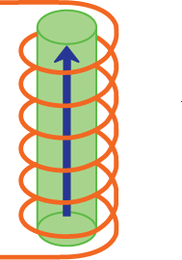

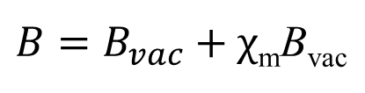
Generation of a Magnetic Field -- within a Solid Material
• A magnetic field is induced in the material
B
B = Magnetic field (tesla)
inside the material
current I
• Relative permeability (dimensionless)
$B=B_{vac}+χ$_{m}B_{vac}
χ_{m} = Magnetic Susceptibility. Measure of a material’s magnetic response.

Slide 4
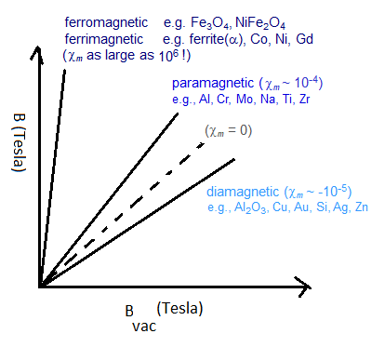
Types of Magnetism

Slide 5
Magnetic Responses for 4 Types
No Applied
Applied
Magnetic Field
Magnetic Field
(1) diamagnetic
none
opposing
Adapted from Fig. 20.5(a), Callister & Rethwisch 8e.
(2) paramagnetic
random
aligned
Adapted from Fig. 20.5(b), Callister & Rethwisch 8e.
(3) ferromagnetic
(4) ferrimagnetic
Adapted from Fig. 20.7, Callister & Rethwisch 8e.
aligned
aligned

Slide 6
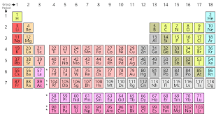
Un paired electrons are necessary for magnetic materials

Slide 7
Origins of Magnetic Moments
• Magnetic moments arise from electron motions and the
spins on electrons.
magnetic moments
electron
electron
nucleus
spin
Adapted from Fig. 20.4, Callister & Rethwisch 8e.
electron orbital
motion
electron spin
• Net atomic magnetic moment:
-- sum of moments from all electrons.

Slide 8
The most fundamental
magnetic moment
Bohr Magneton

Slide 9
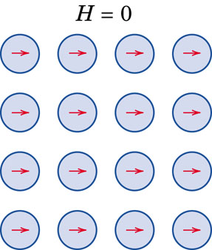
Ferromagnetism
Certain metallic materials possess a permanent magnetic moment in the absence of
an external field and manifest very large and permanent magnetizations. These are
the characteristics of ferromagnetism, and they are displayed by the transition metals
iron (as BCC α-ferrite), cobalt, nickel, and some rare earth metals such as gadolinium
(Gd). Magnetic susceptibilities as high as 10⁶ are possible for ferromagnetic materials.
B = B_{vac} + μ₀M
B = µ₀ M
This mutual spin alignment exists over relatively large-volume regions of the crystal called domains. The maximum possible magnetization, or saturation magnetization, of a ferromagnetic
material represents the magnetization (M) that results when all the magnetic dipoles in a solid piece are mutually aligned with the external field; there is also a corresponding saturation flux density (B).
For each of iron, cobalt, and nickel, the net magnetic moments per atom are 2.22, 1.72, and 0.60 Bohr magnetons, respectively.
Bohr magneton = 9.27 x 10⁻²⁴ A.m²

Slide 10
Iron: 2.2 Bohr Magnetons
Confirm that there are 2.2 Bohr magnetons associated with each iron atom, given that the saturation magnetization is 1.70 × 10⁶ A/m, that iron has a BCC crystal structure, and that the unit cell edge length is 0.2866 nm.

Slide 11
Problem 20.7
Compute (a) the saturation magnetization and (b) the saturation magnetic field for iron, which has a net magnetic moment per atom of 2.2 Bohr magnetons and a density of 7.87 g/cm³. Bohr magneton = 9.27 x 10⁻²⁴ A.m².

Slide 12
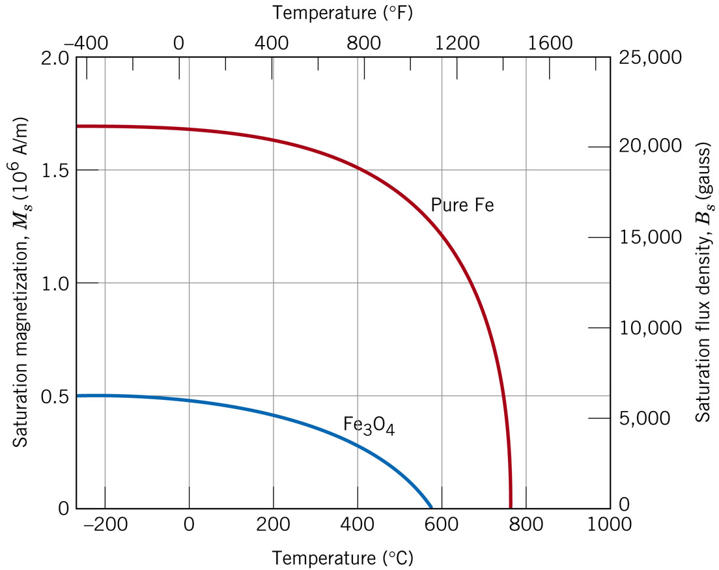
Influence of Temperature on Magnetic Behavior
With increasing temperature, the saturation magnetization diminishes gradually and then abruptly drops to zero at Curie Temperature, Tc.

Slide 13
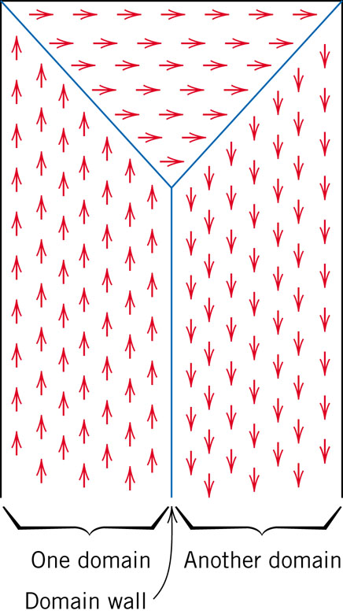
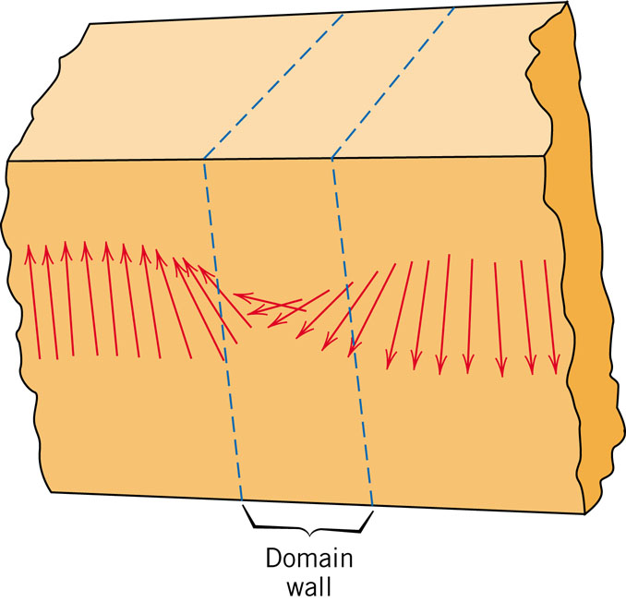
Magnetic Domains

Slide 14
Domains in Ferromagnetic & Ferrimagnetic Materials
• As the applied field (B) increases the magnetic domains
change shape and size by movement of domain boundaries.
B
sat
B
B
Adapted from Fig. 20.13, Callister & Rethwisch 8e. (Fig. 20.13 adapted from O.H. Wyatt and D. Dew-Hughes, Metals, Ceramics, and Polymers, Cambridge University Press, 1974.)
B
• “Domains” with
induction (B)
aligned magnetic
Magnetic
moment grow at
B
expense of poorly
aligned ones!
B
0
Applied Magnetic Field (B)
B= 0

Slide 15
Hysteresis and Permanent Magnetization
• The magnetic hysteresis phenomenon
B
Stage 2. Apply B_{vac},
align domains
Stage 3. Remove B_{vac}, alignment
remains! => permanent magnet!
Adapted from Fig. 20.14, Callister & Rethwisch 8e.
B _{vac}
Stage 4. Coercivity, B_{C}
Negative B_{vac} needed to demagnitize!
Stage 1. Initial (unmagnetized state)
Stage 6. Close the hysteresis loop
Stage 5. Apply
–B _{vac}, align domains

Slide 16
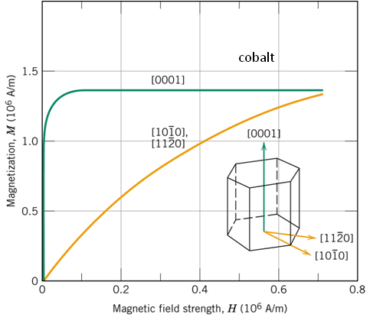
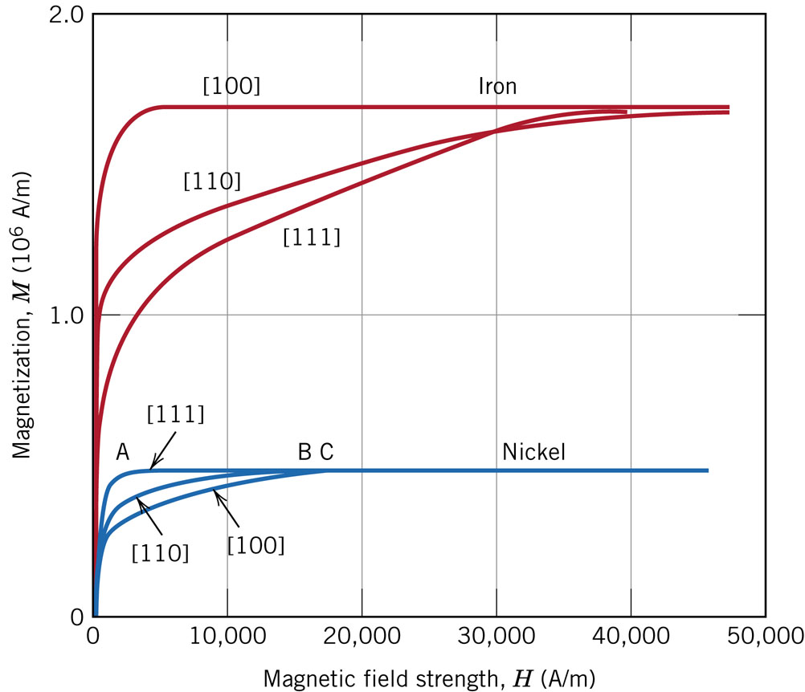

Magnetic Anisotropy
Easy magnetization direction:
Ni- [111], Fe- [100], Co- [0001].
Hard magnetization direction:
Ni- [100], Fe- [111],
Co-

Slide 17
Hard and Soft Magnets
Electric generators:
Hard permanent magnets
Transformers:
Soft permanent magnets
Hard Disk:
In between hard and soft.

Slide 18
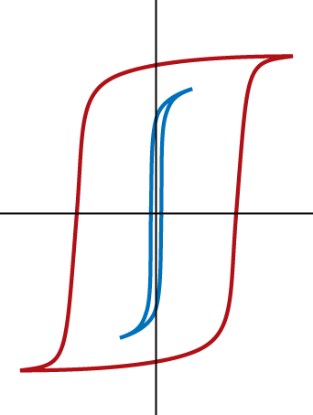
Hard and Soft Magnetic Materials
Hard magnetic materials:
-- large coercivities
-- used for permanent magnets
-- add particles/voids to
inhibit domain wall motion
-- example: tungsten steel --
B_{c} = 5900 amp-turn/m)
B
Hard
Soft
H
Soft magnetic materials:
-- small coercivities
-- used for transformers
-- example: commercial iron 99.95 Fe
Adapted from Fig. 20.19, Callister & Rethwisch 8e. (Fig. 20.19 from K.M. Ralls, T.H. Courtney, and J. Wulff, Introduction to Materials Science and Engineering, John Wiley and Sons, Inc., 1976.)
18
Notes:
18

Slide 19
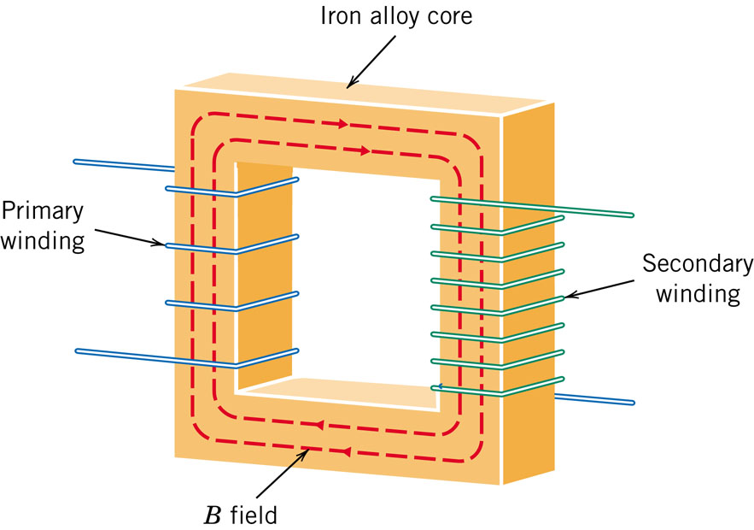
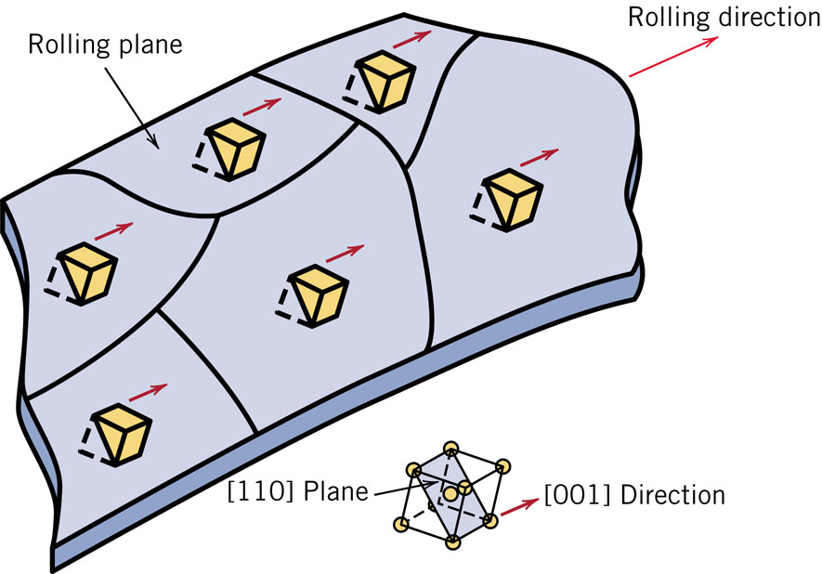
Iron-Silicon Alloy (97 wt% Fe – 3 wt% Si) in Transformer Cores
Transformer cores require soft magnetic materials, which are easily magnetized and de-magnetized, and have high electrical resistivity.
Energy losses in transformers could be minimized if their cores were fabricated such that the easy magnetization direction is parallel to the direction of the applied magnetic field.

Slide 20
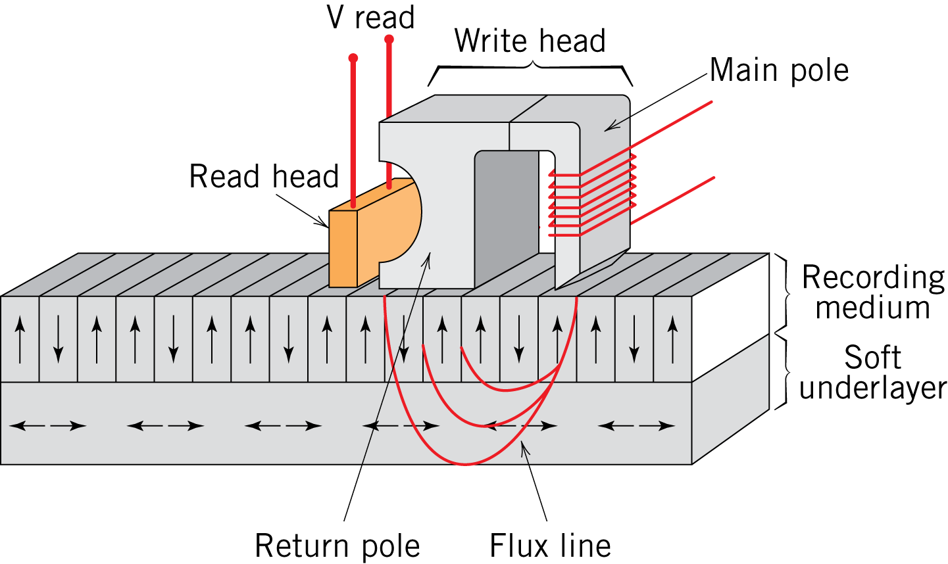
Magnetic Storage
• Digitized data in the form of electrical signals are transferred to
and recorded digitally on a magnetic medium (tape or disk)
• This transference is accomplished by a recording system that
consists of a read/write head
-- “write” or record data by applying a
magnetic field that aligns domains
in small regions of the recording
medium
-- “read” or retrieve data from
medium by sensing changes
in magnetization
Fig. 20.23, Callister & Rethwisch 8e.
http://www.ehow.com/how-does_4968711_solid-state-hard-drives-work.html

Slide 21
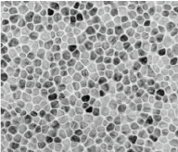
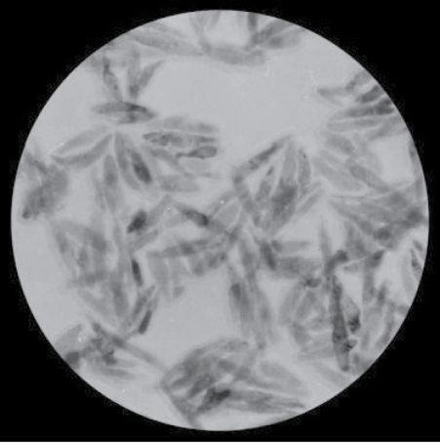
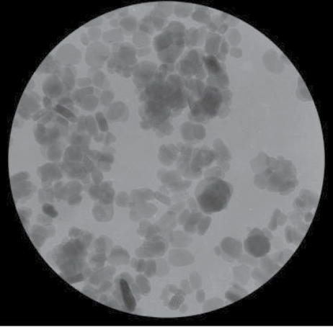
Magnetic Storage Media Types
• Hard disk drives (granular/perpendicular media):
-- CoCr alloy grains (darker regions)
separated by oxide grain boundary
segregant layer (lighter regions)
-- Magnetization direction of each
grain is perpendicular to plane of
disk
Fig. 20.25, Callister & Rethwisch 8e. (Fig. 20.25 from Seagate Recording Media)
80 nm
• Recording tape (particulate media):
Fig. 20.24, Callister & Rethwisch 8e. (Fig. 20.24 courtesy Fuji Film Inc., Recording Media Division)
~ 500 nm
~ 500 nm
-- Acicular (needle-shaped)
ferromagnetic metal alloy
particles
-- Tabular (plate-shaped)
ferrimagnetic barium-ferrite
particles

Slide 22
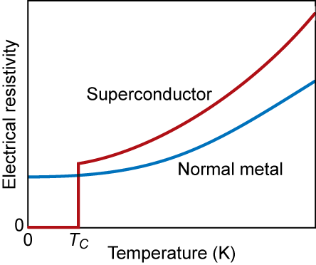
Superconductivity
Found in 26 metals and hundreds of alloys & compounds
Mercury
Copper (normal)
4.2 K
Fig. 20.26, Callister & Rethwisch 8e.
T_{C} = critical temperature
= temperature below which material is superconductive

Slide 23
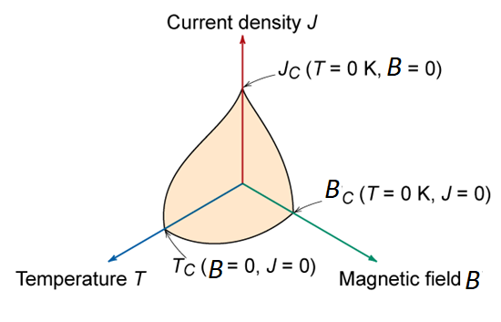

Critical Properties of Superconductive Materials
T_{C} = critical temperature - if T > T_{C} not superconducting
J_{C} = critical current density - if J > J_{C} not superconducting
B_{C} = critical magnetic field - if B > B_{C} not superconducting
Fig. 20.27, Callister & Rethwisch 8e.

Slide 24
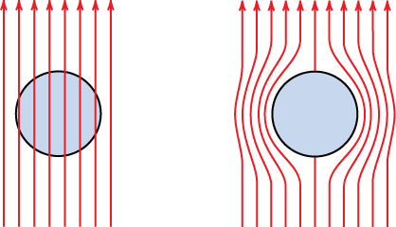
Meissner Effect
Superconductors expel magnetic fields
This is why a superconductor will float above a magnet
normal
superconductor
Fig. 20.28, Callister & Rethwisch 8e.

Slide 25
Advances in Superconductivity
Research in superconductive materials was stagnant for many years.
  Everyone assumed T_{C,max} was about 23 K
  Many theories said it was impossible to increase T_{C} beyond this value
1987- new materials were discovered with T_{C} > 30 K
  ceramics of form Ba_{1-x} K_{x} BiO_{3-y}
  Started enormous race
    Y Ba₂Cu₃O_{7-x} T_{C} = 90 K
    Tl₂Ba₂Ca₂Cu₃O_{x} T_{C} = 122 K
    difficult to make since oxidation state is very important
The major problem is that these ceramic materials are inherently brittle.
Notes:
Suddenly everyone was doing superconductivity. Everyone was doing similar work, making discoveries, & rushing to publish so they could claim to have done it first. Practically, daily new high temp. records were set.

Slide 26
Summary
• A magnetic field is produced when a current flows
through a wire coil.
• Magnetic induction (B):
-- an internal magnetic field is induced in a material that is
situated within an external magnetic field
-- magnetic moments result from electron interactions with
the applied magnetic field
• Types of material responses to magnetic fields are:
-- ferrimagnetic and ferromagnetic (large magnetic susceptibilities)
-- paramagnetic (small and positive magnetic susceptibilities)
-- diamagnetic (small and negative magnetic susceptibilities)
• Types of ferrimagnetic and ferromagnetic materials:
-- Hard: large coercivities
-- Soft: small coercivities
• Magnetic storage media:
-- particulate barium-ferrite in polymeric film (tape)
-- thin film Co-Cr alloy (hard drive)

