Slide 1
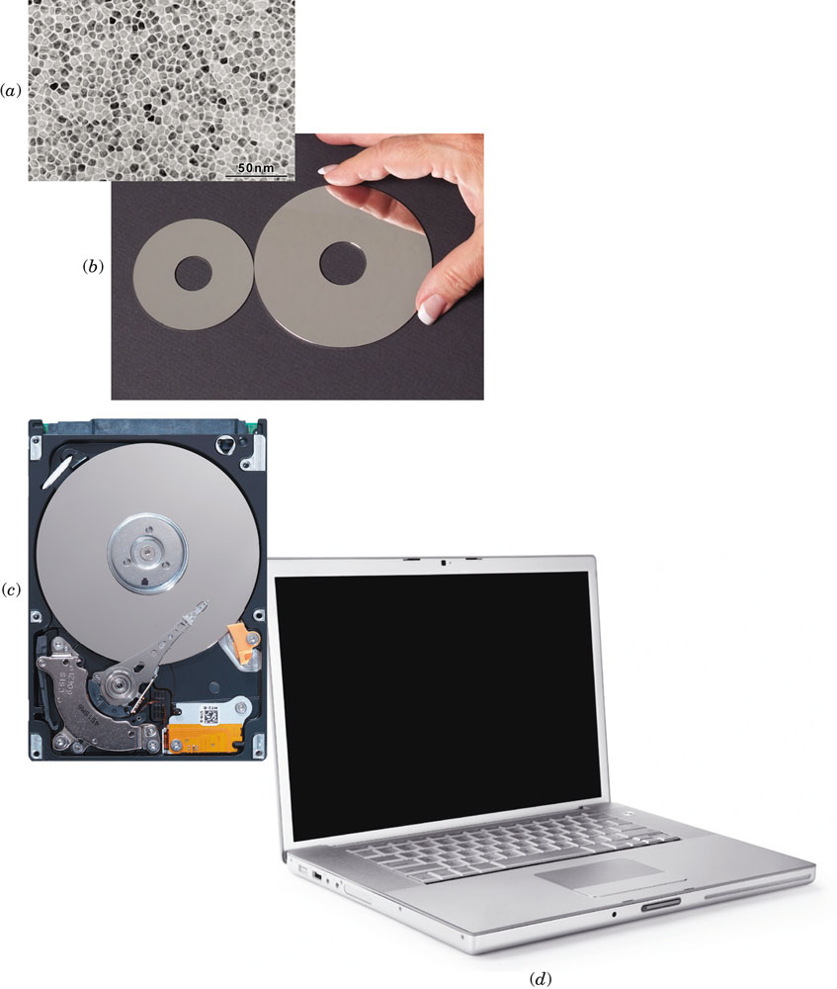
Chap 20: Magnetic Properties
a) Transmission electron micrograph showing the microstructure of the perpendicular magnetic recording medium used in hard-disk drives.
b) Magnetic storage hard disks used in laptop (left) and desktop (right) computers.
c) Inside of a hard disk drive.
d) Laptop computer

Slide 2
Chapter 20: Magnetic Properties
ISSUES TO ADDRESS...
• What are the important magnetic properties?
• How do we explain magnetic phenomena?
• How are magnetic materials classified?
• How does magnetic memory storage work?
• What is superconductivity and how do magnetic
fields effect the behavior of superconductors?

Slide 3


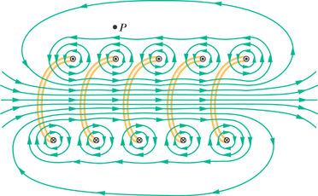
Generation of a Magnetic Field -- Vacuum
• Created by current through a coil:
B
N = total number of turns
● = length of each turn (m)
I = current (ampere)
B = magnetic field (tesla)
I

Slide 4
Generation of a Magnetic Field -- Vacuum
• Created by current through a coil:
B₀
N = total number of turns
● = length of each turn (m)
I = current (ampere)
H
H = applied magnetic field (ampere-turns/m)
B₀ = magnetic flux density in a vacuum
(tesla)
I
• Computation of the applied magnetic field, H:
• Computation of the magnetic flux density in a vacuum, B₀:
B₀ = μ₀H
permeability of a vacuum
(1.257 x 10⁻⁶ Henry/m)

Slide 5
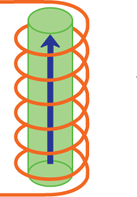
Generation of a Magnetic Field -- within a Solid Material
• A magnetic field is induced in the material
B
B = Magnetic Induction (tesla)
inside the material
applied
magnetic field H
B = μH
permeability of a solid
current I
• Relative permeability (dimensionless)

Slide 6
Generation of a Magnetic Field -- within a Solid Material (cont.)
• Magnetization
M = χ_{m}H
Magnetic susceptibility
(dimensionless)
• B in terms of H and M
B = μ₀H + μ₀M
• Combining the above two equations:
B = μ₀H + μ₀ χ_{m}H
B
χ_{m}
> 0
= (1 + χ_{m})μ₀H
vacuum χ_{m} = 0
permeability of a vacuum:
(1.26 x 10⁻⁶ Henry/m)
χ_{m}
< 0
χ_{m} is a measure of a material’s magnetic response relative to a vacuum
H

Slide 7
20.1 A coil of wire 0.20 m long and having 200 turns carries a current of 10 A.
(a) What is the magnitude of the magnetic field strength H?
(b) Compute the flux density B if the coil is in a vacuum.
(c) Compute the flux density inside a bar of titanium that is positioned within the coil. The susceptibility for titanium is found in Table 20.2. 1.81 x 10^(-4)
(d) Compute the magnitude of the magnetization M.

Slide 8
Origins of Magnetic Moments
• Magnetic moments arise from electron motions and the
spins on electrons.
magnetic moments
electron
electron
nucleus
spin
electron orbital
motion
electron spin
Fundamental magnetic moment:
Bohr magneton = 9.27 x 10⁻²⁴ A.m²
• Net atomic magnetic moment:
-- sum of moments from all electrons.
• Four types of response...

Slide 9
Types of Magnetism
(3) ferromagnetic e.g. Fe₃O₄, NiFe₂O₄
(4) ferrimagnetic e.g. ferrite(α), Co, Ni, Gd
(
χ_{m}
as large as
10⁶
!)
B (tesla)
χ_{m}
(2) paramagnetic (
e.g., Al, Cr, Mo, Na, Ti, Zr
~ 10⁻⁴)
vacuum
(
χ_{m}
= 0)
(1) diamagnetic (
χ_{m}
~ -10⁻⁵)
e.g., Al₂O₃, Cu, Au, Si, Ag, Zn
H (ampere-turns/m)
Plot adapted from Fig. 20.6, Callister & Rethwisch 8e. Values and materials from Table 20.2 and discussion in Section 20.4, Callister & Rethwisch 8e.

Slide 10
Magnetic Responses for 4 Types
No Applied
Applied
Magnetic Field (H = 0)
Magnetic Field (H)
(1) diamagnetic
none
opposing
Adapted from Fig. 20.5(a), Callister & Rethwisch 8e.
(2) paramagnetic
random
aligned
Adapted from Fig. 20.5(b), Callister & Rethwisch 8e.
(3) ferromagnetic
(4) ferrimagnetic
Adapted from Fig. 20.7, Callister & Rethwisch 8e.
aligned
aligned

Slide 11
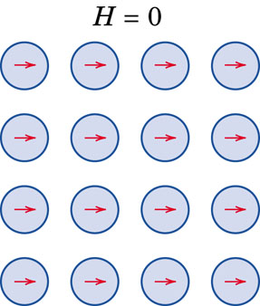
Ferromagnetism
Certain metallic materials possess a permanent magnetic moment in the absence of
an external field and manifest very large and permanent magnetizations. These are
the characteristics of ferromagnetism, and they are displayed by the transition metals
iron (as BCC α-ferrite), cobalt, nickel, and some rare earth metals such as gadolinium
(Gd). Magnetic susceptibilities as high as 106 are possible for ferromagnetic materials, H<<M.
B = μ₀H + μ₀M
B = µ₀ M
This mutual spin alignment exists over relatively large-volume regions of the crystal called domains. The maximum possible magnetization, or saturation magnetization, of a ferromagnetic
material represents the magnetization (M) that results when all the magnetic dipoles in a solid piece are mutually aligned with the external field; there is also a corresponding saturation flux density (B).
For each of iron, cobalt, and nickel, the net magnetic moments per atom are 2.22, 1.72, and 0.60 Bohr magnetons, respectively.
Bohr magneton = 9.27 x 10⁻²⁴ A.m²

Slide 12
Problem 20.7
Compute (a) the saturation magnetization and (b) the saturation flux density for iron, which has a net magnetic moment per atom of 2.2 Bohr magnetons and a density of 7.87 g/cm³. Bohr magneton = 9.27 x 10⁻²⁴ A.m².

Slide 13
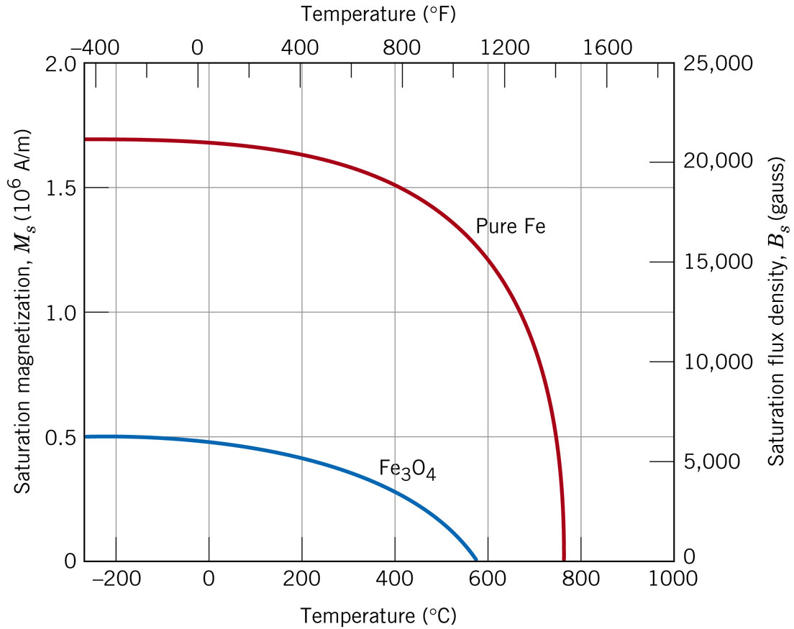
Influence of Temperature on Magnetic Behavior
With increasing temperature, the saturation magnetization diminishes gradually and then abruptly drops to zero at Curie Temperature, Tc.

Slide 14
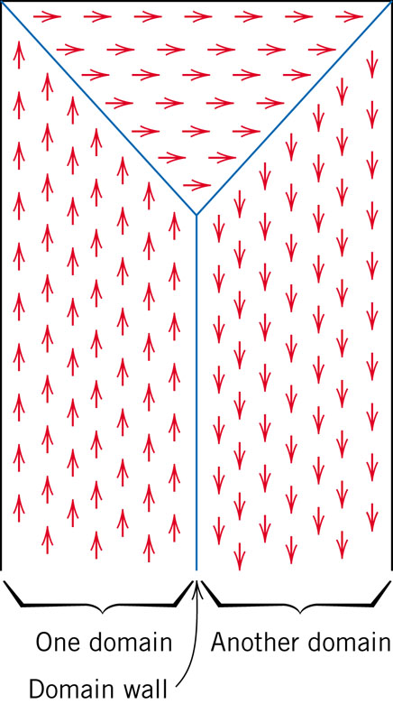
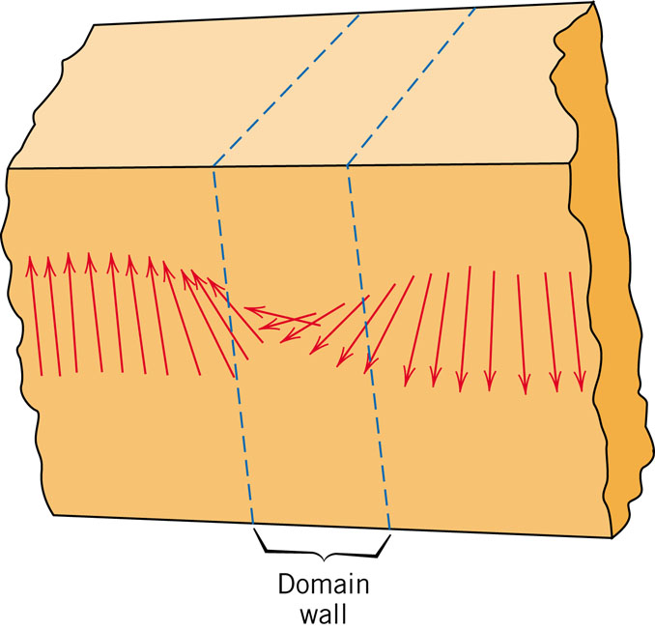
Magnetic Domains

Slide 15
Domains in Ferromagnetic & Ferrimagnetic Materials
• As the applied field (H) increases the magnetic domains
change shape and size by movement of domain boundaries.
B
sat
H
H
Adapted from Fig. 20.13, Callister & Rethwisch 8e. (Fig. 20.13 adapted from O.H. Wyatt and D. Dew-Hughes, Metals, Ceramics, and Polymers, Cambridge University Press, 1974.)
H
• “Domains” with
induction (B)
aligned magnetic
Magnetic
moment grow at
H
expense of poorly
aligned ones!
H
0
Applied Magnetic Field (H)
H = 0

Slide 16
Hysteresis and Permanent Magnetization
• The magnetic hysteresis phenomenon
B
Stage 2. Apply H,
align domains
Stage 3. Remove H, alignment
remains! => permanent magnet!
Adapted from Fig. 20.14, Callister & Rethwisch 8e.
H
Stage 4. Coercivity, H_{C}
Negative H needed to demagnitize!
Stage 1. Initial (unmagnetized state)
Stage 6. Close the hysteresis loop
Stage 5. Apply -H, align domains

Slide 17
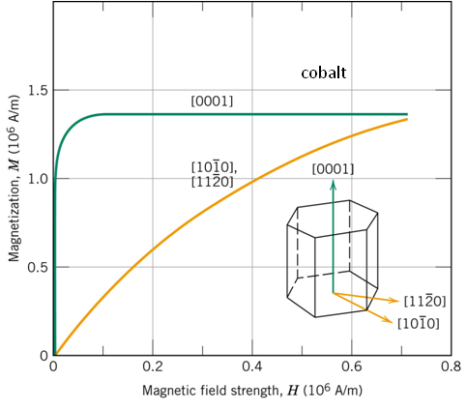
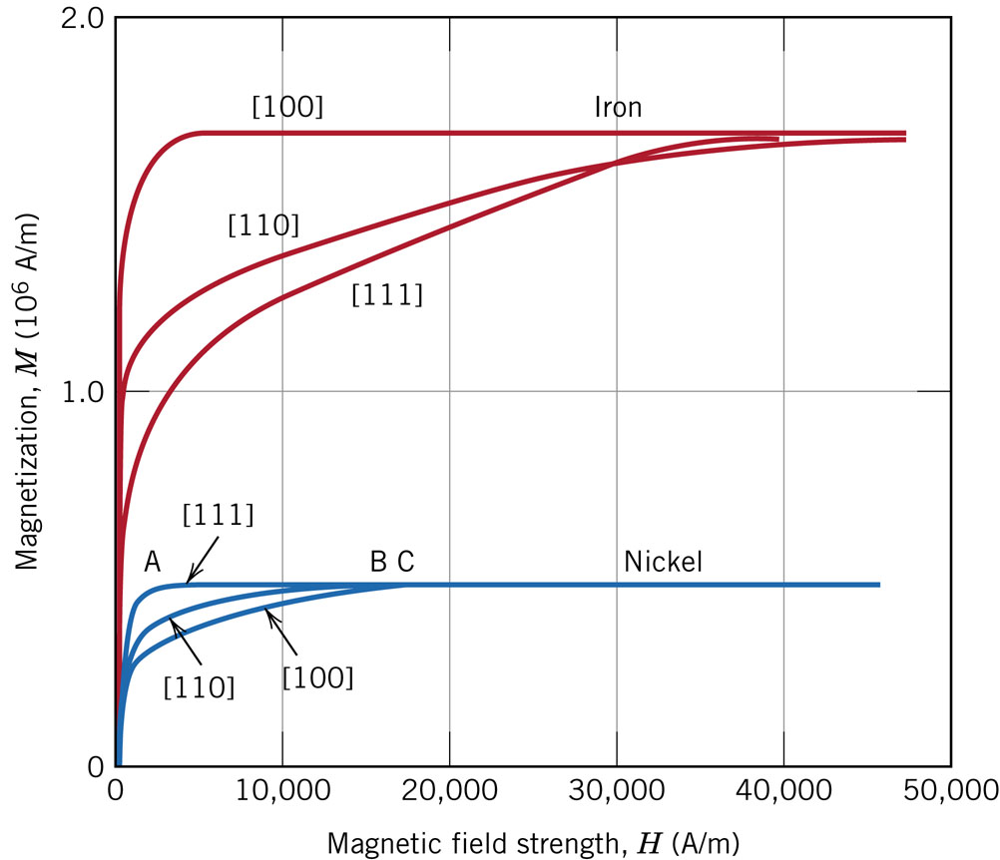

Magnetic Anisotropy
Easy magnetization direction:
Ni- [111], Fe- [100], Co- [0001].
Hard magnetization direction:
Ni- [100], Fe- [111],
Co-

Slide 18
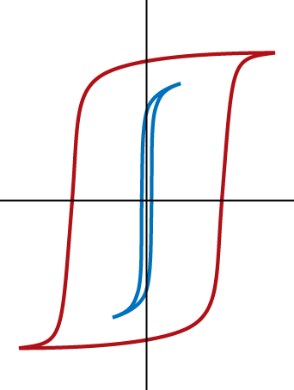
Hard and Soft Magnetic Materials
Hard magnetic materials:
-- large coercivities
-- used for permanent magnets
-- add particles/voids to
inhibit domain wall motion
-- example: tungsten steel --
H_{c} = 5900 amp-turn/m)
B
Hard
Soft
H
Soft magnetic materials:
-- small coercivities
-- used for transformers & electric motors
-- example: commercial iron 99.95 Fe
Adapted from Fig. 20.19, Callister & Rethwisch 8e. (Fig. 20.19 from K.M. Ralls, T.H. Courtney, and J. Wulff, Introduction to Materials Science and Engineering, John Wiley and Sons, Inc., 1976.)
18
Notes:
18

Slide 19
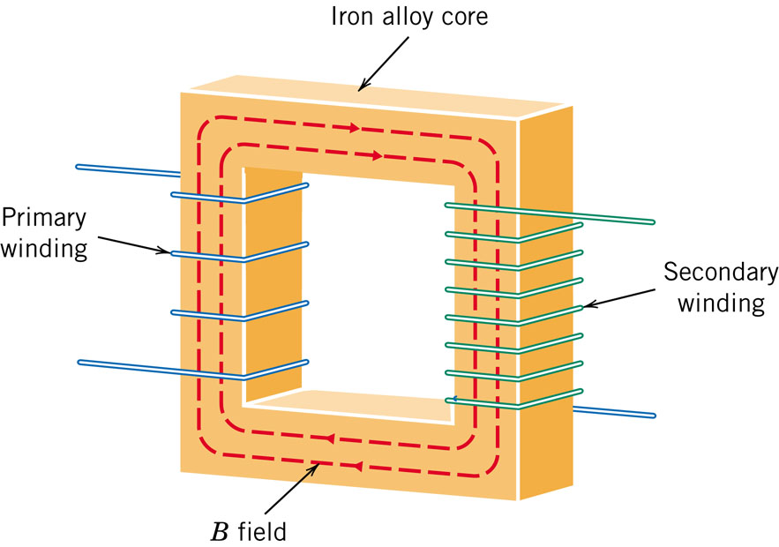
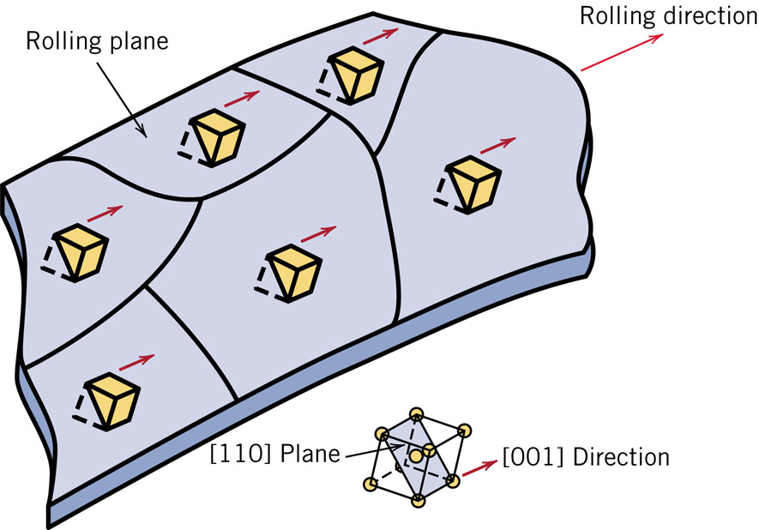
Iron-Silicon Alloy (97 wt% Fe – 3 wt% Si) in Transformer Cores
Transformer cores require soft magnetic materials, which are easily magnetized and de-magnetized, and have high electrical resistivity.
Energy losses in transformers could be minimized if their cores were fabricated such that the easy magnetization direction is parallel to the direction of the applied magnetic field.

Slide 20
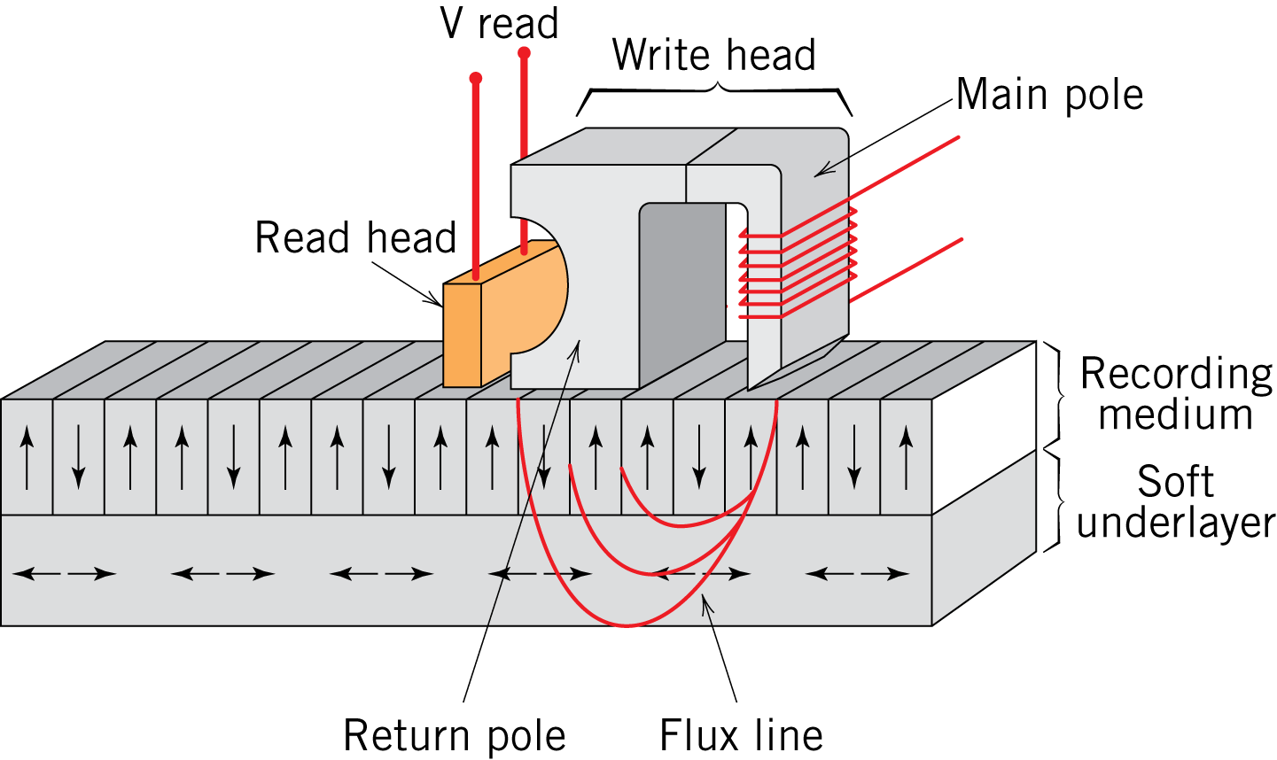
Magnetic Storage
• Digitized data in the form of electrical signals are transferred to
and recorded digitally on a magnetic medium (tape or disk)
• This transference is accomplished by a recording system that
consists of a read/write head
-- “write” or record data by applying a
magnetic field that aligns domains
in small regions of the recording
medium
-- “read” or retrieve data from
medium by sensing changes
in magnetization
https://www.youtube.com/watch?v=f3BNHhfTsvk
Fig. 20.23, Callister & Rethwisch 8e.
http://www.ehow.com/how-does_4968711_solid-state-hard-drives-work.html

Slide 21
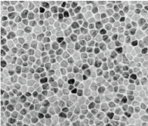
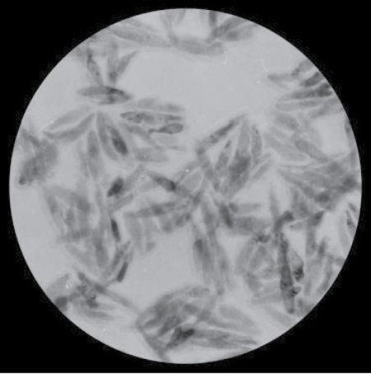
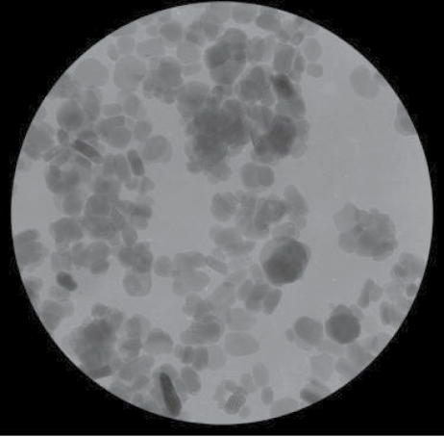
Magnetic Storage Media Types
• Hard disk drives (granular/perpendicular media):
-- CoCr alloy grains (darker regions)
separated by oxide grain boundary
segregant layer (lighter regions)
-- Magnetization direction of each
grain is perpendicular to plane of
disk
Fig. 20.25, Callister & Rethwisch 8e. (Fig. 20.25 from Seagate Recording Media)
80 nm
• Recording tape (particulate media):
Fig. 20.24, Callister & Rethwisch 8e. (Fig. 20.24 courtesy Fuji Film Inc., Recording Media Division)
~ 500 nm
~ 500 nm
-- Acicular (needle-shaped)
ferromagnetic metal alloy
particles
-- Tabular (plate-shaped)
ferrimagnetic barium-ferrite
particles

Slide 22
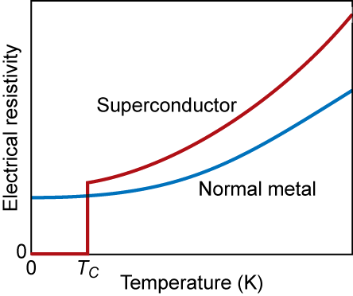
Superconductivity
Found in 26 metals and hundreds of alloys & compounds
Mercury
Copper (normal)
4.2 K
Fig. 20.26, Callister & Rethwisch 8e.
T_{C} = critical temperature
= temperature below which material is superconductive

Slide 23
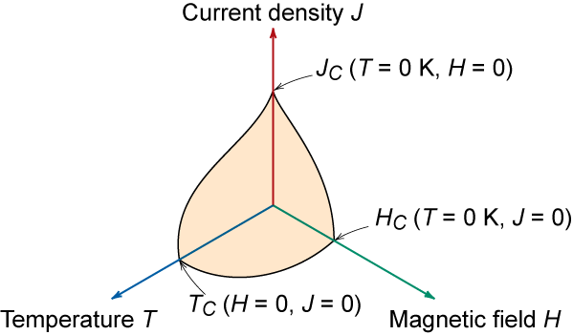
Critical Properties of Superconductive Materials
T_{C} = critical temperature - if T > T_{C} not superconducting
J_{C} = critical current density - if J > J_{C} not superconducting
H_{C} = critical magnetic field - if H > H_{C} not superconducting
Fig. 20.27, Callister & Rethwisch 8e.

Slide 24
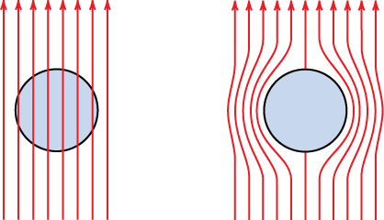
Meissner Effect
Superconductors expel magnetic fields
This is why a superconductor will float above a magnet
normal
superconductor
Fig. 20.28, Callister & Rethwisch 8e.

Slide 25
Advances in Superconductivity
Research in superconductive materials was stagnant for many years.
  Everyone assumed T_{C,max} was about 23 K
  Many theories said it was impossible to increase T_{C} beyond this value
1987- new materials were discovered with T_{C} > 30 K
  ceramics of form Ba_{1-x} K_{x} BiO_{3-y}
  Started enormous race
    Y Ba₂Cu₃O_{7-x} T_{C} = 90 K
    Tl₂Ba₂Ca₂Cu₃O_{x} T_{C} = 122 K
    difficult to make since oxidation state is very important
The major problem is that these ceramic materials are inherently brittle.
Notes:
Suddenly everyone was doing superconductivity. Everyone was doing similar work, making discoveries, & rushing to publish so they could claim to have done it first. Practically, daily new high temp. records were set.

Slide 26
Summary
• A magnetic field is produced when a current flows
through a wire coil.
• Magnetic induction (B):
-- an internal magnetic field is induced in a material that is
situated within an external magnetic field (H).
-- magnetic moments result from electron interactions with
the applied magnetic field
• Types of material responses to magnetic fields are:
-- ferrimagnetic and ferromagnetic (large magnetic susceptibilities)
-- paramagnetic (small and positive magnetic susceptibilities)
-- diamagnetic (small and negative magnetic susceptibilities)
• Types of ferrimagnetic and ferromagnetic materials:
-- Hard: large coercivities
-- Soft: small coercivities
• Magnetic storage media:
-- particulate barium-ferrite in polymeric film (tape)
-- thin film Co-Cr alloy (hard drive)

