Slide 1
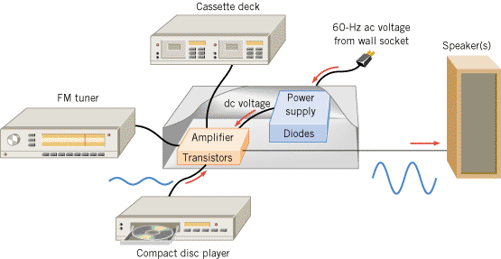
Semiconductor Devices
In a typical audio system, diodes are used in the power supply to create a dc voltage from the ac voltage present at the wall socket. This dc voltage is necessary so the transistors in the amplifier can perform their task of enlarging the small ac voltages originating in the compact disc player, etc.

Slide 2
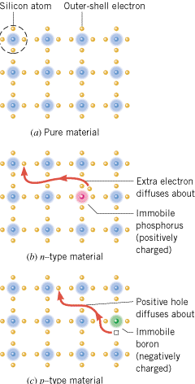
n-TYPE AND p-TYPE SEMICONDUCTORS
A silicon crystal that is (a) undoped, or pure,
(b) doped with phosphorus to produce an n-type material, and
(c) doped with boron to produce a p-type material.

Slide 3
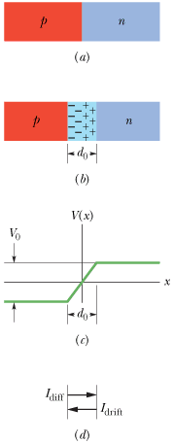
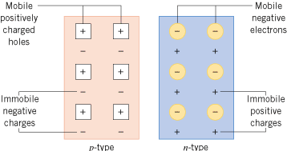
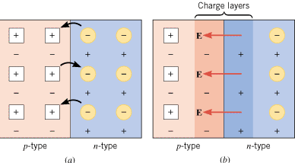
THE SEMICONDUCTOR DIODE
A p-n junction diode is a device formed from a p-type semiconductor and an n-type semiconductor. The p-n junction between the two materials is of fundamental importance to the operation of diodes and transistors.

Slide 4
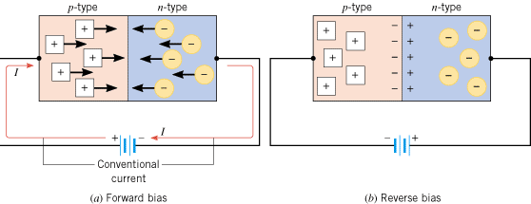
Forward and Reverse Bias
(a) There is an appreciable current through the diode when the diode is forward biased. (b) Under a reverse bias condition, there is almost no current through the diode.

Slide 5
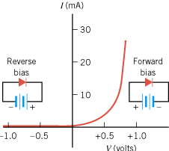
The current-versus-voltage characteristics of a typical p-n junction diode

Slide 6
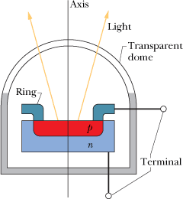
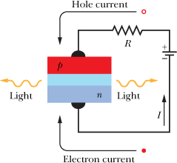
LED, light-emitting diode
A forward-biased p-n junction, showing electrons being injected into the n-type material and holes into the p-type material. Light is emitted from the narrow depletion zone each time an electron and a hole combine .

Slide 7
Rectifier Circuits
Because diodes are unidirectional devices, they are commonly used in rectifier circuits, which convert an ac voltage into a dc voltage.
A half-wave rectifier circuit, together with a capacitor and a transformer (not shown), constitutes a dc power supply because the rectifier converts an ac voltage into a dc voltage.

Slide 8
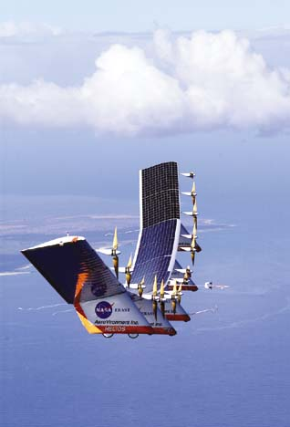
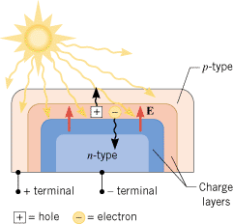
SOLAR CELLS
Solar cells use p-n junctions to convert sunlight directly into electricity.
The sunlight causes the solar cell to develop negative and positive terminals, much like the terminals of a battery.

Slide 9
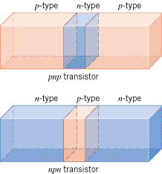
TRANSISTORS
A number of different kinds of transistors are in use today. One type is the bipolar junction transistor, which consists of two p-n junctions formed by three layers of doped semiconductors.
There are two kinds of bipolar junction transistors, pnp and npn.

Slide 10
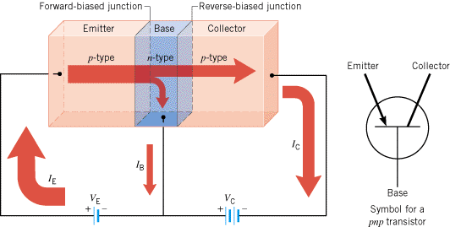
PNP-Transistor

Slide 11
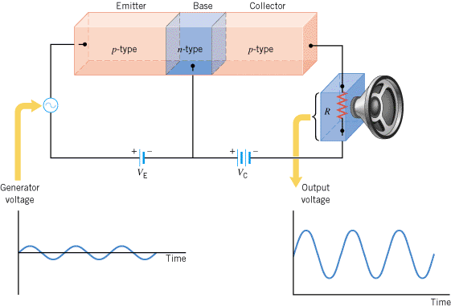
The basic pnp transistor amplifier

Slide 12
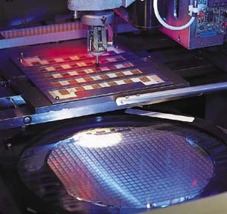
Integrated circuit (IC) chips
Today it is possible to combine arrays of tens of thousands of transistors, diodes, resistors, and capacitors on a tiny chip of silicon that usually measures less than a centimeter on a side. These arrays are called integrated circuits (ICs) and can be designed to perform almost any desired electronic function.
Integrated circuits have revolutionized the electronics industry and lie at the heart of computers, cellular phones, digital watches, and programmable appliances.

