Slide 1
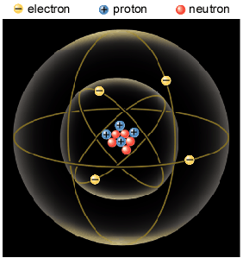
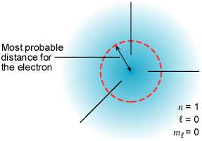
Electric Charge
Electric charge comes from atoms.
Atomic Model
Atomic Particle
Charge
Mass
The coulomb unit is derived from the SI unit ampere for electric current i. Current is the rate dq/dt at which charge moves through a region.
Electron
–1.6 × 10⁻¹⁹ C
9.11 × 10⁻³¹ Kg
Proton
+1.6 × 10⁻¹⁹ C
1.673 × 10⁻²⁷ Kg
Neutron
0
1.675 × 10⁻²⁷ Kg

Slide 2
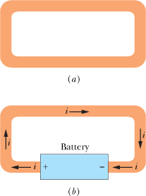
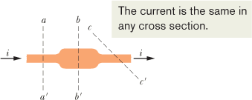
Electric Current
Electric current: charges in motion. Examples of electric currents abound and involve many professions.
(a) A loop of copper in electrostatic equilibrium, the electric field is zero at all points inside the copper. (b) Adding a battery produces an electric field within the loop, from terminal to terminal, and the field causes charges to move around the loop. This movement of charges is a current i.
We can find the charge that passes through the plane in a time interval extending from 0 to t by integration:
The direction of current flow is in the opposite direction of electron flow.

Slide 3
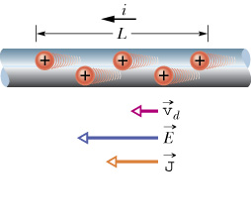
conductor
A
+ q
i
Current is a scalar. Current density is a vector.
Current Density and Drift Speed

Slide 4
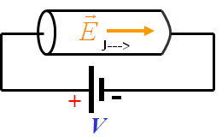
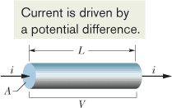
Resistance and Resistivity
We determine the resistance between any two points of a conductor by applying a potential difference V between those points and measuring the current i that results. The resistance R is then
i
-
The SI unit for resistance:
+
V
The resistivity ρ of a material is defined as:

Slide 5
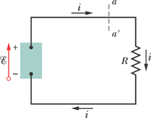
Work, Energy, and Emf
A simple electric circuit, in which a device of emf does work on the charge carriers and maintains a steady current i in a resistor of resistance R.
In any time interval dt, a charge dq passes through any cross section of this circuit, such as aa′. This same amount of charge must enter the emf device at its low-potential end and leave at its high-potential end. The device must do an amount of work dW on the charge dq to force it to move in this way. We define the emf of the emf device in terms of this work:
An ideal emf device is one that lacks any internal resistance to the internal movement of charge from terminal to terminal.
A real emf device, such as any real battery, has internal resistance to the internal movement of charge.

Slide 6
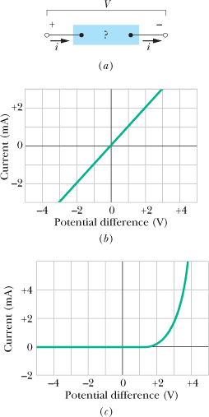
Ohm's Law
Ohm's law is an assertion that the current through a device is always directly proportional to the potential difference applied to the device. This assertion is correct only in certain situations; still, for historical reasons, the term “law” is used.
V = iR.
A potential difference V is applied to the terminals of a device, establishing a current i.
(b) A plot of current i versus applied potential difference V when the device is a 1000 Ω resistor.
(c) A plot when the device is a semiconducting pn junction diode
The power P, or rate of energy transfer, in an electrical device across which a potential difference V is:

