Slide 1
Atomic Model: Timeline
Rutherford
Democritus
Thompson
Bohr
Chadwick
Schrodinger
Dalton

Slide 2
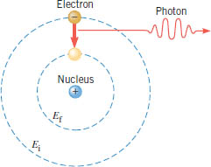
Bohr Model
Bohr's theory begins with Rutherford's picture of an atom as a nucleus surrounded by electrons moving in circular orbits.
In his theory, Bohr made a number of assumptions and combined the new quantum ideas of Planck and Einstein with the traditional description of a particle in uniform circular motion.
Bohr’s Postulates:
1. Electrons in stationary orbits do not radiate.
2. The atom radiates energy as photon when it transition to lower energy.

Slide 3
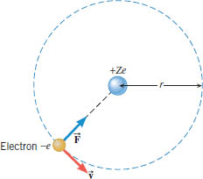
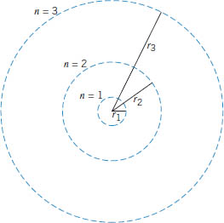
Orbital Radius

Slide 4
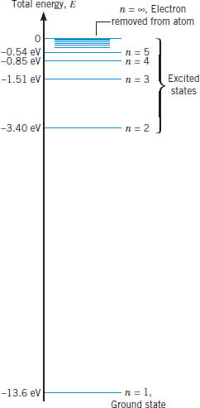
Energy-Level diagram for Hydrogen

Slide 5
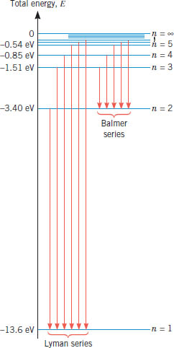
Wavelengths of Balmer Series

