Slide 1
Trombone
Bartholomew Simonson

Slide 2
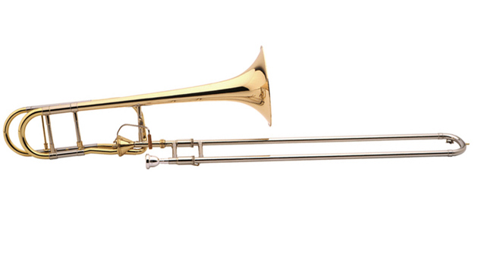
History
Originally the ‘sackbut’, smaller dimensions, less flare.
First solo/trombone-specific piece written was in the early 17th century
First use of trombone in a symphony was in 1807 in Eggert’s Symphony in E flat

Slide 3
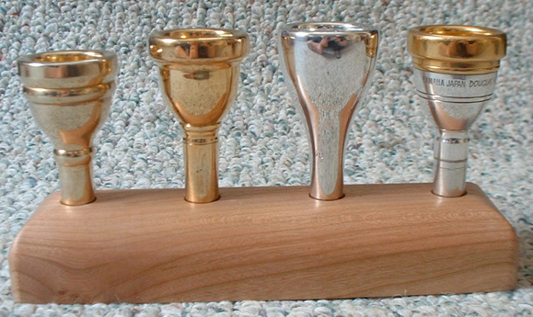
History cont.
During the Romantic period, trombone was taught to students starting in Leipzig, Germany.
20th century brought experimentation in size, metals, pedals, and mouthpieces used.
Today, trombones are a crucial part of symphonic music as well as a Jazz and Swing staple.

Slide 4
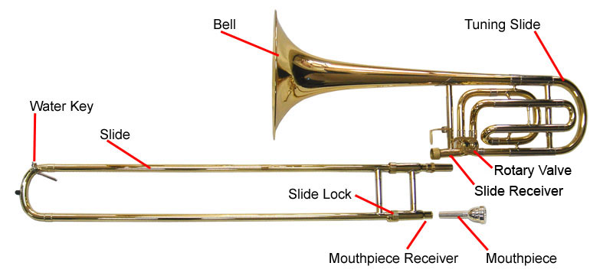
Construction

Slide 5
Mouthpiece
Like most brass instruments, the sound produced begins with the mouthpiece.
The player presses his/her lips to the mouthpiece and creates a sound by buzzing the lips together.
This buzzing and the air that flows through the mouthpiece creates the waves that reverberate along the brass columns of the trombone to produce its baritone sound.
http://www.phys.unsw.edu.au/jw/brassacoustics.html

Slide 6
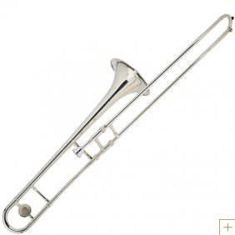
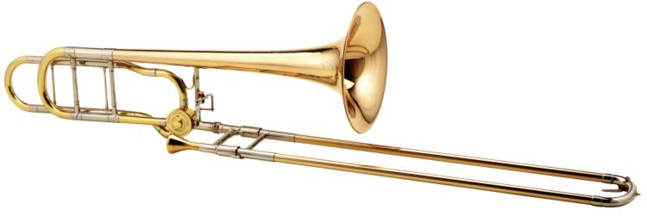
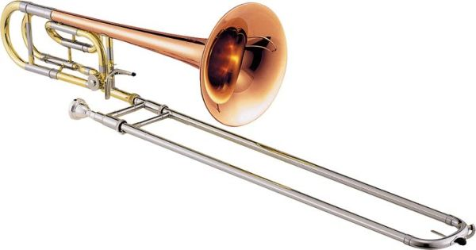
Make-up
The trombone is a brass instrument, meaning it is made out of primarily brass.
Some instruments differ by the type of metal used or the coating used.

Slide 7
Trombone Style
Differs from all other symphonic instruments in the use of the slide
While most valved instruments switch the position of airflow, the trombone simply extends the size of the closed tube that air and sound waves must travel through
In trombones with a pedal (Bb), pressing the pedal extends the column even more, allowing the player to stay in first position while playing a note normally in a further position.

Slide 8
Style (cont.)
Because of the lack of valves which can briefly interrupt the flow of air, the trombone can perform a glissando, which is basically sliding up the positions with uninterrupted air waves, creating a sliding effect in the sound.
This technique is used often in Jazz and swing.

Slide 9
Resources
http://www.phys.unsw.edu.au/jw/brassacoustics.html
http://www.classicol.com/classical.cfm?music=instrumentInfo&section=Trombone&title=About%20The%20Trombone
http://en.wikipedia.org/wiki/Trombone

