Slide 1
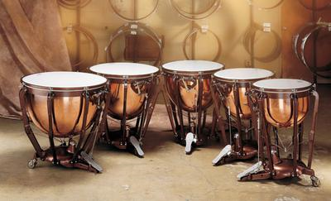
Timpani
Melody Lewis

Slide 2
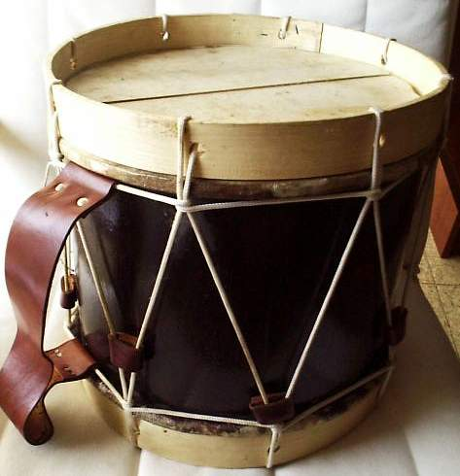
Membranophones
Percussion instruments that use vibrating membranes to produce sound.
Such as timpani, tom-toms, snare drums and bass drums
Sound production in membranes begins with the oscillation of the membranes.
More complicated modes and frequencies are not integrally related.
Modes in a drumhead are compared to inhaling and exhaling.
http://paws.kettering.edu/~drussell/Demos/MembraneCircle/Circle.html

Slide 3
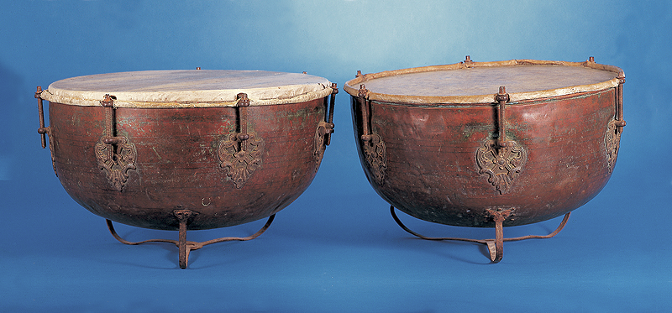
History of the Timpani
Also called the “kettle drum”
Descended from a small pair
of drums called “nakers.”
Used in Europe for military ceremonies.
Brought to Europe by King Henry
Evolved into the large orchestral timpani

Slide 4
History cont.
Until the 19th century, the pitch of the timpani was altered by turning a series of threaded bolts called taps which tightened or loosened the tension on the head thus raising or lowering the pitch.
In 1812, a ‘machine’ timpani was produced with a single tuning handle.
The most common mechanism used today is a pedal with a spider-like system of metal rods connected to a foot pedal and tension screws.

Slide 5
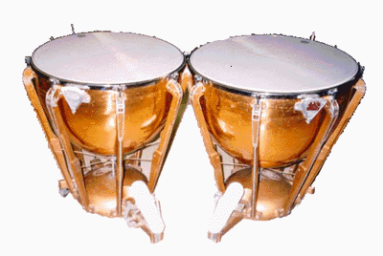
Design
Considered a ‘tuned’ percussion instrument because it can produce a note or definite pitch.
Pitch depends on the drum head.
Size of drum head.
Material stretched over the drumhead; plastic or animal skin.
Tension rods or tuning screws are placed regularly around the circumference of the bowl and are used to adjust the pitch.

Slide 6
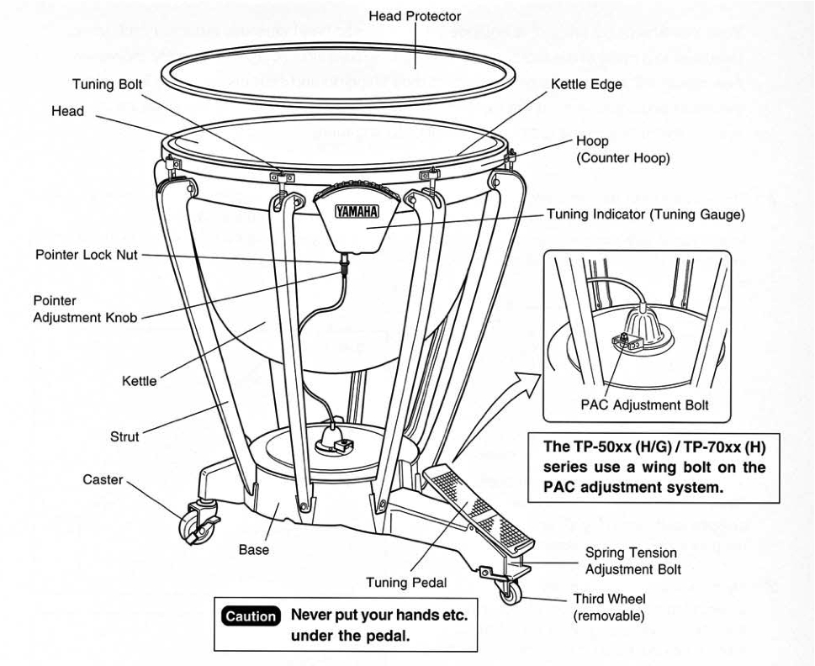
Parts

Slide 7
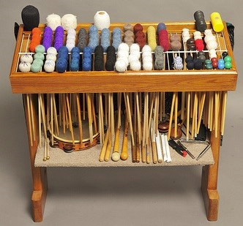
Sound possibilities
Variety of sticks and mallets used to strike the timpani.
Each stick or mallet produces a different sound.
Felt-tipped
Cotton
Plastic

Slide 8
Works Cited
http://www.helium.com/items/1753798-instruments-of-the-orchestra-the-timpani
http://www.colorado.edu/physics/phys1240/phys1240_fa06/pdfdocs/JohnGalmDrums.pdf
http://www.andsim.com/timperc.htm
http://www.ehow.com/about_6574659_information-timpani.html
http://www.helium.com/items/1753798-instruments-of-the-orchestra-the-timpani

