Slide 1
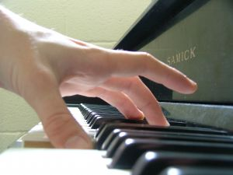
The Piano
Theresa Horton

Slide 2
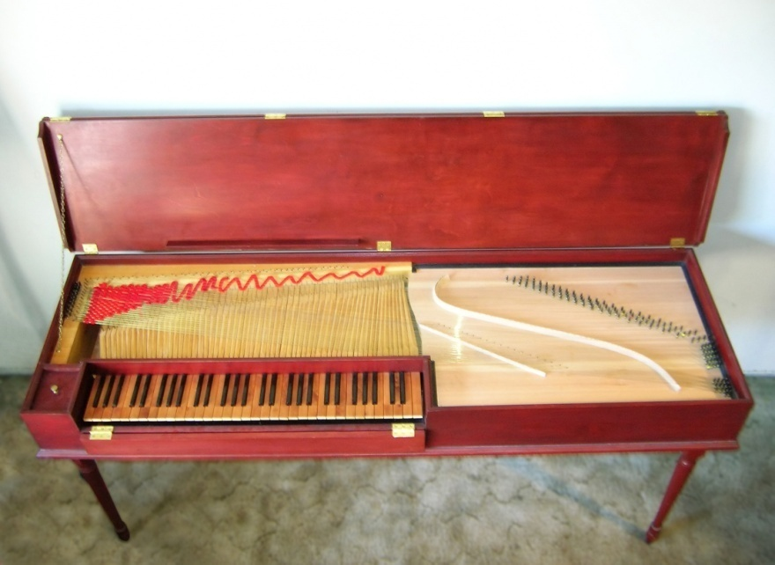
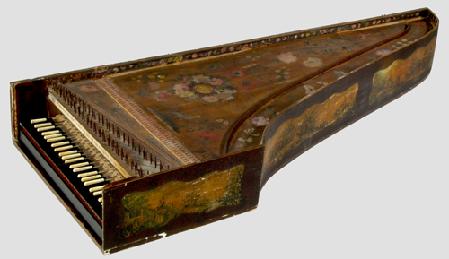
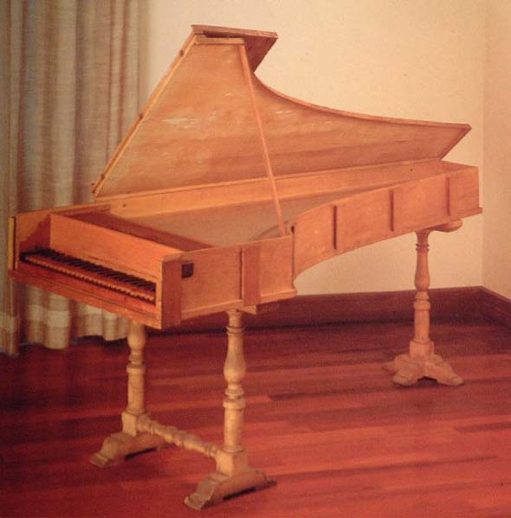
Brief History
Clavichord—c1400
Harpsichord—1425
Piano—c1700

Slide 3
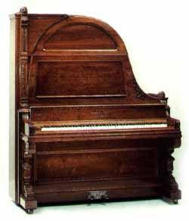
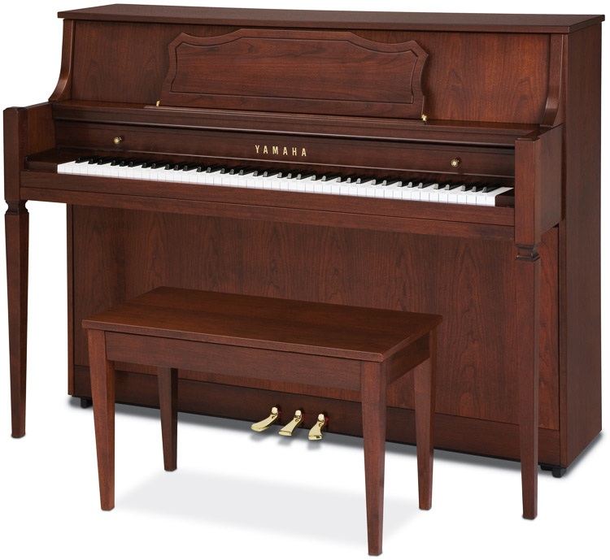
Upright Piano
First one built in 1780 by Johann Schmidt
50-60 inches in height
58 inches in width

Slide 4
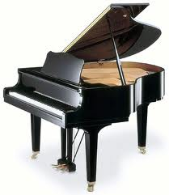
Grand Piano
4 ½ feet to 9 feet in length
Petite Grand is the smallest
Concert Grand is the largest

Slide 5
Components
Case made from Maple
Rim made from Maple
Ribs made from Pine
Frame or Harp made from Iron
Soundboard made from Spruce
Hammer made from Birch and Felt
Strings made from Steel and Copper
Keys made from Spruce and Plastic

Slide 6
Mechanics
A key is pressed
Levers are activated
A hammer strikes a string
The string vibrates
The vibrations are transmitted to the soundboard
The soundboard reproduces the vibrations
Air around the soundboard vibrates

Slide 7
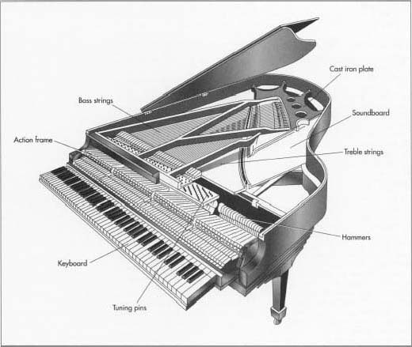

Slide 8
Sources
Chapin, Miles. 88 Keys, The Making of a
Steinway Piano. New Jersey. Amadeus Press,
2006. Print.
Dolge, Alfred. Pianos and Their Makers.
California. Covina Publishing Company, 1911. Print.
Good, Edwin. Giraffes, Black Dragons, and Other
Pianos. California. Stanford University Press,
2001. Print.
Hollis, Helen Rice. The Piano. New York.
Hippocrene Books, 1975. Print.
http://musiced.about.com/

