Slide 1
The Stradivari Violins:
Aged to Perfection:
Andres Gil

Slide 2
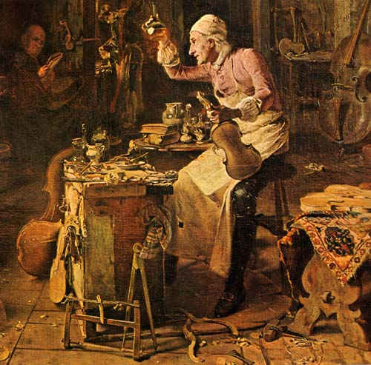
Antonio Stradivari

Slide 3
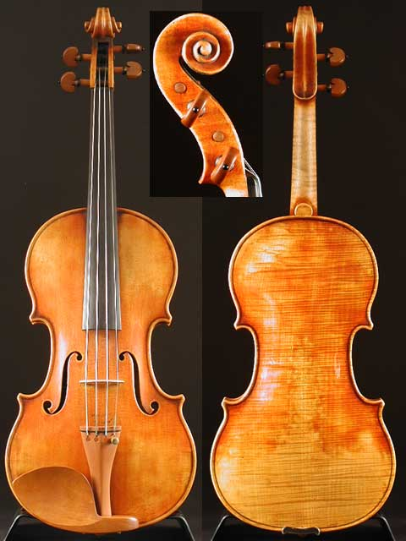
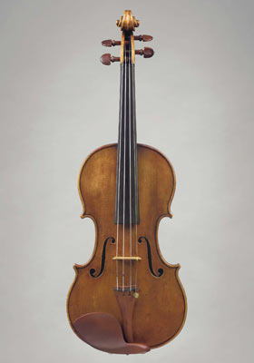
Exquisite Examples
10 million
14 million

Slide 4
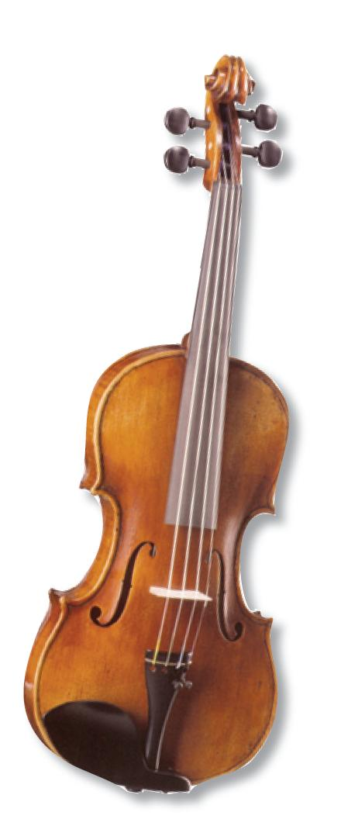
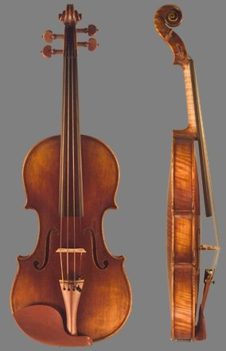
Like Snowflakes

Slide 5
Acoustical Properties
…The top plate of a violin is usually made of spruce and the back of maple. The scientists believe that the homogenous density of the Cremonese violins gives them the edge in terms of stiffness and sound-damping characteristics, which both help to produce superior musical notes…
the independent

Slide 6
The Mystery
“This research proves unquestionably that the wood of the great masters was subjected to an aggressive chemical treatment and the chemicals – most likely some sort of oxidizing agents – had a crucial role in creating the great sound of the Stradivarius and the Guarneri,”
Nature Magazine

Slide 7
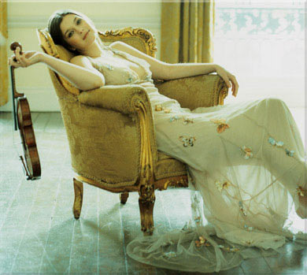
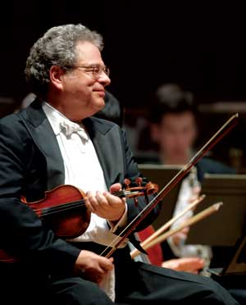
The Fame

Slide 8
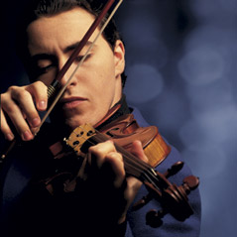
The End!

