Slide 1
Speaker Design
A. Ryan Parker

Slide 2
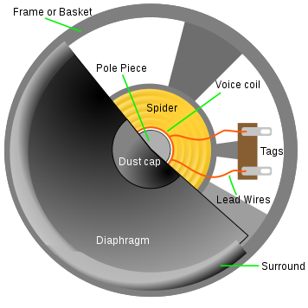
Diaphragm
Usually manufactured with a cone or dome shaped profile to accurately reproduce the voice coil signal waveform if replications aren’t precise acoustical distortion could occur

Slide 3
Frame/Basket
Houses speaker and its components while protecting the magnet gap and voice coil (over heating)

Slide 4
Pole Piece
Serves as magnet in center of speaker

Slide 5
Suspension System
Spider & Surround
Suspension System:
Keeps coil centered and serves as a restoring force for the cone after vibration.
Spider:
Connects frame and diaphragm or voice coil
Surround:
Ring of fabric attached to outer diaphragm & frame

Slide 6
Voice Coil
Copper or aluminum wire wrapped around a drum located in the magnetic gap where it moves

Slide 7
Tags/Lead Wires
Used to wrap voice coil

Slide 8
Dust cap
Sometimes lowers acoustic quality because it hinders the overall cone design

Slide 9
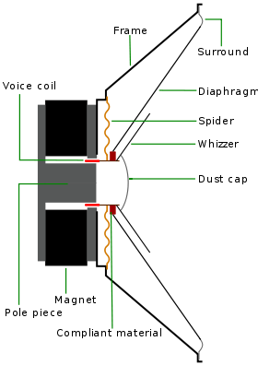

Slide 10
How it all works
“An electromagnet is placed n front of a permanent magnet (pole piece). The permanent magnet is fixed firmly into position whereas the electromagnet is mobile. As pulses of electricity pass through the coil of electromagnet the direction of its magnetic field is rapidly changed. Meaning that this is attracted to and repelled from the permanent magnet, vibrating back and forth. “
-http://www.physics.org

Slide 11
http://www.physics.org/explorelink.asp?id=1748&q=speaker&currentpage=1&age=0&knowledge=0&item=0

Slide 12
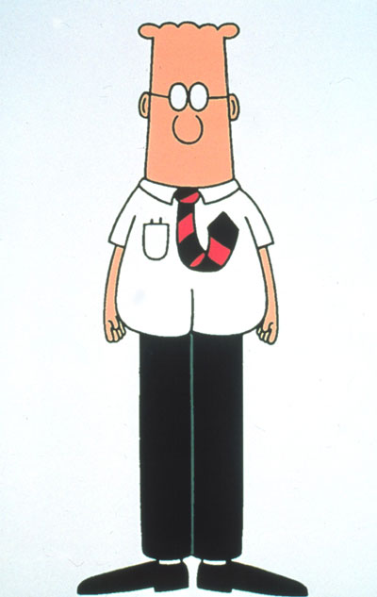
…

Slide 13
Sources
http://www.physics.org
Soundofmind.com

