Slide 1
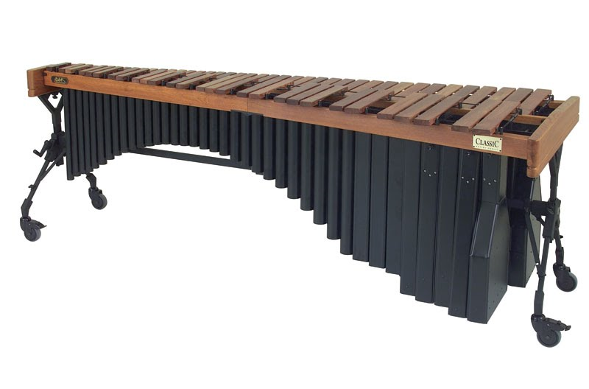
The Marimba
By Chad Wesely

Slide 2
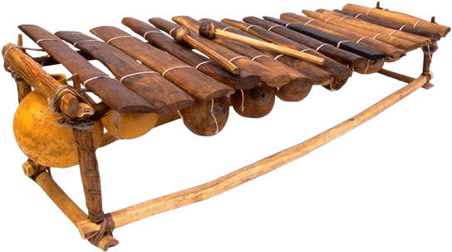
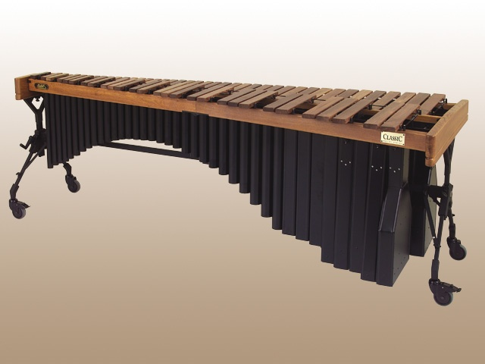
History and background

Slide 3
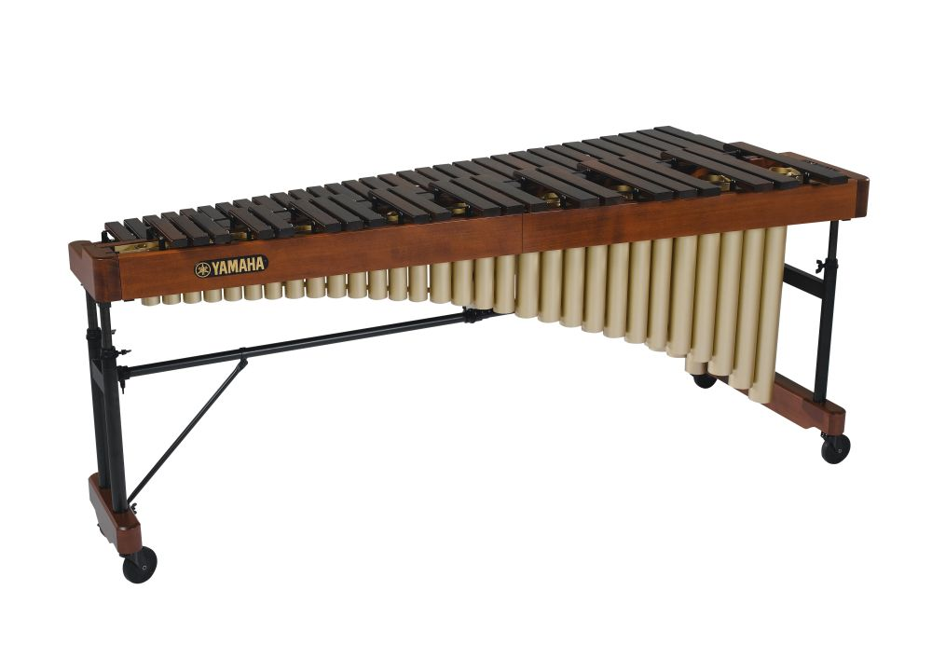
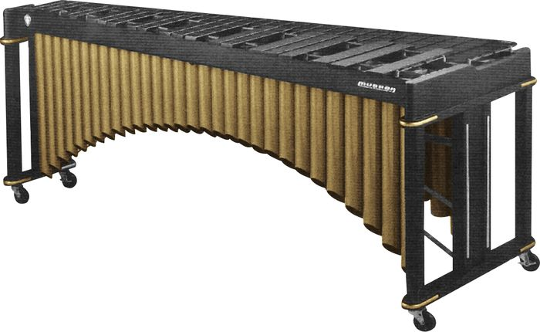
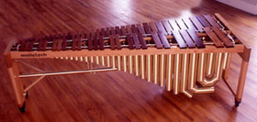
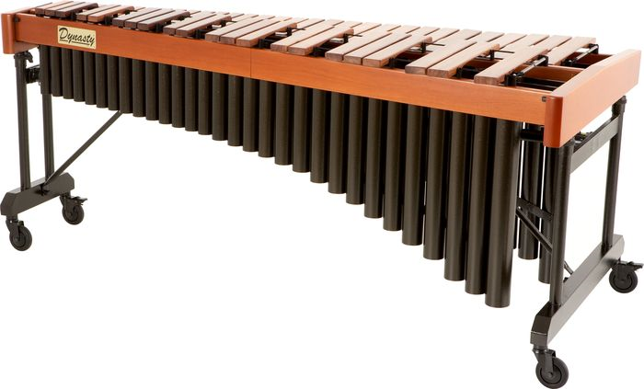
Design and make

Slide 4
“Adams' policy is to keep our wood in special climate-controlled rooms for 8 years to insure precise aging. The result is quite honestly phenomenal! A much faster, clearer tone and pitch. Exactly what all marimba players want.”

Slide 5
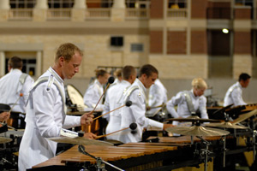
Violin Solo played on Marimba
Marimba Solo
Marimba Solo played in Ensemble

Slide 6
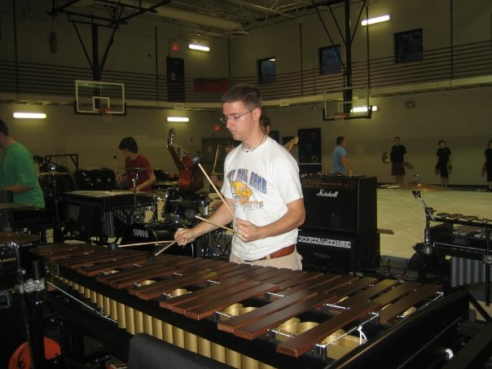
The End

