Slide 1
Acoustic Guitar
Cale Medley

Slide 2
Brief History of Acoustic Guitar
Member of stringed instrument family
Most modernly used plucked string instrument along with harp
Category also includes:
Banjo, ukulele, and dulcimer
B.C.
Medieval Animal Shells and Guts
Renaissance
Baroque
Notes:
B.C. – early drawings depict strings
Medieval – used animal shells as resonators
Renaissance
Keyboard – clavichord and harpsichord
Baroque
Violin family created
Guitar and other plucked instruments began to gain popularity

Slide 3
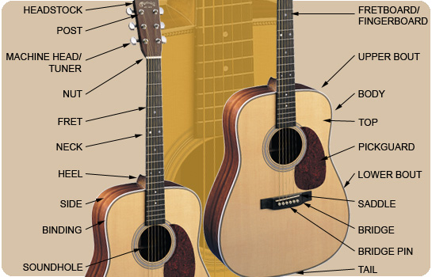

Slide 4
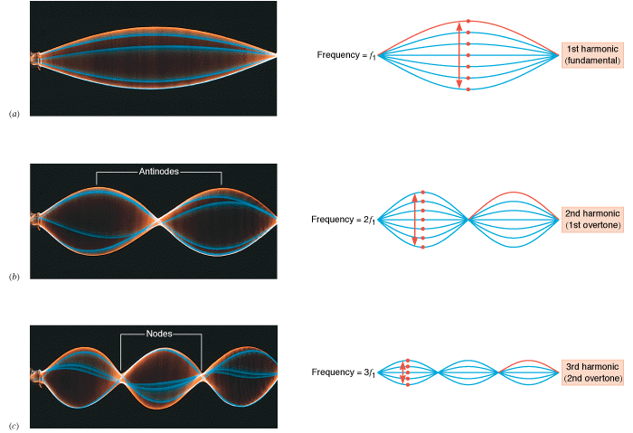

Slide 5
Miscellaneous Parts
Machine Heads
Tuning Pegs
Headstock
Bridge Pins
Neck

Slide 6
Bridge
No sound post and bridge is lower than on bowed instruments
Transfers vibrations to the interior of instrument
Couples oscillations in the plane perpendicular to the plate more efficiently than those parallel
Gives prompt and sustained components to the decaying sound

Slide 7
Fret Board
To produce correct intonation of fretted notes
Frequency depends on position of fret and slight increase in tension of string
“Rule of 18”
Creates ratio of frequencies – 1.0588 per half step
Compared to equal-tempered ratio of 1.0595
Higher frets = higher intonation errors

Slide 8
Sound Hole
Vibrations bounce between front plate and back plate, forcing air and audible sound through sound hole
Sound hole produces focused sound

Slide 9
Wooden Body
Hardwood family
Usually Mahogany or Rosewood

Slide 10
Resources
www.musiciansfriend.com
The Physics of Sound

