Slide 1
Chapter 18
Temperature, Heat, and the First Law of Thermodynamics
In this chapter we will explore the following topics:
Temperature and the zeroth law of thermodynamics Thermometers and temperature scales Thermal expansion Temperature and heat Specific heat Heat of transformation Heat, work, and the first law of thermodynamics Heat transfer mechanisms

Slide 2
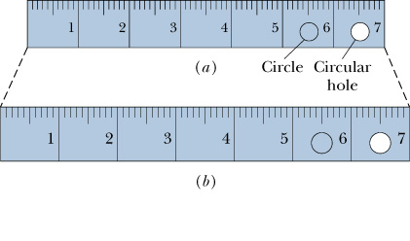

Slide 3
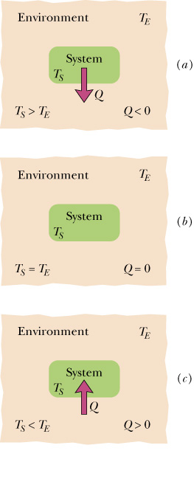

Slide 6
Prob. 40, Chap. 18, Page 502:Calculate the specific heat of a metal from the following data. A container made of the metal has a mass of 3.6 kg and contains 14 kg of water. A 1.8 kg piece of the metal initially at a temperature of 180°C is dropped into the water. The container and water initially have a temperature of 16.0°C, and the final temperature of the entire (insulated) system is 18.0°C.

