Slide 1
Temperature
Thermometer
Zeroth Law of Thermodynamics
Thermal Expansion

Slide 2
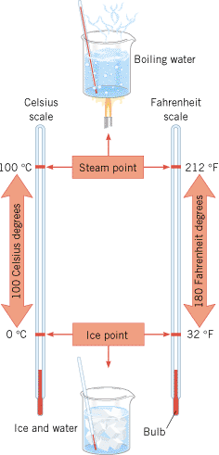
Common Temperature Scales
Fahrenheit scale
Celsius scale
Boiling point
212
100
Unknown
T_{f}
T_{c}
Freezing point
32
0

Slide 3
Thermometers
Thermometers make use of the change in some physical property with temperature, thermometric property.
Thermometer | Thermometric Property
Liquid (mercury) thermometer | Expansion of the liquid column
Constant-volume gas thermometer | Pressure of the gas
Thermocouple | Voltage (potential difference)
Thermogram or Ear thermometer | Infrared radiation
Resistance Thermometer (RTD) | Resistance

Slide 4
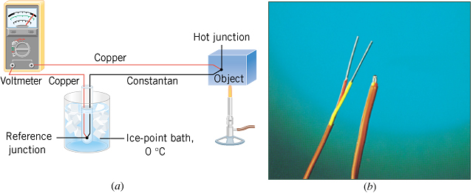
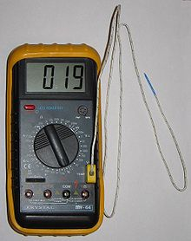
Thermocouple

Slide 5
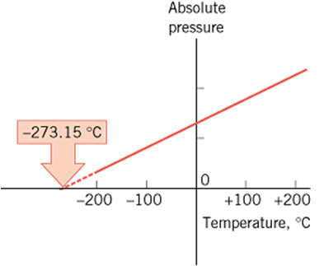
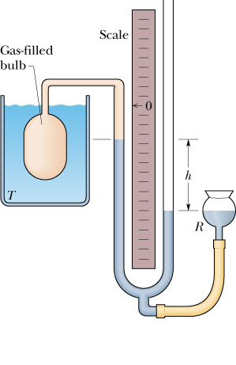
The Constant-Volume Gas Thermometer
A
The temperature at which the absolute pressure of the gas is zero, is the absolute temperature. It is found to be –273.15⁰C or 0 K.

Slide 6
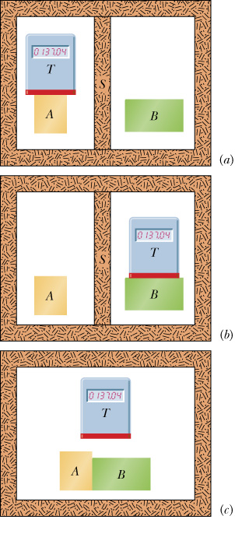
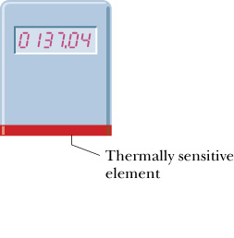
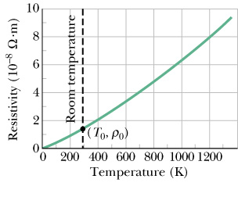
The Zeroth Law of Thermodynamics
Thermoscope
A calibrated Thermoscope is a Thermometer.
The Zeroth Law of Thermodynamics:
If body A is in thermal equilibrium with body T and body B is in thermal equilibrium with body T, then A and B are in thermal equilibrium with each other.

Slide 7
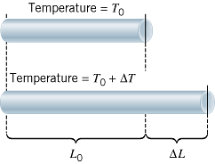
Linear Thermal Expansion
α = the coefficient of linear expansion.

Slide 8
Area Expansion
The area A₀ of an object changes by an amount ΔΑ when its temperature changes by an amount ΔT:
where α is the coefficient of linear expansion.

Slide 9
Volume Expansion
The volume V₀ of an object changes by an amount ΔV when its temperature changes by an amount ΔT:
where β (=3α, for solids) is the coefficient of volume expansion.

Slide 10
TABLE 12.1
Coefficients of Thermal Expansion for Solids and Liquidsª
Coefficient of Thermal Expansion, (C°)⁻¹
Substance
Linear (α)
Volumetric (β)
Solids
Aluminum
23 × 10⁻⁶
69 × 10⁻⁶
Brass
19 × 10⁻⁶
57 × 10⁻⁶
Concrete
12 × 10⁻⁶
36 × 10⁻⁶
Copper
17 × 10⁻⁶
51 × 10⁻⁶
Glass (common)
8.5 × 10⁻⁶
26 × 10⁻⁶
Glass (Pyrex)
3.3 × 10⁻⁶
9.9 × 10⁻⁶
Gold
14 × 10⁻⁶
42 × 10⁻⁶
Iron or steel
12 × 10⁻⁶
36 × 10⁻⁶
Lead
29 × 10⁻⁶
87 × 10⁻⁶
Nickel
13 × 10⁻⁶
39 × 10⁻⁶

Slide 11
Volumetric Thermal Expansion Coefficient (C°)⁻¹
Liquids^{b}
Benzene
—
1240 × 10⁻⁶
Carbon tetrachloride
—
1240 × 10⁻⁶
Ethyl alcohol
—
1120 × 10⁻⁶
Gasoline
—
950 × 10⁻⁶
Mercury
—
182 × 10⁻⁶
Methyl alcohol
—
1200 × 10⁻⁶
Water
—
207 × 10⁻⁶

Slide 12
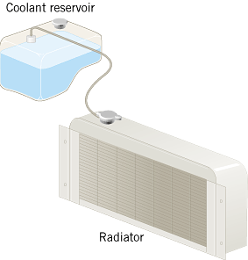
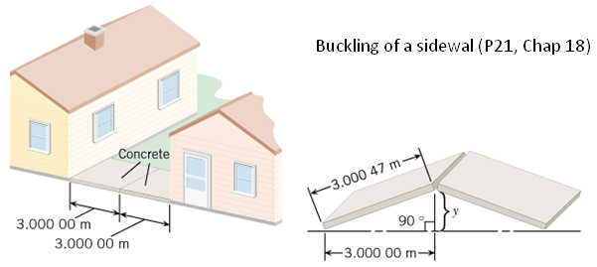
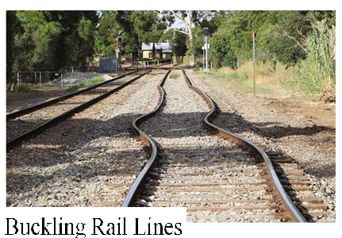
Consequences of Thermal Expansion

Slide 13
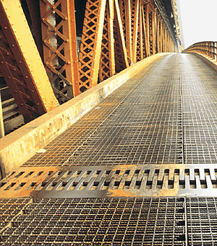
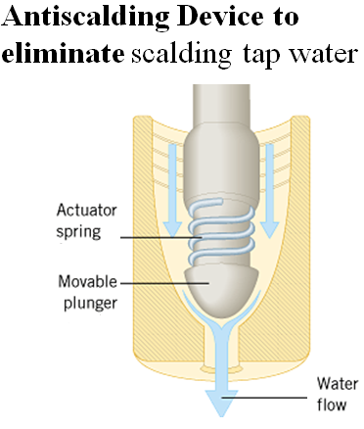
Expansion Joint in a Bridge

Slide 14
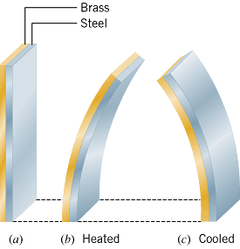
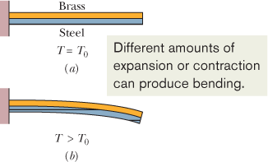
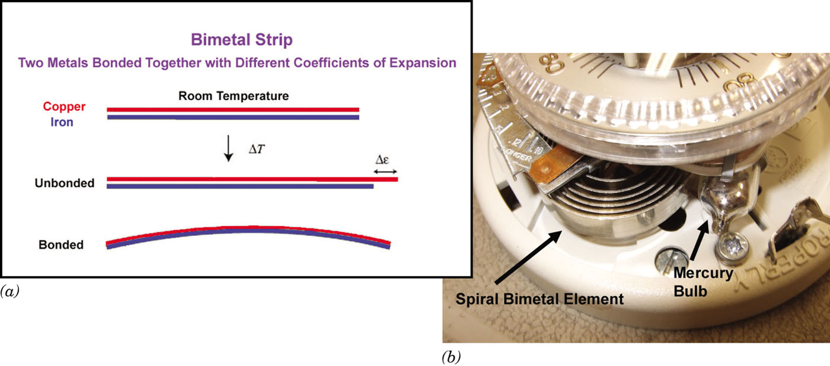
The Bimetallic Strip

Slide 15
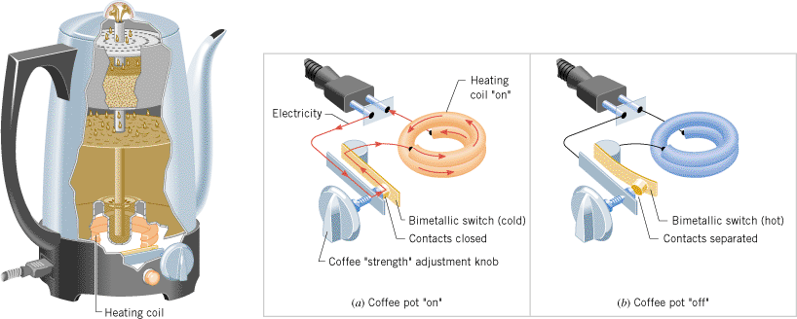
Bimetallic Switch
A bimetallic strip controls whether this coffee pot is (a) “on” (strip cool, straight) or (b) “off” (strip hot, bent).

Slide 16
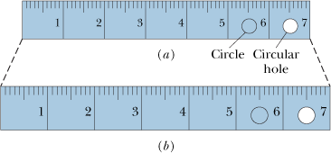
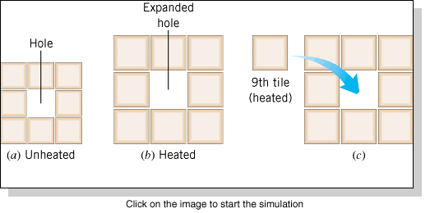
The Expansion of Holes
Do Holes Expand or Contract When the Temperature Increases?
Answer: Expand.

Slide 17
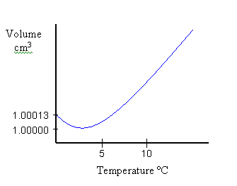
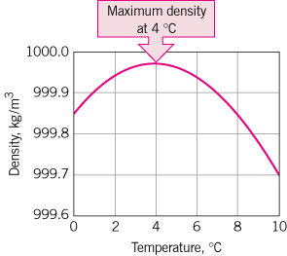
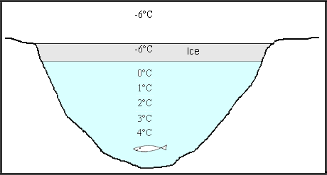
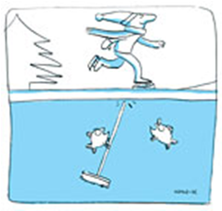
Unusual Expansion of Water
Most substances contract upon cooling. But, water expands while cooling from 4 ⁰C until it freezes.

Slide 18
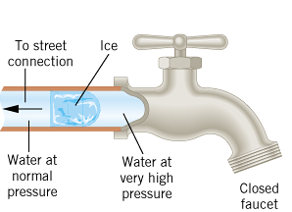
Bursting Water Pipes
As water freezes and expands, enormous pressure is applied to the liquid water between the ice and the faucet.
https://www.youtube.com/watch?v=4i5r65QGUpw

