Slide 1
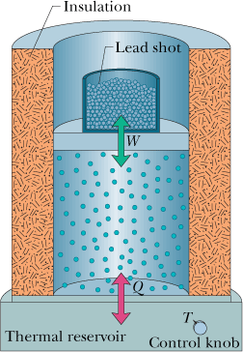
18.9 A Closer Look at Heat and Work

Slide 2
18.10 The First Law of Thermodynamics
You have just seen that when a system changes from a given initial state to a given final state, both the work W and the heat Q depend on the nature of the process. Experimentally, however, we find a surprising thing. The quantity, is the same for all processes.

Slide 3
Some Special Cases of the First Law of Thermodynamics
Adiabatic processes. An adiabatic process is one that occurs so rapidly or occurs in a system that is so well insulated that no transfer of energy as heat occurs between the system and its environment.
Constant-volume processes. If the volume of a system (such as a gas) is held constant, that system can do no work.
Cyclical processes. There are processes in which, after certain interchanges of heat and work, the system is restored to its initial state. In that case, no intrinsic property of the system—including its internal energy—can possibly change.
Free expansions. These are adiabatic processes in which no transfer of heat occurs between the system and its environment and no work is done on or by the system.

Slide 4
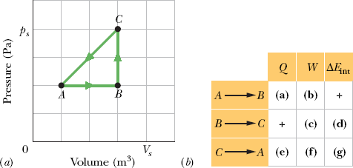
P 44. A thermodynamic system is taken from state A to state B to state C, and then back to A, as shown in the p-V diagram. The vertical scale is set by p_{s} = 40 Pa, and the horizontal scale is set by . (a)–(g) Complete the table below by inserting a plus sign, a minus sign, or a zero in each indicated cell. (h) What is the net work done by the system as it moves once through the cycle ABCA?

Slide 5
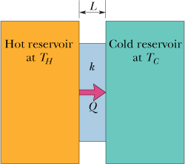
18.12 Heat Transfer Mechanisms
Conduction
Thermal Resistance to Conduction (R-Value)

Slide 6
Radiation
The rate P_{rad} at which an object emits energy via electromagnetic radiation depends on the object’s surface area A and the temperature T of that area in kelvins and is given by
The symbol represents the emissivity of the object’s surface, which has a value between 0 and 1, depending on the composition of the surface.
The rate P_{abs} at which an object absorbs energy via thermal radiation from its environment, which we take to be at uniform temperature T_{env} (in kelvins), is

