Slide 1
CH-32: Maxwell's Equations (4)
Gauss' law for electricity:
Relates net electric flux to net enclosed electric charge.
Gauss' law for magnetism:
Relates net magnetic flux to net enclosed magnetic charge.
Faraday' law:
Relates induced electric field to changing magnetic flux.
Ampere-Maxwell law:
Relates induced magnetic field to changing electric flux and to current.

Slide 2
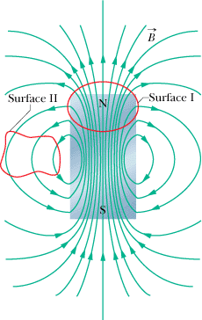
Gauss' Law for Electric and Magnetic Fields
In Chapter 23, we studied Gauss’ law for electric fields:
The simplest magnetic structure that can exist is a magnetic dipole. Magnetic monopoles do not exist (as far as we know).
Gauss' law for magnetic fields is a formal way of saying that magnetic monopoles do not exist. The law asserts that the net magnetic flux Φ_{B} through any closed Gaussian surface is zero:

Slide 3
Faraday’s and Maxwell’s laws of Induction
In Chapter 30 you saw that a changing magnetic flux induces an electric field, and we ended up with Faraday's law of induction:
Because symmetry is often so powerful in physics, we should be tempted to ask whether induction can occur in the opposite sense; that is, can a changing electric flux induce a magnetic field? The answer is that it can; furthermore, the equation governing the induction of a magnetic field is almost symmetric with the above equation. We often call it Maxwell's law of induction after James Clerk Maxwell, and we write it as:

Slide 4
Ampere–Maxwell Law
Now recall that the left side of the above equation, the integral of the dot product around a closed loop, appears in another equation—namely, Ampere's law:
Thus, our two equations that specify the magnetic field produced by means other than a magnetic material (that is, by a current and by a changing electric field) give the field in exactly the same form. We can combine the two equations into the single equation:

