Slide 1
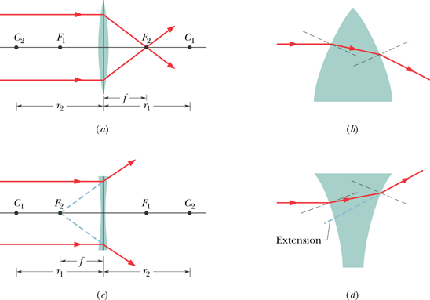
Thin Lenses
A lens is a transparent object with two refracting surfaces whose central axes coincide. The common central axis is the central axis of the lens. A lens that causes light rays initially parallel to the central axis to converge is called a converging lens. If, instead, it causes such rays to diverge, the lens is a diverging lens.
Focal length is positive.
Focal length is negative.

Slide 2
Images from Thin Lenses
Real images form on the side of a lens that is opposite the object, and virtual images form on the side where the object is.

Slide 3
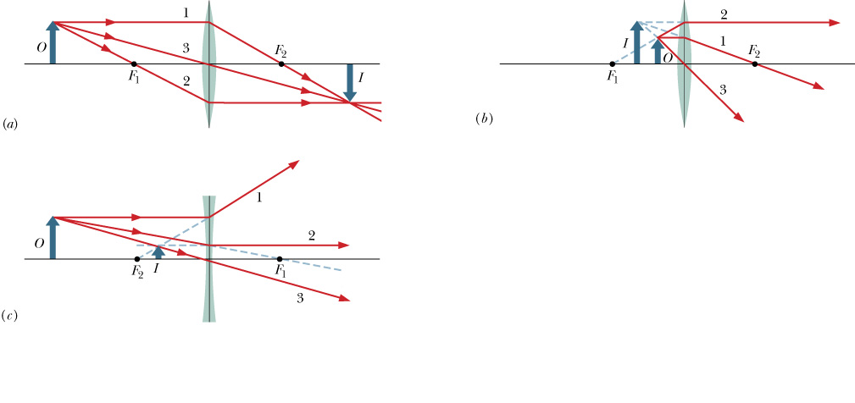
Locating Images of Extended Objects by Drawing Rays
Fig. 34-17
A ray initially parallel to central axis will pass through F₂.
A ray that initially passes through F₁, will emerge parallel to central axis.
A ray that initially is directed toward the center of the lens will emerge from the lens with no change in its direction (the two sides of the lens at the center are almost parallel).

Slide 4
P112, page 956: An object is 20 cm to the left of a thin diverging lens that has a 30 cm focal length. (a) What is the image distance i? (b) Draw a ray diagram showing the image position.

