Slide 1
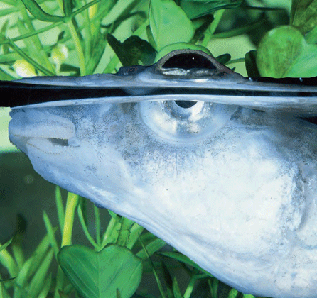
Chap-34: Images
One of the most important uses of the basic laws governing light is the production of images. Images are critical to a variety of fields and industries ranging from entertainment, to security, to medicine.
In this chapter we define and classify images, and then classify several basic ways in which they can be produced. Anableps anableps
Anableps anableps
Underwater vision is usually difficult even if you have perfect vision above water. The reason has to do with how water affects the refraction of light entering the eye. The refraction may be appropriate in the air but quite wrong in the water. However, the peculiar fish Anableps anableps swims with its eyes partially extending above the water surface so that it can see simultaneously above and below water. How can its eyes function in both air and water?

Slide 2
Two Types of Images
real image
object
lens
object
mirror
virtual image
Image: A reproduction derived from light.
Real Image: Light rays actually pass through image, really exist in space (or on a screen for example) whether you are looking or not.
Virtual Image: No light rays actually pass through image. Only appear to be coming from image. Image only exists when rays are traced back to perceived location of source.

Slide 3
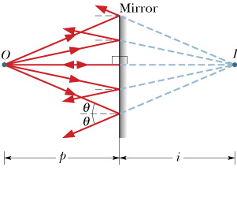
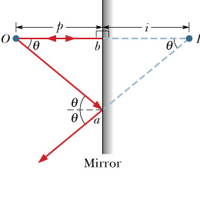
Plane Mirrors, Point Object
Plane mirror is a flat reflecting surface.
Identical triangles
Fig. 34-2
Fig. 34-3
Plane Mirror:
Since I is a virtual image, i < 0.

Slide 4
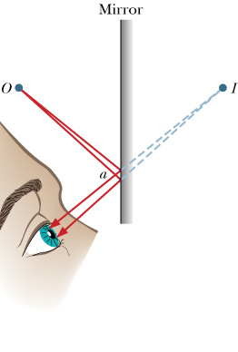
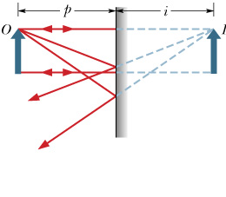
Plane Mirrors, Extended Object
Each point source of light in the extended object is mapped to a point in the image.
Fig. 34-4
Fig. 34-5

Slide 5
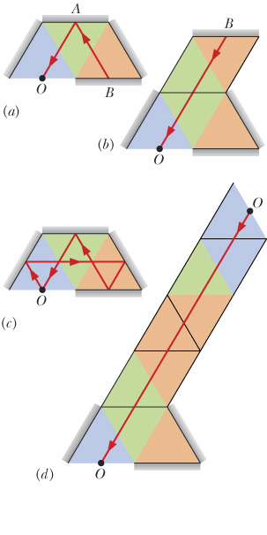
Plane Mirrors, Mirror Maze
Your eye traces incoming rays straight back, and cannot know that the rays may have actually been reflected many times.
1
2
8
7
4
2
1
9
3
6
5
3
4
(a) Overhead view of a mirror maze. A ray from mirror B reaches you at O by reflecting from mirror A. (b)Mirror B appears to be behind A. (c) The ray reaching you comes from you. (d) You see a virtual image of yourself at the end of an apparent hallway.
5
6
7
8
9
Fig. 34-7

Slide 6
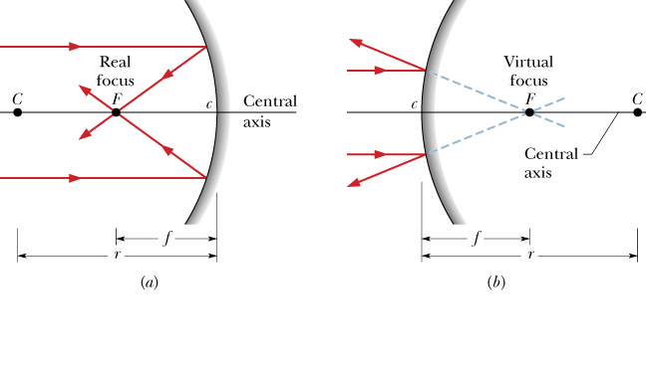
Spherical Mirrors, Focal Points of Spherical Mirrors
concave
convex
Fig. 34-9
Spherical Mirror:
r > 0 for concave (real focal point)
r < 0 for convex (virtual focal point)

Slide 7
Images from Spherical Mirrors
Start with rays leaving a point on object, where they intersect, or appear to intersect, marks the corresponding point on the image.
Fig. 34-9
Real images form on the side where the object is located (side to which light is going). Virtual images form on the opposite side.
Spherical Mirror:
Lateral Magnification:
Lateral Magnification:
(34-9)

Slide 8
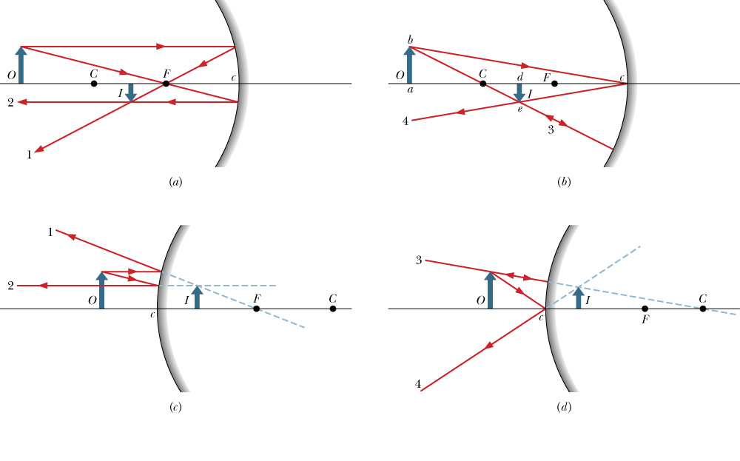
Locating Images by Drawing Rays
Fig. 34-10
A ray that is parallel to central axis reflects through F.
A ray that reflects from mirror after passing through F emerges parallel to central axis.
A ray that reflects from mirror after passing through C returns along itself.
A ray that reflects from mirror after passing through c is reflected symmetrically about the central axis.
(34-10)

