Slide 1
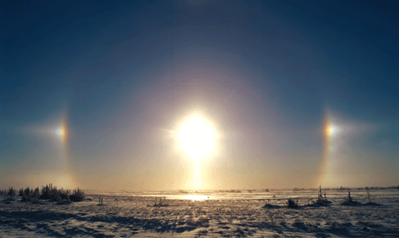
Chapter 33: Electromagnetic Waves
Today’s information age is based almost entirely on the physics of electromagnetic waves. The connection between electric and magnetic fields to produce light is one of the greatest achievements produced by physics, and electromagnetic waves are at the core of many fields in science and engineering.
The above is a sun dog that appears to the left or right of the Sun and sometimes on both sides. Because sun dogs often show colors, they can be mistaken for rainbows. However, sun dogs are not produced by water drops as rainbows are.
What produces sun dogs?

Slide 2
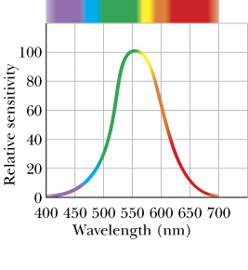
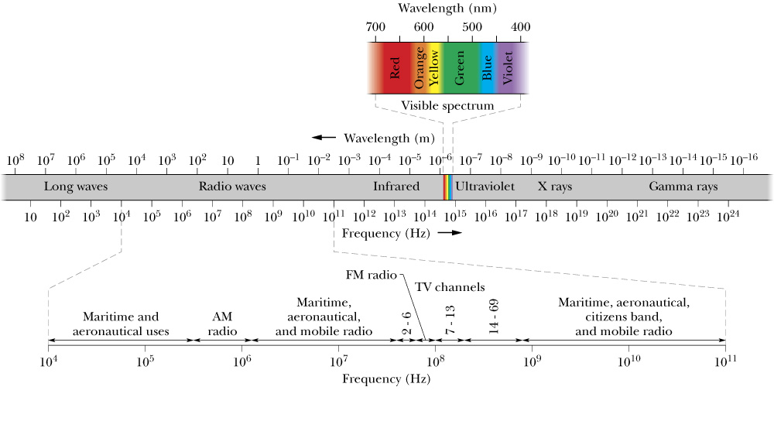
Maxwell’s Rainbow
The wavelength/frequency range in which electromagnetic (EM) waves (light) are visible is only a tiny fraction of the entire electromagnetic spectrum.
The relative sensitivity of the average human eye to electromagnetic waves at different wavelengths.

Slide 3
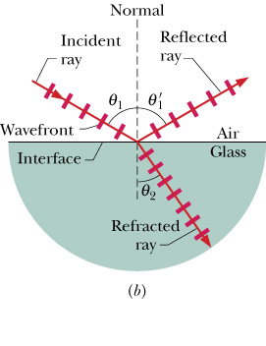
Reflection and Refraction
Although light waves spread as they move from a source, often we can approximate its travel as being a straight line → geometrical optics.
What happens when a narrow beam of light encounters a glass surface?
Law of Reflection
Reflection:
Snell’s Law
Refraction:
n is the index of refraction of the material, See Table 33-1 .

Slide 4
TABLE 33-1 | Some Indexes of Refraction
Medium | Index | Medium | Index
Vacuum | Exactly 1 | Typical crown glass | 1.52
Air (STP) | 1.00029 | Sodium chloride | 1.54
Water (20° C) | 1.33 | Polystyrene | 1.55
Acetone | 1.36 | Carbon disulfide | 1.63
Ethyl alcohol | 1.36 | Heavy flint glass | 1.65
Sugar solution (30%) | 1.38 | Sapphire | 1.77
Fused quartz | 1.46 | Heaviest flint glass | 1.89
Sugar solution (80%) | 1.49 | Diamond | 2.42

Slide 5
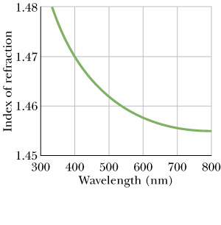
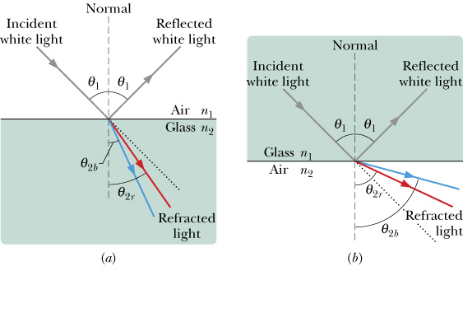
Chromatic Dispersion
The index of refraction n encountered by light in any medium except vacuum depends on the wavelength of the light. So if light consisting of different wavelengths enters a material, the different wavelengths will be refracted differently → chromatic dispersion.
N_{2,blue}>n_{2,red}
Fig. 33-19
Fig. 33-20
Chromatic dispersion can be good (e.g., used to analyze wavelength composition of light) or bad (e.g., chromatic aberration in lenses).
(33-19)

Slide 6
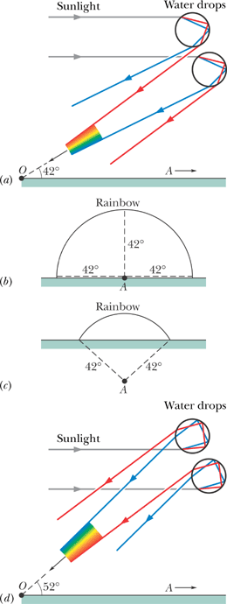
Rainbows
Primary Rainbow
The most charming example of chromatic dispersion is a rainbow.
(a) The separation of colors when sunlight refracts into and out of falling raindrops leads to a primary rainbow. The antisolar point A is on the horizon at the right. The rainbow colors appear at an angle of 42° from the direction of A. (d) The separation of colors leading to a secondary rainbow.
Secondary Rainbow

Slide 7
Total Internal Reflection
Total internal reflection takes place in optical fibers, which are used in many applications including in communications and medical technologies.

