Slide 1
Inductors and Inductance
A capacitor can be used to produce a desired electric field.
Similarly, an inductor (symbol ) can be used to produce a desired magnetic field. We shall consider a long solenoid (more specifically, a short length near the middle of a long solenoid) as our basic type of inductor. If we establish a current i in the windings (turns) of the solenoid we are taking as our inductor, the current produces a magnetic flux through the central region of the inductor. The inductance of the inductor is then:
in which N is the number of turns. The windings of the inductor are said to be linked by the shared flux, and the product is called the magnetic flux linkage. The inductance L is thus a measure of the flux linkage produced by the inductor per unit of current.
P40. The inductance of a closely packed coil of 400 turns is 8.0 mH. Calculate the magnetic flux through the coil when the current is 5.0 mA.

Slide 2
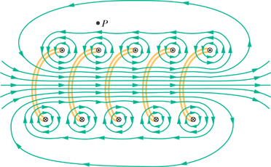
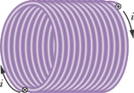
Inductance, L of a Solenoid
Inductance—like capacitance—depends only on the geometry of the device.

Slide 3
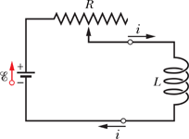
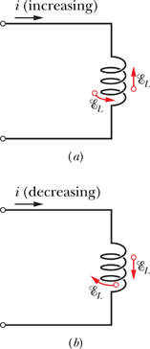
Self-Induction
If the current in a coil is changed by varying the contact position on a variable resistor, a self-induced emf will appear in the coil while the current is changing.
You can find the direction of a self-induced emf from Lenz's law. The minus sign above indicates that—as the law states—the self-induced emf has the orientation such that it opposes the change in current i. We can drop the minus sign when we want only the magnitude of .
P44. A 12 H inductor carries a current of 2.0 A. At what rate must the current be changed to produce a 60 V emf in the inductor?

Slide 4
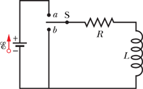
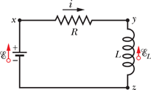
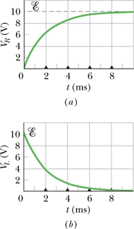
RL Circuits
Initially, an inductor acts to oppose changes in the current through it. A long time later, it acts like ordinary connecting wire.
P55. A solenoid having an inductance of 6.30 μH is connected in series with a 1.20 kΩ resistor. (a) If a 14.0 V battery is connected across the pair, how long will it take for the current through the resistor to reach 80.0% of its final value? (b) What is the current through the resistor at time ?

Slide 5
Energy Stored in a Magnetic Field
P69. A solenoid that is 85.0 cm long has a cross-sectional area of 17.0 cm². There are 950 turns of wire carrying a current of 6.60 A. (a) Calculate the energy density of the magnetic field inside the solenoid. (b) Find the total energy stored in the magnetic field there (neglect end effects).

