Slide 1
Chapter 30: Induction and Inductance
Chapter 29: A current can produce a magnetic field. How about the reverse effect?
A magnetic field can produce an electric field that can drive a current. This link between a magnetic field and the electric field it produces (induces) is now called Faraday's law of induction.
This chapter covers the following topics:
-Faraday’s law of induction -Lenz’s Law -Electric field induced by a changing magnetic field -Inductance and mutual inductance - RL circuits -Energy stored in a magnetic field

Slide 2
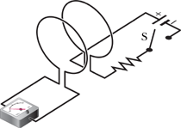
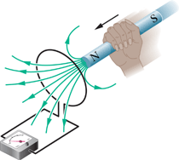
Faraday’s Experiments
FIGURE 30-2
FIGURE 30-1
An ammeter registers a current in the left-hand wire loop just as switch S is closed (to turn on the current in the right-hand wire loop) or opened (to turn of the current in the right-hand loop). No motion of the coils is involved.
An ammeter registers a current in the wire loop when the magnet is moving with respect to the loop.
An emf is induced in the loop at the left in Figs. 30-1 and 30-2 when the number of magnetic field lines that pass through the loop is changing.

Slide 3
Faraday's Law of Induction
The magnitude of the emf induced in a conducting loop is equal to the rate at which the magnetic flux through that loop changes with time.
Faraday's Law for a coil of N turns:

Slide 4
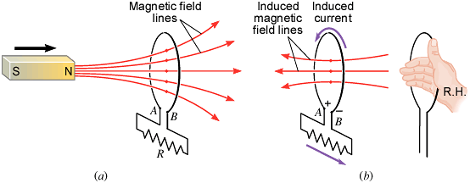
Lenz's Law
Faraday's Law:
The minus sign in the Faraday’s law of induction is due to the fact that the induced emf will always oppose the change. It is also known as the Lenz’s law and it is stated as follows:
The current from the induced emf will produce a magnetic field, which will always oppose the original change in the magnetic flux.

