Slide 1
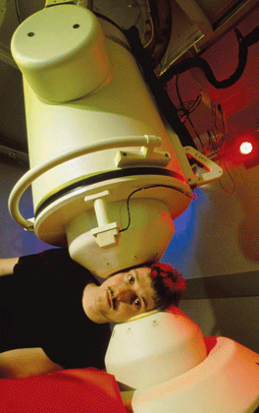
Magnetic Fields Due to Currents
When you read this sentence, a certain region of your brain is activated. When you smell a rose or feel a pencil in your grip, other regions are activated. One of the best ways to determine which regions are activated is to detect the magnetic field produced by the activation. The apparatus in the photograph can detect the magnetic field set up by a person's brain so that a map of brain activity can be correlated with what the person does. However, there are no magnetic materials in the brain.
So, how can brain activation produce a magnetic field?

Slide 2
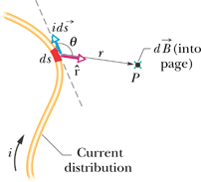
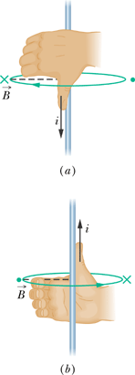
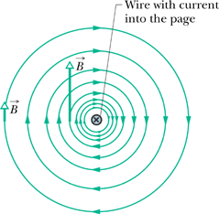
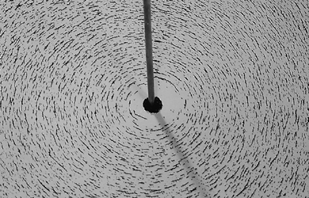
Calculating the Magnetic Field Due to a Current
Magnetic Field Due to a Current in a Long Straight Wire

Slide 3
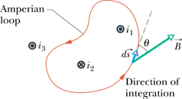
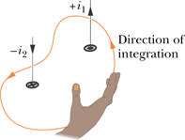
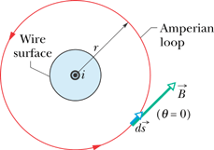
Ampere's Law
The line integral in this equation is evaluated around a closed loop called an Amperian loop. The current i is the net current encircled by the loop.
Magnetic Field Outside a Long Straight Wire with Current:

Slide 4
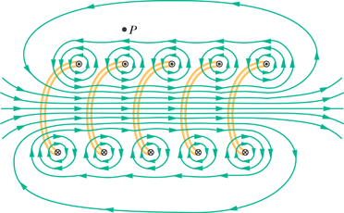
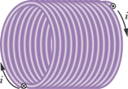
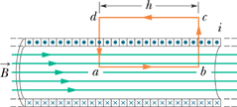
Magnetic Field of a Solenoid
n is the number of turns per unit length of the solenoid.

