Slide 1
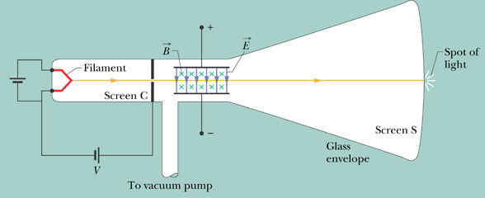
Crossed Fields: Velocity Selector

Slide 2
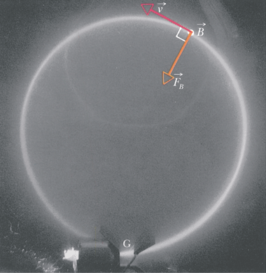
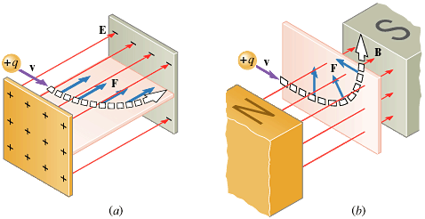
A Circulating Charged Particle

Slide 3
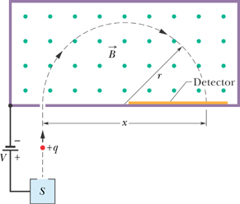
Mass Spectrometer

Slide 4
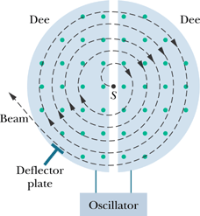
The Cyclotron
Beams of high-energy particles, such as high-energy electrons and protons, have been enormously useful in probing atoms and nuclei to reveal the fundamental structure of matter. Such beams were instrumental in the discovery that atomic nuclei consist of protons and neutrons and in the discovery that protons and neutrons consist of quarks and gluons.
The key to the operation of the cyclotron is that the frequency f at which the proton circulates in the magnetic field (and that does not depend on its speed) must be equal to the fixed frequency f_{osc} of the electrical oscillator, or

Slide 5
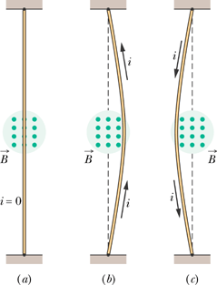
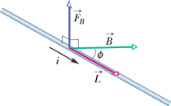
Magnetic Force on a Current-Carrying Wire
Here is a length vector that has magnitude L and is directed along the wire segment in the direction of the (conventional) current. The force magnitude F_{B} is:
where is the angle between the directions of and .

Slide 6
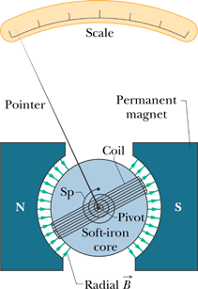
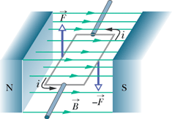
Torque on a Current Loop

