Slide 1
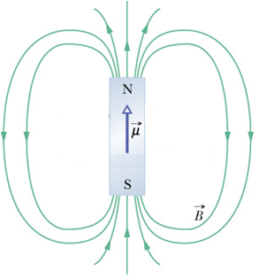
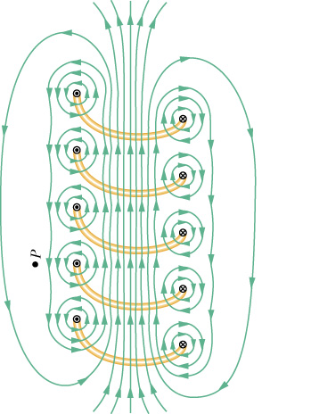
CH-28: Magnetic Fields
Q:What Produces a Magnetic Field?
Permanent magnet: Elementary particles such as electrons have an intrinsic magnetic field around them. The magnetic fields of the electrons in certain materials add together to give a net magnetic field around the material.
Electromagnet: Current in a wire .
http://www.irm.umn.edu/hg2m/hg2m_b/hg2m_b.html#magnetic%20properties
http://www.ndt-ed.org/EducationResources/CommunityCollege/MagParticle/Physics/MagneticMatls.htm

Slide 2
The Definition of Magnetic Field
Magnetic Field can be defined similar to that of electric field:
Magnetic Field, is defined in terms of the force, acting on a test particle with charge q moving through the field with velocity, :
The SI unit of the magnetic field is the tesla,T named after the Croatian-born American engineer Nikola Tesla (1856-1943).

Slide 3
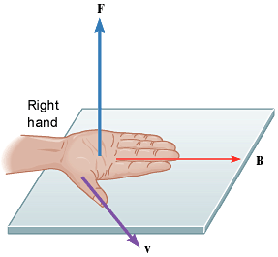
Right-Hand Rule: Finding the direction of
(a) The right-hand rule (in which is swept into through the smaller angle between them) gives the direction of as the direction of the thumb. (b) If q is positive, then the direction is in the direction of . (c) If q is negative, then the direction is opposite that of .

Slide 4
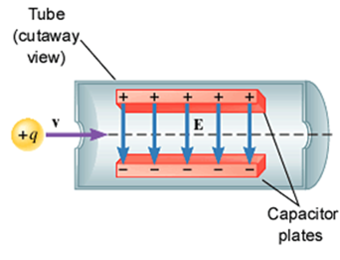
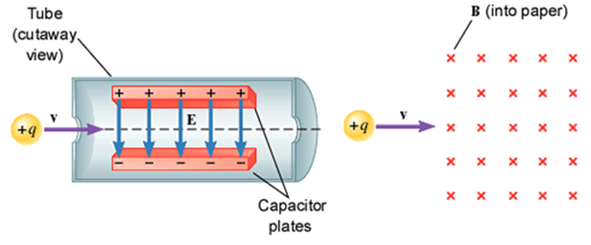
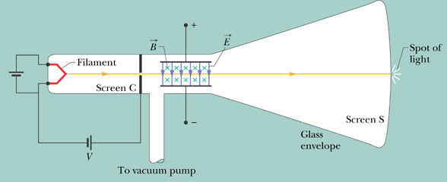
Crossed Fields: Velocity Selector

