Slide 1
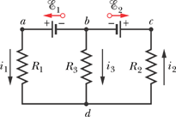
Multiloop Circuits

Slide 2
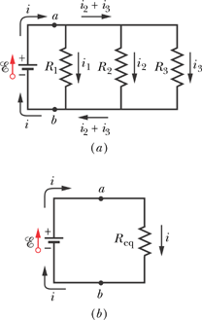
Resistances in Parallel

Slide 3
Resistors Capacitors
Series
Parallel

Slide 4
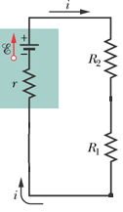
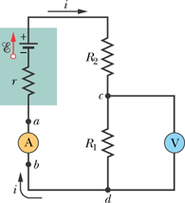
The Ammeter and the Voltmeter
How will you connect an ammeter and a voltmeter in the circuit to measure the current through and the voltage across R1?

Slide 5
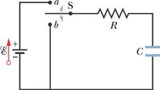
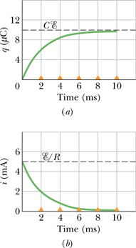
RC Circuits: Charging a Capacitor

Slide 6
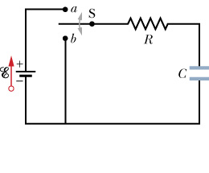
Discharging a Capacitor
i
+
-
q
q_{o}
t
O

