Slide 1
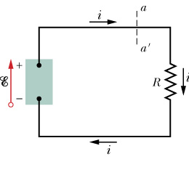
Chapter-27: Circuits
This chapter deals with DC (direct current) Circuits. We will cover the following topics:
-Electromotive force (emf) -Ideal and real emf devices -Kirchhoff’s loop rule -Kirchhoff’s junction rule -Multiloop circuits -Resistors in series -Resistors in parallel -RC circuits: charging and discharging of a capacitor
High (+) reservoir
pump
Low (-) reservoir

Slide 2
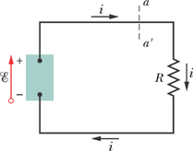
Work, Energy, and Emf
A simple electric circuit, in which a device of emf does work on the charge carriers and maintains a steady current i in a resistor of resistance R.
In any time interval dt, a charge dq passes through any cross section of this circuit, such as aa′. This same amount of charge must enter the emf device at its low-potential end and leave at its high-potential end. The device must do an amount of work dW on the charge dq to force it to move in this way. We define the emf of the emf device in terms of this work:
An ideal emf device is one that lacks any internal resistance to the internal movement of charge from terminal to terminal.
A real emf device, such as any real battery, has internal resistance to the internal movement of charge.

Slide 3
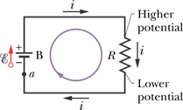
Calculating the Current in a Single-Loop Circuit
Energy Method
Potential Method
Kirchhoff’s LOOP RULE: The algebraic sum of the changes in potential encountered in a complete traversal of any loop of a circuit must be zero.
Potential Rise = Potential Drop or Potential Rise – Potential Drop = 0

Slide 4
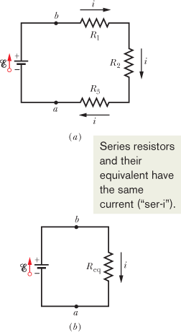
Other Single-Loop Circuits
a. Internal Resistance
b. Resistances in Series

