Slide 1
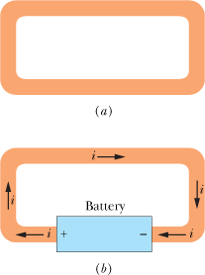
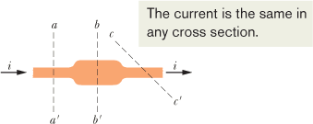
Chap-26: Current and Resistance
In the last five chapters we discussed electrostatics—the physics of stationary charges. In this and the next chapter, we discuss the physics of electric currents—that is, charges in motion. Examples of electric currents abound and involve many professions.
(a) A loop of copper in electrostatic equilibrium, the electric field is zero at all points inside the copper. (b) Adding a battery produces an electric field within the loop, from terminal to terminal, and the field causes charges to move around the loop. This movement of charges is a current i.
We can find the charge that passes through the plane in a time interval extending from 0 to t by integration:
The direction of current flow is in the opposite direction of electron flow.

Slide 2
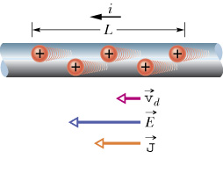
conductor
A
+ q
i
Current is a scalar. Current density is a vector.
Current Density and Drift Speed

Slide 3
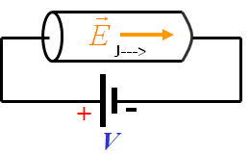
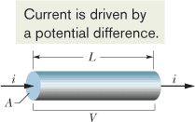
Resistance and Resistivity
We determine the resistance between any two points of a conductor by applying a potential difference V between those points and measuring the current i that results. The resistance R is then
i
-
The SI unit for resistance:
+
V
The resistivity ρ of a material is defined as:

Slide 4
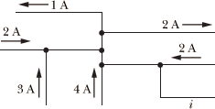
CP1: The figure here shows a portion of a circuit. What is the current i in the lower right-hand wire?
P10. The magnitude J of the current density in a certain lab wire with a circular cross section of radius R = 2.00 mm is given by J = (3.00 × 10⁸)r², with J in amperes per square meter and radial distance r in meters. a. What is the current through the wire? b. What is the current through the outer section bounded by r = 0.6R and r = R?
P17. A wire of Nichrome (a nickel–chromium–iron alloy commonly used in heating elements) is 1.0 m long and 1.0 mm² in cross-sectional area. It carries a current of 4.0 A when a 2.0 V potential difference is applied between its ends. Calculate the conductivity σ of Nichrome.
P22. Suppose a kite string of radius 2.00 mm extends directly upward by 0.800 km and is coated with a 0.500 mm layer of water having resistivity 150 Ω.m. If the potential difference between the two ends of the string is 160 MV, what is the current through the water layer? The danger is not this current but the chance that the string draws a lightning strike, which can have a current as large as 500 000 A (way beyond just being lethal).

