Slide 1
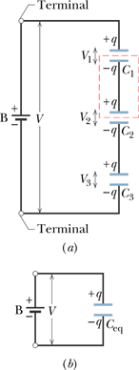
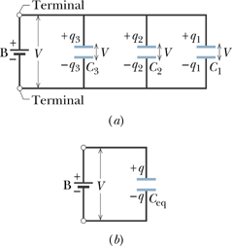
Capacitors in Parallel and in Series
When a potential difference V is applied across several capacitors connected in series, the capacitors have identical charge q. The sum of the potential differences across all the capacitors is equal to the applied potential difference V.
When a potential difference V is applied across several capacitors connected in parallel, that potential difference V is applied across each capacitor. The total charge q stored on the capacitors is the sum of the charges stored on all the capacitors.

Slide 2
Energy Stored in an Electric Field
Suppose that, at a given instant, a charge q′ has been transferred from one plate of a capacitor to the other. The potential difference V′ between the plates at that instant will be q′/C. If an extra increment of charge dq′ is then transferred, the increment of work required will be,
The work required to bring the total capacitor charge up to a final value q is
This work is stored as potential energy U in the capacitor,
The potential energy of a charged capacitor may be viewed as being stored in the electric field between its plates.

Slide 3
Energy Density
In a parallel-plate capacitor, neglecting fringing, the electric field has the same value at all points between the plates. Thus, the energy density u—that is, the potential energy per unit volume between the plates—should also be uniform. We can find u by dividing the total potential energy by the volume Ad of the space between the plates.
Although we derived this result for the special case of a parallel-plate capacitor, it holds generally, whatever may be the source of the electric field. If an electric field, E exists at any point in space, we can think of that point as a site of electric potential energy whose amount per unit volume is given by the above equation.

