Slide 1
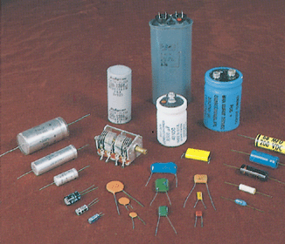
Chap-25: Capacitance
Capacitor:
Capacitor is a device in which electrical energy can be stored. Ex: Photoflash in a camera.
The physics of capacitors can be generalized to other devices and to any situation involving electric fields.
For example, Earth's atmospheric electric field is modeled by meteorologists as being produced by a huge spherical capacitor that partially discharges via lightning.
The first step in our discussion of capacitors is to determine how much charge can be stored in a capacitor. This “how much” is called capacitance.

Slide 2
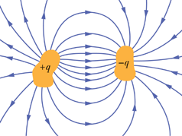
Capacitance
Two conductors, isolated electrically from each other and from their surroundings, form a capacitor. When the capacitor is charged, the charges on the conductors, or plates as they are called, builds up equally.
The charge q and the potential difference V for a capacitor are proportional to each other;
The proportionality constant C is called the capacitance of the capacitor. The SI unit of capacitance = farad = F. The farad (F) is a very large unit. The microfarad (μF) and the picofarad (pF), are more convenient units in practice.

Slide 3
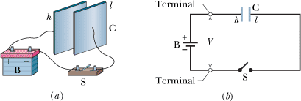
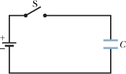
Charging a Capacitor
P2: The capacitor in Fig. 25-25 has a capacitance of 25 μF and is initially uncharged. The battery provides a potential difference of 120 V. After switch S is closed, how much charge will pass through it?

Slide 4
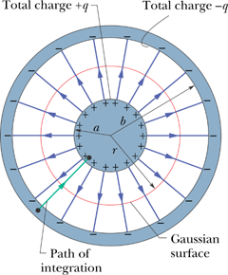
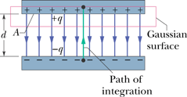
Calculating the Capacitance
Parallel-Plate Capacitor
Cylindrical Capacitor

Slide 5
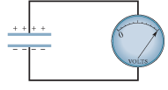
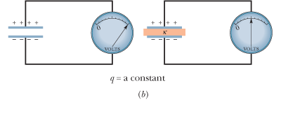
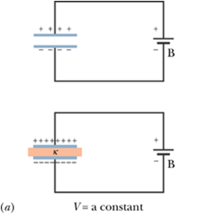
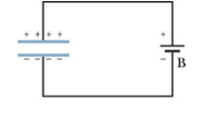
Effects of Dielectrics
Material | Dielectric Constant κ | Dielectric Strength (kV/mm)
Air (1 atm) | 1.00054 | 3
Polystyrene | 2.6 | 24
Paper | 3.5 | 16
Transformer oil | 4.5
Pyrex | 4.7 | 14
Ruby mica | 5.4
Porcelain | 6.5
Silicon | 12
Germanium | 16
Ethanol | 25
Water (20°C) | 80.4
Water (25°C) | 78.5
Titania ceramic | 130
Strontium titanate | 310 | 8
For a vacuum, κ = unity.

