Slide 1
Chap-24: Electric Potential
What is the danger in these situations?
The answer is in this chapter.

Slide 2
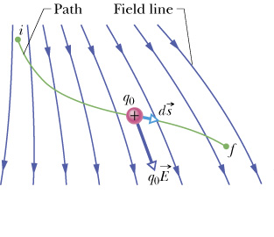
F(x)
.
.
.
x
O
x_{i}
x
x_{f}
A
B

Slide 3
A
B

Slide 4
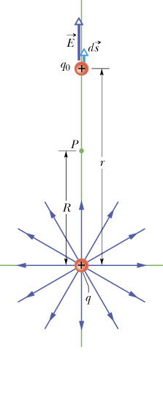
O

Slide 5
q₁
r₁
q₂
r₂
P
r₃
q₃

Slide 6
.
P
r
dq

