Slide 1
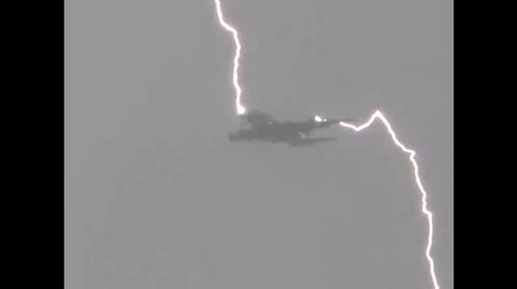
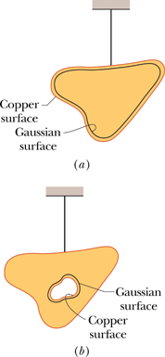
Charged Isolated Conductor
The electric field inside the conductor is zero. Why?
If this were not so, the field would exert forces on the conduction (free) electrons, which are always present in a conductor.
Gauss' law permits us to prove the following important theorem about conductors:
If an excess charge is placed on an isolated conductor, it will move entirely to the surface of the conductor. None will be found within the conductor.

Slide 2
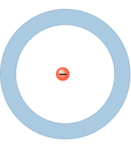
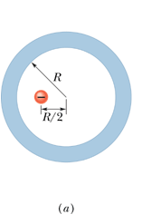
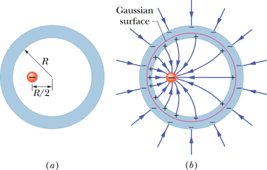
Electric field inside and outside an isolated spherical conductor

Slide 3
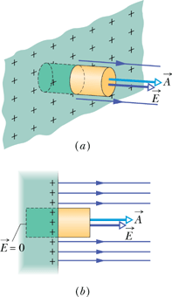
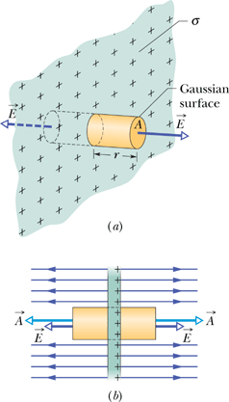
Applying Gauss' Law: Planar Symmetry
conducting surface
Non-conducting sheet

Slide 4
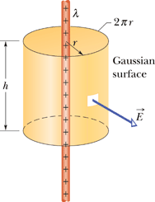
Applying Gauss' Law: Cylindrical Symmetry
P25, Page 623:
An infinite line of charge produces a field of magnitude, 4.5 x 10⁴ N/C, at a distance of 2.0 m. Calculate the linear charge density.

