Slide 1
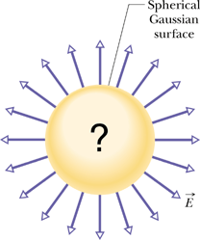
Chapter-23: Gauss' Law
.
One of the primary goals of physics is to find simple ways of solving seemingly complex problems. One of the main tools of physics in attaining this goal is the use of symmetry.
For certain charge distributions involving symmetry, we can save far more work by using a law called Gauss' law, developed by German mathematician and physicist Carl Friedrich Gauss (1777–1855).
Gauss' law relates the electric fields at points on a (closed) Gaussian surface to the net charge enclosed by that surface.

Slide 2
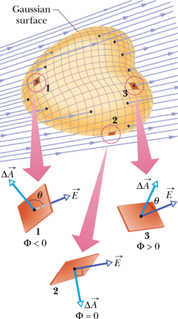
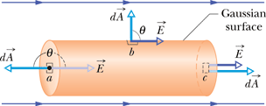
Flux of an Electric Field
The electric flux Φ through a Gaussian surface is proportional to the net number of electric field lines passing through that surface.
The loop on the integral sign indicates that the integration is to be taken over the entire (closed) surface. The flux of the electric field is a scalar, and its SI unit is N.m²/C.
Ex: Figure below shows a Gaussian surface in the form of a cylinder of radius R immersed in a uniform electric field, with the cylinder axis parallel to the field. What is the flux Φ of the electric field through this closed surface?

Slide 3
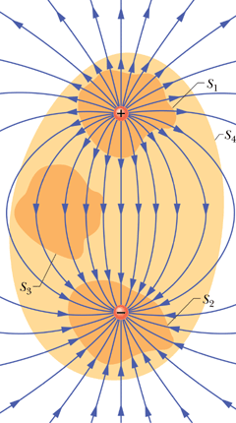
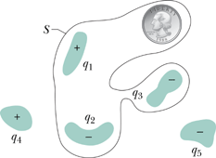
Gauss' Law
Gauss' law relates the net flux of an electric field through a closed surface (a Gaussian surface) to the net charge enclosed by that surface.
Q: What can be said about the flux of the electric field through surfaces S1, S2, S3, and S4?
A. positive B. negative C. zero
Figure to the right shows five charged lumps of plastic and an electrically neutral coin. The cross section of a Gaussian surface S is indicated. What is the net electric flux through the surface?
Electric field of a point charge using Gauss’ law.

Slide 4
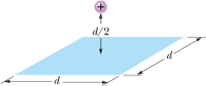
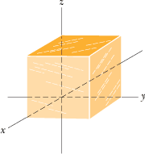
7. A point charge of 1.8 μC is at the center of a Gaussian cube 55 cm on edge. What is the net electric flux through the surface?
5. In Fig. 23-29, a proton is a distance d/2 directly above the center of a square of side d. What is the magnitude of the electric flux through the square? (Hint: Think of the square as one face of a cube with edge d.)
3. The cube in Fig. 23-27 has edge length 1.40 m and is oriented as shown in a region of uniform electric field. Find the electric flux through the front face if the electric field, in N/C, is given by: (a)
(b) What is the total flux through the cube for each field?

