Slide 1
The Electric Field Due to continuous Charges
So far we have considered the electric field produced by point charges.
We now consider charge distributions that are spread along a line, over a surface, or within a volume.
Such distributions are said to be continuous rather than discrete.
Since these distributions can include an enormous number of point charges, we find the electric fields that they produce by means of calculus.
Some Measures of Electric Charge
Name | Symbol | SI Unit
Charge | q | C
Linear charge density | λ | C/m
Surface charge density | σ | C/m²
Volume charge density | ρ | C/m³

Slide 2
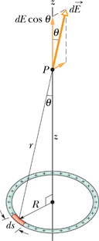
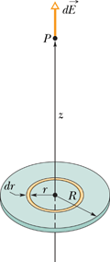
The Electric Field Due to a Line of Charge and Charged Disk

