Slide 1
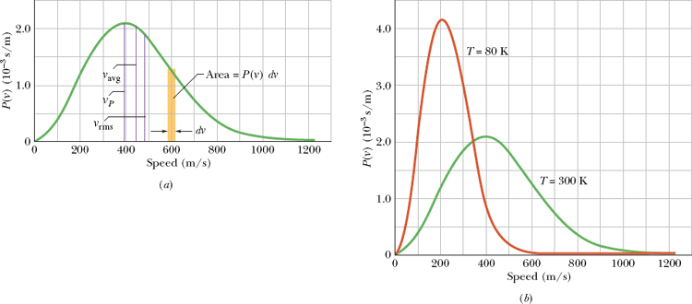
The Distribution of Molecular Speeds
Maxwell’s speed distribution law:

Slide 2
Internal Energy E_{int}
Molar Specific Heats at Constant Volume
Molecule | Example | C_{V} (J/mol · K)
Monatomic | Ideal
 | Real | He | 12.5
 |  | Ar | 12.6
Diatomic | Ideal
 | Real | N₂ | 20.7
 |  | O₂ | 20.8
Polyatomic | Ideal | 3R = 24.9
 | Real | NH₄ | 29.0
 |  | CO₂ | 29.7

Slide 3
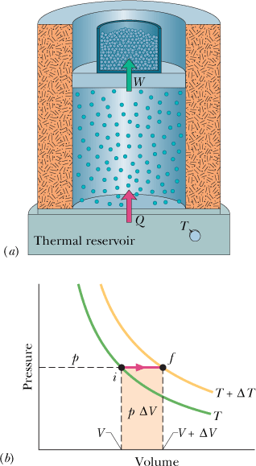
Molar Specific Heat at Constant Pressure, Cp

Slide 4
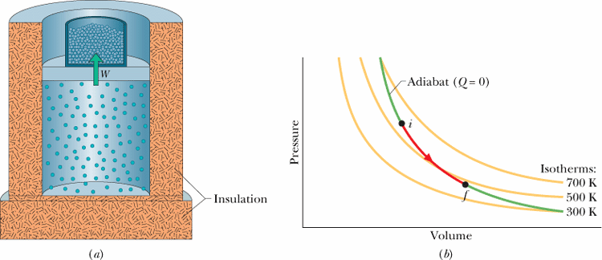
The Adiabatic Expansion of an Ideal Gas
γ = C_{p}/C_{V}

Slide 5
Proof of:

Slide 6
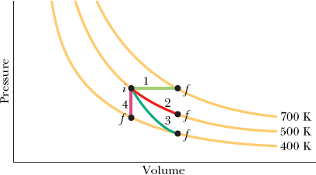
Graphical Summary of Four Gas Processes
Equations Valid for all paths:
Path | Constant Quantity | Process Type | Some Special Results

