Slide 1
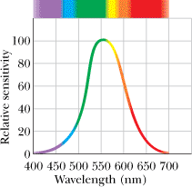
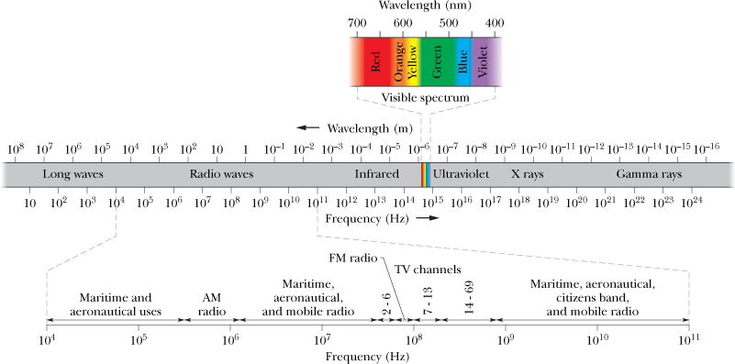
CH-33: Electromagnetic Waves
The information age in which we live is based almost entirely on the physics of electromagnetic waves. We are now globally connected by television, telephones, and the Web and constantly immersed in those signals which are electromagnetic waves.
Maxwell's Rainbow:
The relative sensitivity of the average human eye
P1: A certain helium–neon laser emits red light in a narrow band of wavelengths centered at 632.8 nm and with a “wavelength width” (such as on the scale of Fig. 33-1) of 0.0100 nm. What is the corresponding “frequency width” for the emission?

Slide 2
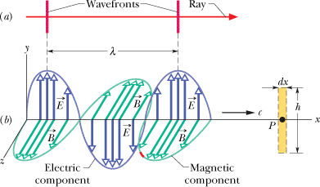
Electromagnetic Wave
The electric and magnetic fields are always perpendicular to the direction in which the wave is traveling. Thus, the wave is a transverse wave.
The electric field is always perpendicular to the magnetic field.
The cross product, always gives the direction in which the wave travels.
The fields always vary sinusoidally, just like the transverse waves, the fields vary with the same frequency and in phase (in step) with each other.

Slide 3
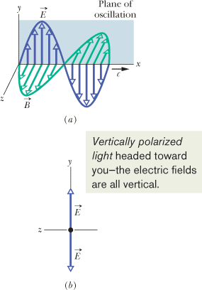
Polarization
VHF (very high frequency) television antennas in England are oriented vertically, but those in North America are horizontal. The difference is due to the direction of oscillation of the electromagnetic waves carrying the TV signal. In England, the transmitting equipment is designed to produce waves that are polarized vertically; that is, their electric field oscillates vertically. Thus, for the electric field of the incident television waves to drive a current along an antenna (and provide a signal to a television set), the antenna must be vertical. In North America, the waves are polarized horizontally.

Slide 4
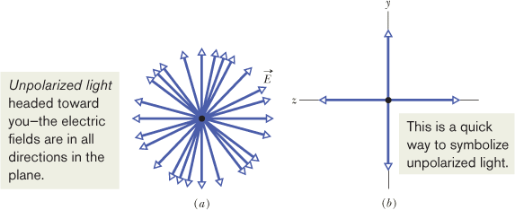
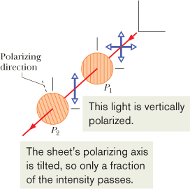
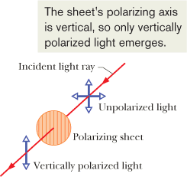
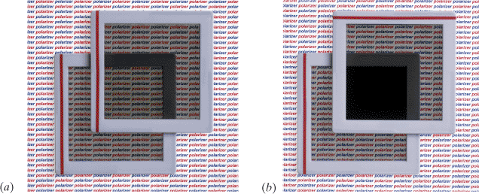
Polarized Light
The electromagnetic waves emitted by a television station all have the same polarization, but the electromagnetic waves emitted by any common source of light (such as the Sun or a bulb) are polarized randomly, or unpolarized (the two terms mean the same thing). That is, the electric field at any given point is always perpendicular to the direction of travel of the waves but changes directions randomly.

