Slide 1
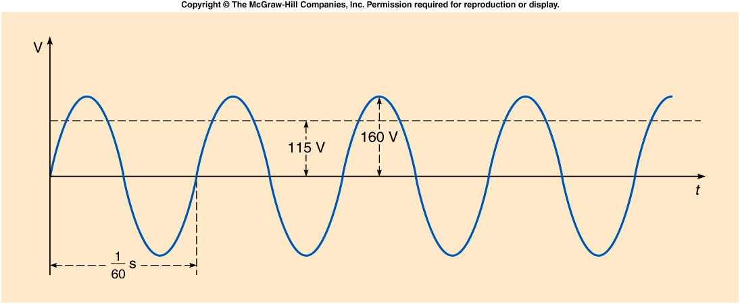
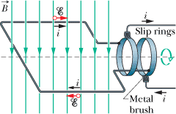
Alternating Current (ac) Voltage

Slide 2
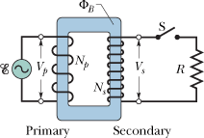
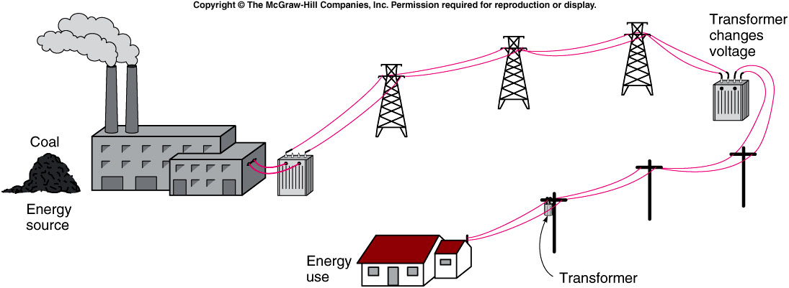
Transformers and Electricity
A transformer is a device for increasing or decreasing an ac voltage.
http://www.duke-energy.com/about-energy/generating-electricity/nuclear.asp

