Slide 1
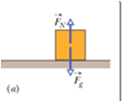
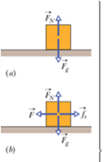
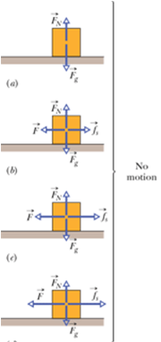
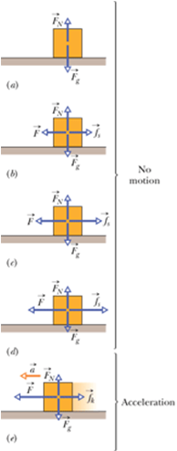
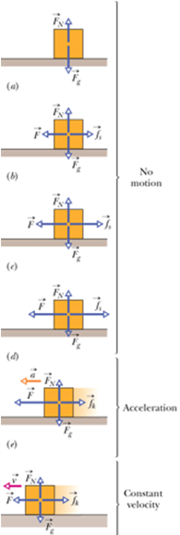
Chap-6: Friction
Frictional forces are unavoidable in our daily lives.
Pros and cons of friction.
Magnitude of the maximum static frictional force is given by:
Magnitude of the kinetic frictional force is given by:

Slide 2
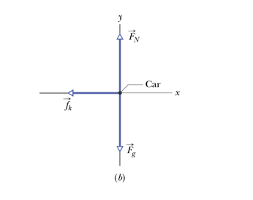
Sample Problem
If a car’s wheels are “locked” (kept from rolling) during emergency braking, the car slides along the road. Ripped-off bits of tire and small melted sections of road form the “skid marks” that reveal that cold-welding occurred during the slide. The record for the longest skid marks on a public road was reportedly set in 1960 by a Jaguar on the M1 highway in England (Fig. 6-3a)—the marks were 290 m long! Assuming that and the car’s acceleration was constant during the braking, how fast was the car going when the wheels became locked?

Slide 3
Problem 9 Page 131
A 3.5 kg block is pushed along a horizontal floor by a force of magnitude 15 N at an angle, with the horizontal. The coefficient of kinetic friction between the block and the floor is 0.25. Calculate the magnitudes of (a) the frictional force on the block from the floor and (b) the block’s acceleration.

Slide 4
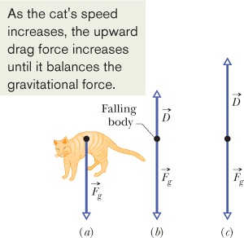
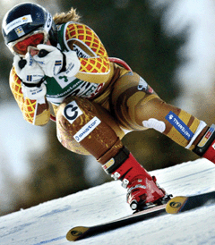
The Drag Force, D and Terminal Speed,
v_{t}
This skier crouches in an “egg position” so as to minimize her effective cross-sectional area and thus minimize the air drag acting on her.
Sky divers in a horizontal “spread eagle” maximize air drag.
P77, Page 137: What is the terminal speed of a 6.00 kg spherical ball that has a radius of 3.00 cm and a drag coefficient of 1.60? The density of the air through which the ball falls is 1.20 kg/m³.

