Slide 1
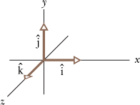
3.5 Unit Vectors
A unit vector is a vector that has a magnitude of exactly 1 and points in a particular direction.
Unit vectors in a right-handed coordinate system are shown below.

Slide 2
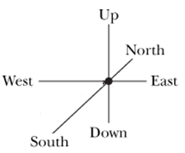
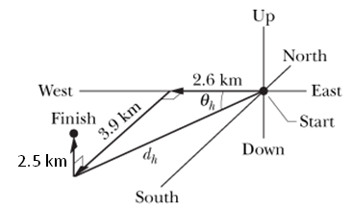
Sample Problem
A scavenger hunt team travels 2.6 km westward, 3.9 km southward, and 2.5 km upward. Express this displacement using unit vectors, as shown below?
P9, page 54.

Slide 3
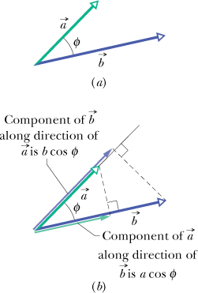
Scalar product or Dot product

Slide 4
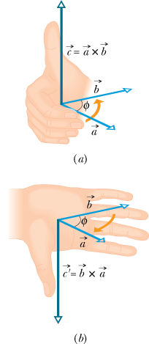
Vector Product or Cross Product

