Slide 1
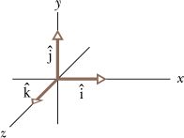
3.5 Unit Vectors
A unit vector is a vector that has a magnitude of exactly 1 and points in a particular direction.
Unit vectors in a right-handed coordinate system are shown below.

Slide 2
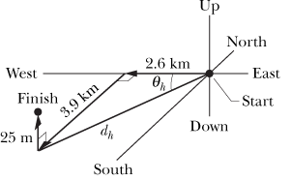
Sample Problem 3-3
For two decades, spelunking teams sought a connection between the Flint Ridge cave system and Mammoth Cave, which are in Kentucky. When the connection was finally discovered, the combined system was declared the world’s longest cave (more than 200 km long). The team that found the connection had to crawl, climb, and squirm through countless passages, traveling a net 2.6 km westward, 3.9 km southward, and 25 m upward.
Express their displacement using unit vectors?

Slide 3
3.6 Adding Vectors by Components
Problem-9:
(a) In unit-vector notation, what is the sum?
What are the (b) magnitude and (c) direction of the sum?

Slide 4
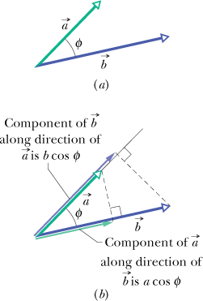
Scalar product or Dot product

Slide 5
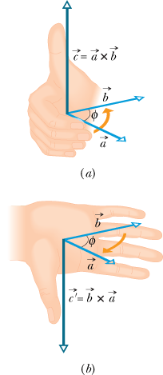
Vector Product or Cross Product

