Slide 1
Ch-2: Motion Along a Straight Line
One purpose of physics is to study the motion of objects—how fast they move, for example, and how far they move in a given amount of time.
We shall examine some general properties of motion that is restricted in three ways, in Chapter 2.
The motion is along a straight line only. The line may be vertical, horizontal, or slanted, but it must be straight.
Forces (pushes and pulls) cause motion but will not be discussed until Chapter 5.
The moving object is either a particle (by which we mean a point-like object) or an object that moves like a particle (such that every portion moves in the same direction and at the same rate).

Slide 2
Mechanics
The study of Physics begins with mechanics.
Mechanics is the branch of physics that focuses on the motion of objects and the forces that cause the motion to change.
There are two parts to mechanics: Kinematics and Dynamics.
Kinematics deals with the concepts that are needed to describe motion, without any reference to forces. Chapter 2: Motion Along a Straight Line Chapter 4: Motion in two and three dimensions
Dynamics deals with the effect that forces have on motion. Chapters 5 & 6: Force and Motion
Terms in Kinematics: Position, Displacement, Distance, Speed, Velocity, and Acceleration.

Slide 3
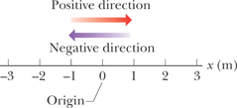
Position and Displacement
Position The position x of a particle on an x axis locates the particle with respect to the origin, of the axis. The position is either positive or negative, according to which side of the origin the particle is on, or zero if the particle is at the origin.
The displacement of a particle is the change in its position:
Checkpoint 1
Here are three pairs of initial and final positions, respectively, along an x axis. Which pairs give a negative displacement: (a) -3m,+5m; (b)-3m,-7m; (c)7m,-3m.

Slide 4
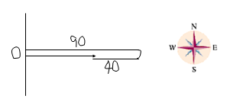
Distance and Displacement
Starting from origin (O), a person walks 90-m east, then turns around and walks 40-m west.
Q: What is the total walked distance?
A: 130-m
Q: What is the displacement?
A: 50-m, due east.
Distance is a scalar. Displacement is a vector.

Slide 5
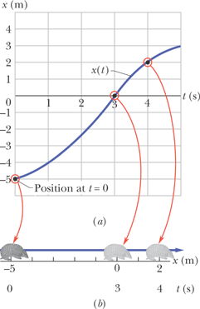
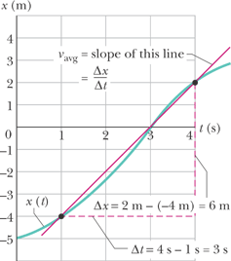
2.4 Average Speed and Average Velocity
Average speed is the total distance per time interval.
Average velocity is the displacement per time interval.
On a graph of x versus t, v_{avg} is the slope of the straight line that connects two particular points on the x(t) curve.
Try Problem 1, Chapter 2.

Slide 6
2.5 Instantaneous Velocity and Speed
Instantaneous velocity (or simply velocity) v refers to how fast a particle is moving at a given instant.
The velocity at any instant is obtained from the average velocity by shrinking the time interval, Δt closer and closer to 0. As Δt dwindles, the average velocity approaches a limiting value, which is the velocity at that instant:
Note that v is the derivative of x with respect to t. Also note that v at any instant is the slope of the position – time curve at the point of interest. Velocity is a vector quantity.
Speed is the magnitude of velocity; that is, speed has no direction. Speed is a scalar. The speedometer in a car measures speed. Units for speed & velocity: m/s, M/H, km/H.
Try Problem 14, Chapter 2.

