Slide 1
16-6 Wave Speed on a Stretched String
The speed of a wave is related to the wave's wavelength and frequency by:
v= λf
It is also depends on the properties of the medium.
If a wave is to travel through a medium such as water, air, steel, or a stretched string, it must cause the particles of that medium to oscillate as it passes, which requires both mass (for kinetic energy) and elasticity (for potential energy). Thus, the mass and elasticity determine how fast the wave can travel.
Speed of sound in a medium with bulk modulus B and densityρ:

Slide 2
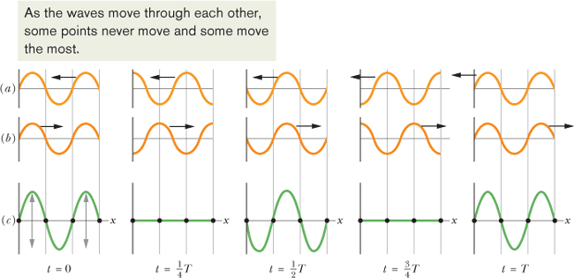
16-12 Standing Waves
If two sinusoidal waves of the same amplitude and wavelength travel in opposite directions along a stretched string, their interference with each other produces a standing wave.
Two waves on the Same String

Slide 3
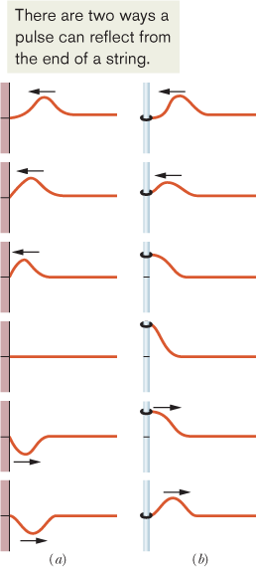
Reflections at a Boundary
Reflection from a fixed end: 180⁰ phase change.
Reflection from a free end: No phase change.
Constructive and Destructive Interference.

Slide 4
16-13 Standing Waves and Resonance
Consider a string, tied to a vibrating plate and stretched.
When the wave reaches the right end, it reflects and begins to travel back to the left.
That left-going wave then overlaps the wave that is still traveling to the right.
These overlapping traveling waves, interfere with one another.
For certain frequencies, the interference produces a standing wave pattern (or oscillation mode) with nodes and large antinodes like those below.
Such a standing wave is said to be produced at resonance, and the string is said to resonate at these certain frequencies, called resonant frequencies.

Slide 5
Problem 58
In Fig. 16-41, a string, tied to a sinusoidal oscillator at P and running over a support at Q, is stretched by a block of mass m. Separation L = 1.20 m, linear density μ = 1.6 g/m, and the oscillator frequency f = 120 Hz. The amplitude of the motion at P is small enough for that point to be considered a node. A node also exists at Q. (a) What mass m allows the oscillator to set up the fourth harmonic on the string? (b) What standing wave mode, if any, can be set up if m = 1.00 kg?

